Slide 1

Hashing and Sketching
Alex Szalay, JHU

Slide 2
Variants of Hashing
Rolling Hashing (Robin-Karp)
  We have a text string S and pattern string P
  We want to determine whether or not P is found in S,
  i.e. P is a substring of S.
P has length L, S has length n>>L
  Hash P to get h(P) O(L)
  Iterate through all length L substrings of S, hashing those substrings and comparing to h(P) O(n.L)
  If a substring hash value does match h(P), do a string comparison on that substring and P, stopping if they do match and continuing if they do not. O(L)
Total cost is O(n.L)

Slide 3
Substring Finder
Take the sequences
The substrings of S will be
Take the following hash function:
We can write this also as
The cost of updating the hash is O(1), so the total cost is O(n)

Slide 4
Common Substring
Two long strings of length n, S and T, share a common substring of length L
Algorithm
  Hash the first length L substring of S O(L)
  Use the rolling hash method to calculate the subsequent O(n) substrings in S, adding each substring into a hash table O(n)
  Hash the first length L substring of T O(L)
  Use the rolling hash method to calculate the hash values subsequent O(n) substrings in T. For each substring, check the hash table to see if there are any collisions with substrings from S. O(n)
  If a substring of T does collide with a substring of S, do a string comparison on those substrings, stopping if they do match and continuing if they do not. O(L)
Total cost is O(n)

Slide 5
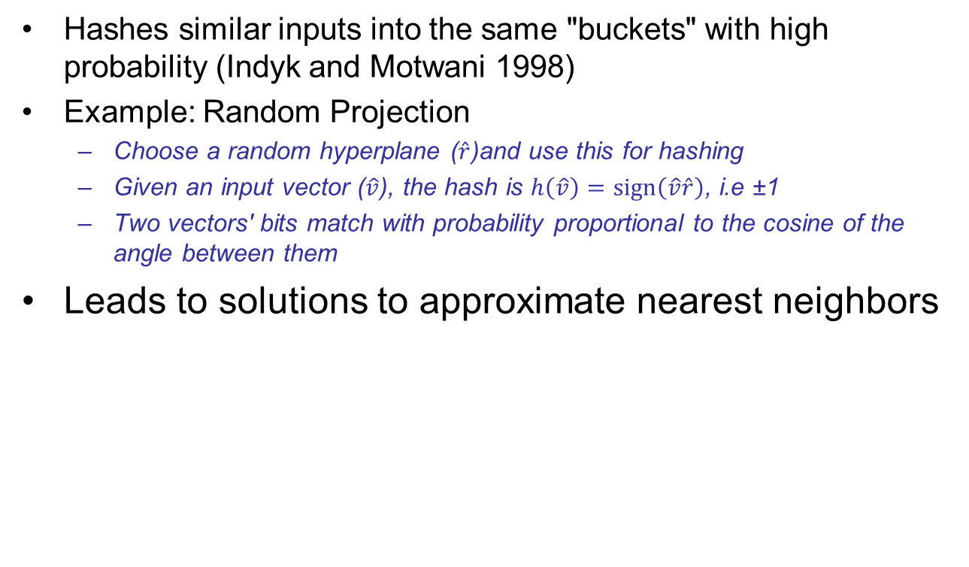
Locality Sensitive Hash
Hashes similar inputs into the same "buckets" with high probability (Indyk and Motwani 1998)
Example: Random Projection
  Choose a random hyperplane ($\hat{r}$)and use this for hashing
  Given an input vector ($\hat{v}$), the hash is $h\left(\hat{v}\right)=\text{sign}\left(\hat{v}\hat{r}\right)$, i.e ±1
  Two vectors' bits match with probability proportional to the cosine of the angle between them
Leads to solutions to approximate nearest neighbors

Slide 6
Bloom Filter
Problem: We have a large collection of items, say a dictionary
How can we determine (quickly!) whether a new word is already contained in the collection
False positives are allowed
False negatives are not
  “definitely not in the collection” : quick rejection
Simplest solution:
  Presort the collection, and build an index tree
  We can decide in logN steps
  Gives a definitive answer
Can we do better?
  Tradeoff: false positives for speed

Slide 7
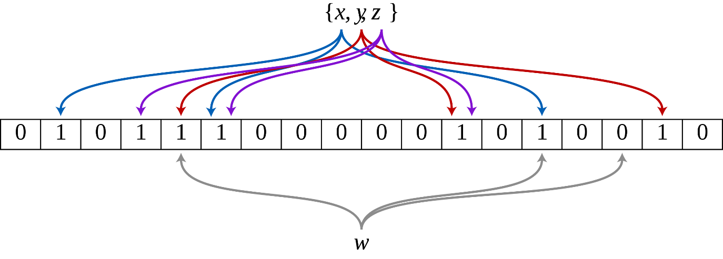
Creating a Bloom Filter
An empty Bloom filter is a bit array of m bits, all set to 0
We have k different hash functions, each mapping to one of the m array positions
To add an element, feed it to each of the k hash functions to get k array positions. Set the bits at all these positions to 1.

Slide 8
Querying a Bloom FIlter
To query for an element (test whether it is in the set), feed it to each of the k hash functions to get k array positions
If any of the bits at these positions is 0, the element is definitely not in the set
If all are 1, then either the element is in the set, or the bits have by chance been set to 1 during the insertion of other elements (=> false positive)

Slide 9
Simplest Version k=1
If k = 1, only a small fraction of bits should be set
  the array must be very large and contain long runs of zeros.
  =>The information content of the array relative to its size is low
The generalized Bloom filter (k greater than 1) allows many more bits to be set while still maintaining a low false positive rate
If the parameters (k and m) are chosen well, about half of the bits will be set, and these will be apparently random, minimizing redundancy and maximizing information content.

Slide 10
Optimal Design
We have k hash functions, m bit Bloom filter
and n dictionary items
The probability of false positives is
The optimal number of hash functions is
For a false positive rate ε

Slide 11

Set Operations of BFs
The union of two Bloom filters
A wonderful example of a randomized data structure
with unique properties, like space efficiency
$$B\left(A\right)∪B\left(C\right)≡B\left(A∪C\right)$$

Slide 12
Sketching
A sketch of a large data set is a small data structure that lets you calculate or approximate certain characteristics of the original data.
The exact nature of the sketch depends on what you are trying to approximate and may depend on the nature of the data as well.
E.g. random sample of 1000 values
  The median of the sample is likely to be roughly the same as the median of the data.
  The mean of the sample will approximate the mean of the data
  The distribution of the sample will be approximately the same as the distribution of the data

Slide 13
Counting Bloom Filters
Also called “Summary Sketch”
Start with a k=4 Bloom filter
For each bit position also add
a counter
When you insert a new item, increment the count
Typically sized to the number of elements in the set

Slide 14
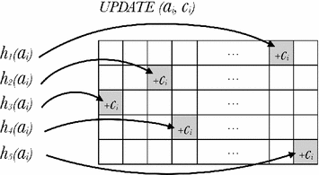
Count-Min Sketch
Set up a Bloom table with m counters and k rows
Eeach row has its own hash function
Upon adding a new item increment
the count in each cell marked
Due to hash collisions we do not
get the same number of hits in each
cell corresponding to a pattern
The min of the counts is a good estimator of the approximate count
You can store the dat form several billion objects in
a small sketch table

Slide 15

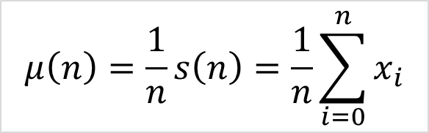
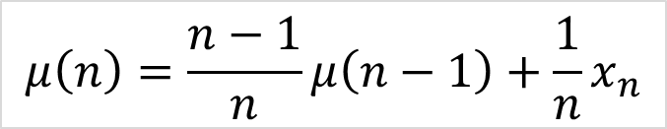
Streaming Algorithms
The input is presented as a sequence of items and can be examined in only a few passes (once)
The performance of an algorithm that operates on data streams is measured by three basic factors:
  The number of passes the algorithm must make over the stream
  The available memory
  The running time of the algorithm
Streaming mean
$$μ\left(n\right)=\frac{1}{n}s\left(n\right)=\frac{1}{n}\sum_{i=0}^{n}{x_{i}}$$
$$s\left(n\right)=s\left(n−1\right)+x_{n}$$
$$μ\left(n\right)=\frac{n−1}{n}μ\left(n−1\right)+\frac{1}{n}x_{n}$$

Slide 16
A Practical Application
Cluster finding with Big Data in astronomy
Project with Zaoxing Liu, Nikita Ivkin, Lin F. Yang, Mark Neyrinck, Gerard Lemson, Vladimir Braverman, Tamas Budavari, Randal Burns, Xin Wang
Combines sketching with streaming algorithms

Slide 17
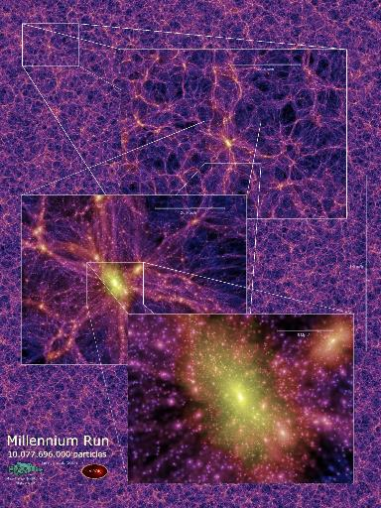
Cosmological Simulations
Simulation:
  is a gravitational evolution of the system of particles
  provides distribution of particles in space and time
  helps to understand the processes of forming galaxies

Slide 18
Cosmological Simulations
What we observe in reality:
  macro-structures, such as galaxies and patterns of galaxies
What can we measure and compare:
  macro structures from simulation and reality
  macro structures from different simulations
Extraction of macro structures is crucial to connect theory to observation.

Slide 19
Halo
In terms of Physics:
  Galaxies are thought to form in halos
Defining property:
  Macro structure with high mass concentration
There is no agreed-upon formal definition of a halo.

Slide 20
Halo
There is no agreed-upon formal definition of a halo.
We can not introduce absolute measure how good is certain halo finder
We can introduce measure to compare outputs of different halo finders

Slide 21
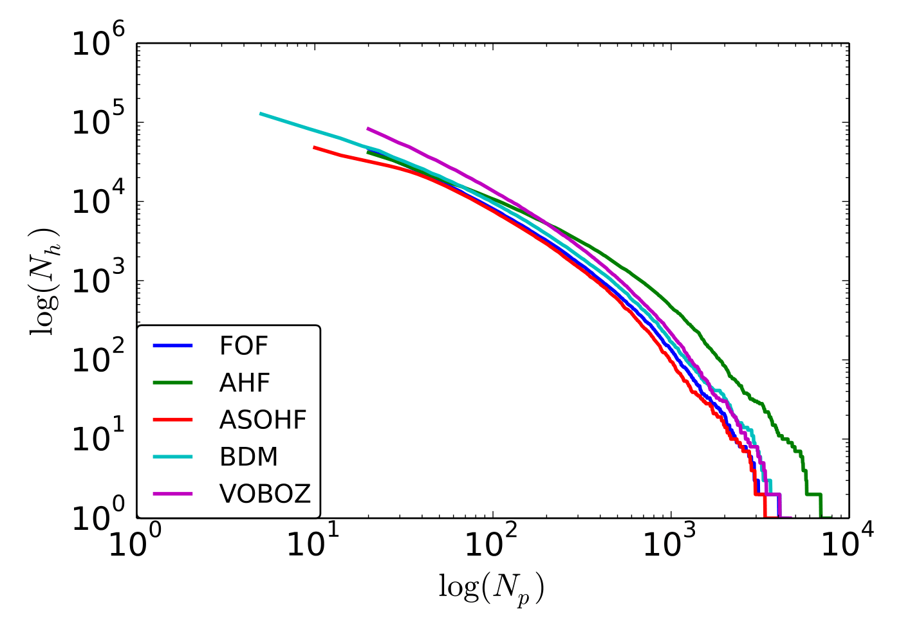

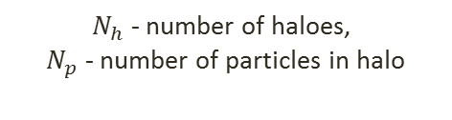
Halo
Some facts about data:
  Total number of particles: $\sim {10}^{12}$
  Number of Haloes: ${ \sim 10}^{9}$
  Particles not associated with haloes: $\sim$ 80-90%
  Particles not associated with large haloes: $\sim$ 99.9%
Distribution of halos sizes
$N_{h}$ - number of haloes,
$N_{p}$ - number of particles in halo

Slide 22
Halo finding algorithms
2001 SKID Stadel
2001 enhanced BDM Bullock et al.
2001 SUBFIND Springel
2004 MHF Gill, Knebe & Gibson
2004 AdaptaHOP Aubert, Pichon & Colombi
2005 improved DENMAX Weller et al.
2005 VOBOZ Neyrinck et al.
2006 PSB Kim & Park
2006 6DFOF Diemand et al.
2007 subhalo finder Shaw et al.
2007 Ntropy-fofsv Gardner, Connolly & McBride
2009 HSF Maciejewski et al.
2009 LANL finder Habib et al.
2009 AHF Knollmann & Knebe
2010 pHOP Skory et al.
2010 ASOHF Planelles & Quilis
2010 pSO Sutter & Ricker
2010 pFOF Rasera et al.
2010 ORIGAMI Falck et al.
2010 HOT Ascasibar
2010 Rockstar Behroozi
1992 DENMAX Gelb & Bertschinger
1995 Adaptive FOF van Kampen et al.
1996 IsoDen Pfitzner & Salmon
1997 BDM Klypin & Holtzman
1998 HOP Eisenstein &Hut
1999 hierarchical FOF Gottloeberg et al.
1974 SO Press & Schechter
1985 FOF Davis et al.
The Halo-Finder Comparison Project
[Knebe et al, 2011]
Notes:
Three pictures here (before FOF, threshold, and final clusters)

Slide 23
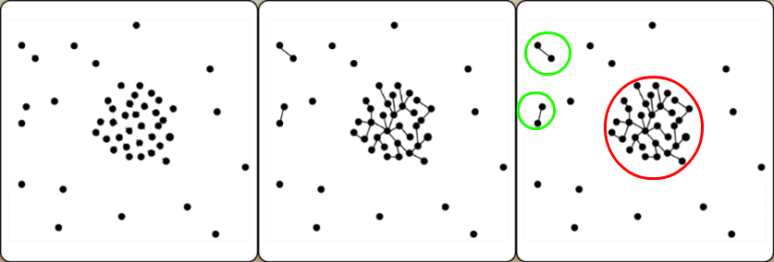

Friends-of-Friends Algorithm
One of the very first algorithms to detect Halos [Davis et al, 1985]
Simple conceptually, is the first step in many other algorithms
Has a single free parameter called the linking length $θ$.
  Two particles are “friends” if the distance between them less than $θ$.
  Two particles are in the same cluster if there exists a chain of friendships between them.
Notes:
Three pictures here (before FOF, threshold, and final clusters)

Slide 24
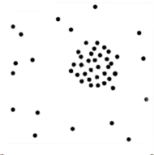
AHF
AMIGA’s Halo Finder [Knollmann&Knebe, 2009]:
  Estimate densities in the regular grid
  Find overdense cells according to given threshold
  Build subgrid in each cell with high density, and iterate
High density
Low density

Slide 25
VOBOZ
VOronoi BOund Zones [Neyrinck et al, 2004]:
  Create Voronoi Tessellation
  Measure the density at each particle, based on size of Voronoi cell
  Group particles around density maxima;

Slide 26
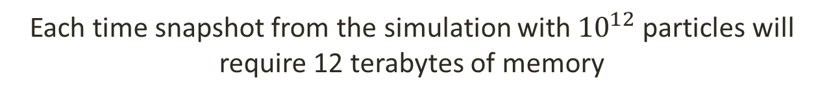
Memory issue
All current halo finders requires to load all the data into memory
Each time snapshot from the simulation with ${10}^{12}$ particles will require 12 terabytes of memory
To build a scalable solution we need to develop
an algorithm with sublinear memory usage

Slide 27
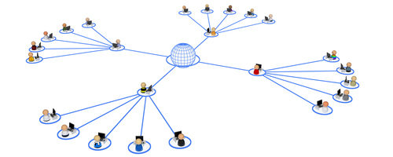


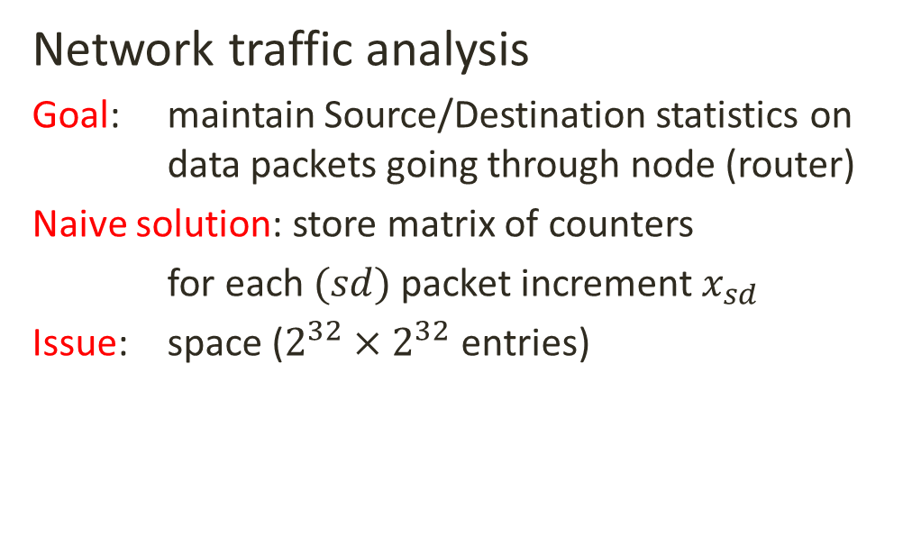
Streaming algorithms:
Motivational Example
Network traffic analysis
Goal: maintain Source/Destination statistics on data packets going through node (router)
Naive solution: store matrix of counters
for each $(sd)$ packet increment $x_{sd}$
Issue: space ($2^{32}×2^{32}$ entries)
Destination
destination
$$x_{sd}$$
router
Source
source

Slide 28
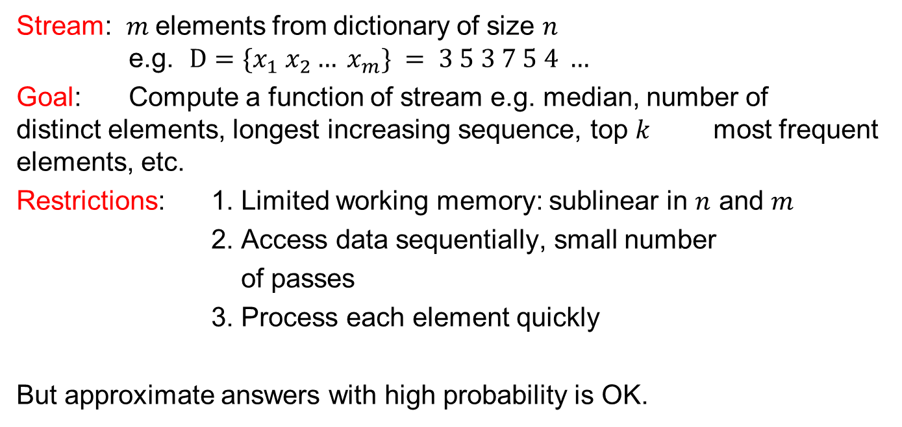
Streaming model
Stream: $m$elements from dictionary of size $n$ e.g. $D={\{x}_{1} x_{2}… x_{m}\} = 3 5 3 7 5 4 …$
Goal: Compute a function of stream e.g. median, number of distinct elements, longest increasing sequence, top $k$ most frequent elements, etc.
Restrictions: 1. Limited working memory: sublinear in $n$ and $m$
2. Access data sequentially, small number
of passes
3. Process each element quickly
But approximate answers with high probability is OK.

Slide 29



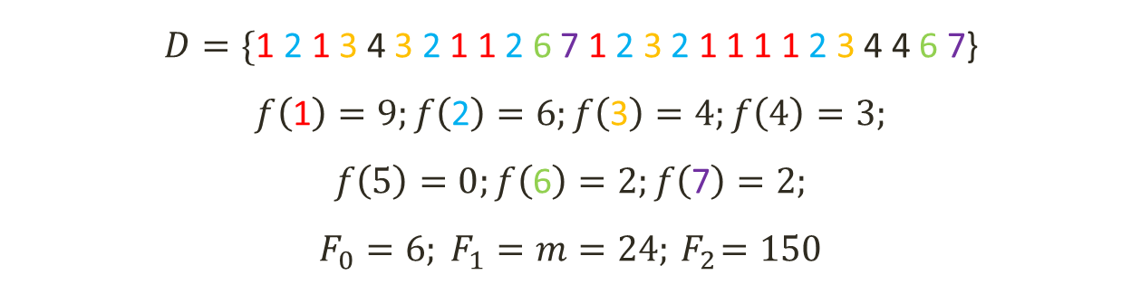



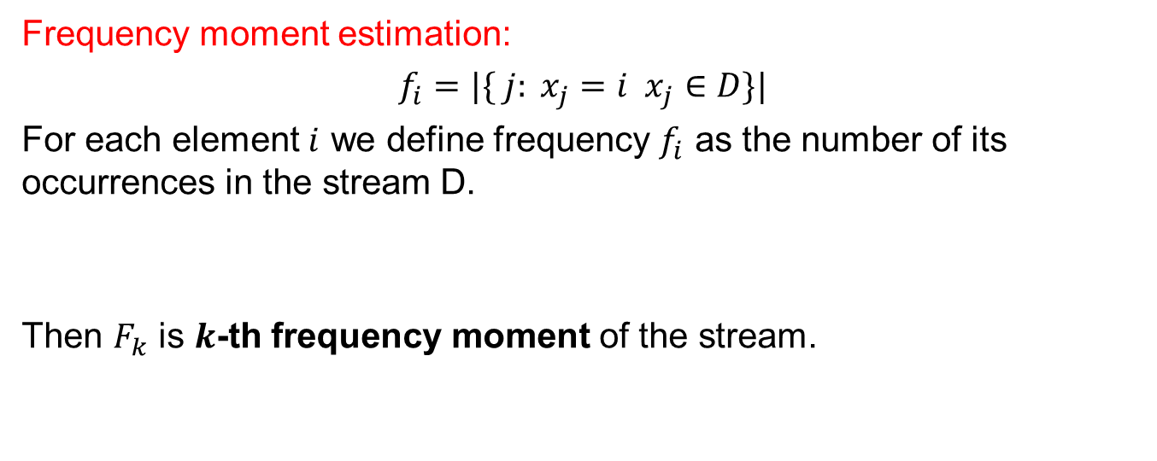







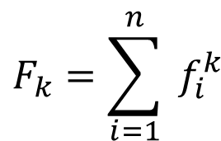


Streaming problems
Frequency moment estimation:
$f_{i}=|\{ j: x_{j}=i x_{j}∈D\}|$
For each element $i$ we define frequency $f_{i}$ as the number of its occurrences in the stream D.
Then $F_{k}$ is $k$-th frequency moment of the stream.
$$F_{k}=\sum_{i=1}^{n}{ f_{i}^{k}}$$
$$f_{i}:$$
$$9$$
$$6$$
$$4$$
$$3$$
$$2$$
$$2$$
$F_{2}$ =
$$9^{2}$$
+
+
+
+
= $150$
+
$$6^{2}$$
$$4^{2}$$
$$3^{2}$$
$$2^{2}$$
$$2^{2}$$
$$D=\text{\{}\text{1} \text{2} \text{1} \text{3}\text{ 4 }\text{3} \text{2} \text{1 1} \text{2} \text{6} \text{7} \text{1} \text{2} \text{3} \text{2} \text{1 1 1 1}\text{ 2 }\text{3}\text{ 4 }\text{4} \text{6} \text{7}\text{\}}$$
$$f\left(\text{1}\right)=9;f\left(\text{2}\right)=6;f\left(\text{3}\right)=4;f\left(4\right)=3;$$
$$f\left(5\right)=0;f\left(\text{6}\right)=2;f\left(\text{7}\right)=2;$$
$$F_{0}=6; F_{1}=m=24;{ F}_{2}=150$$

Slide 30
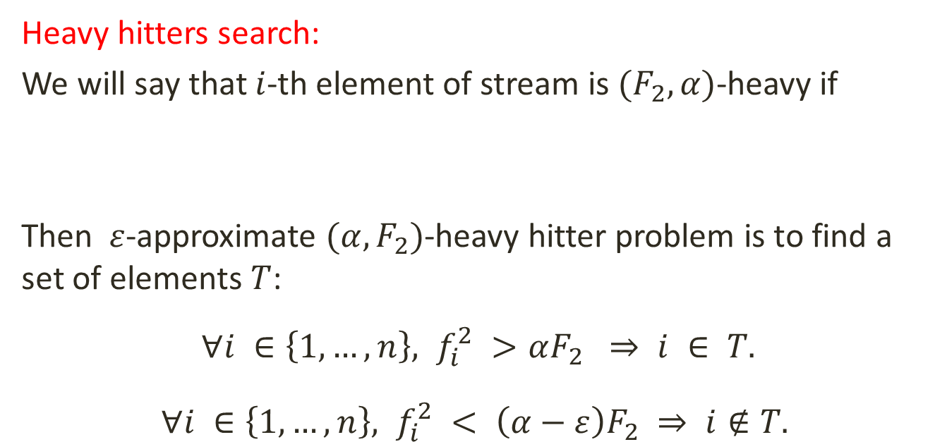

Streaming problems
Heavy hitters search:
We will say that $i$-th element of stream is $(F_{2}, α)$-heavy if
Then $ε$-approximate $(α, F_{2})$-heavy hitter problem is to find a set of elements $T$:
$∀i ∈\left\{1,…,n\right\}, f_{i}^{2} >αF_{2} ⇒ i ∈ T.$
$∀i ∈\left\{1,…,n\right\}, f_{i}^{2} < \left(α−ε\right)F_{2} ⇒ i∉T.$
$$f_{i}^{2}≥αF_{2}$$

Slide 31
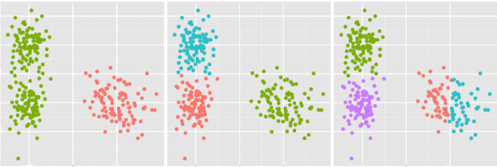
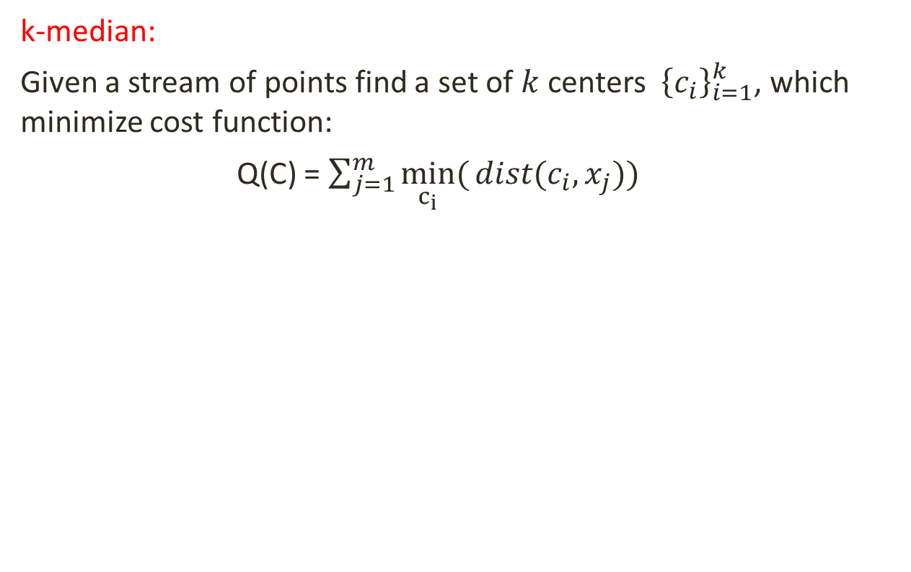



Streaming problems
k-median:
Given a stream of points find a set of $k$ centers ${ \left\{c_{i}\right\}}_{i=1}^{k}$, which minimize cost function:
Q(C) = $\sum_{j=1}^{m}{\min_{c_{i}}({dist(c_{i},x_{j}))}}$
$$k = 2$$
$$k =3$$
$$k =4$$

Slide 32
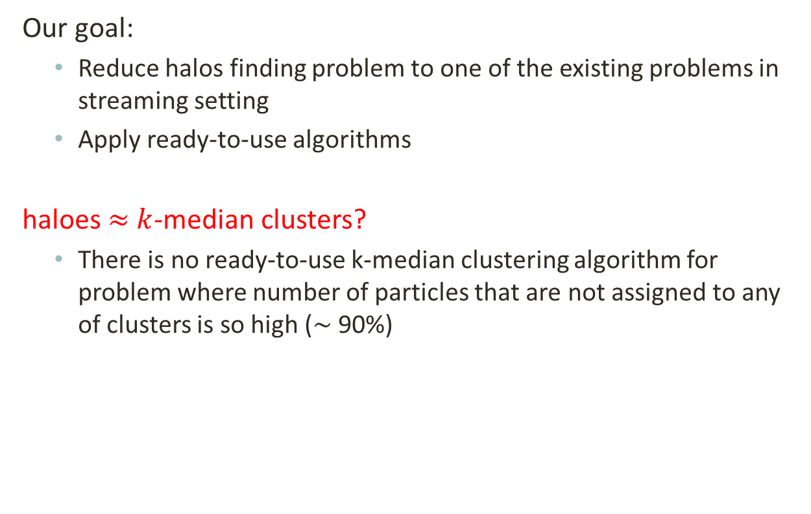
Streaming Solution:
Our goal:
  Reduce halos finding problem to one of the existing problems in streaming setting
  Apply ready-to-use algorithms
haloes $≈$ $k$-median clusters?
  There is no ready-to-use k-median clustering algorithm for problem where number of particles that are not assigned to any of clusters is so high ($\sim$ 90%)

Slide 33
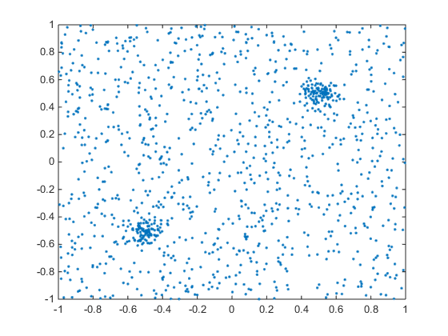
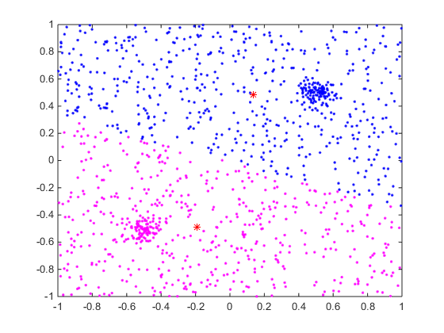
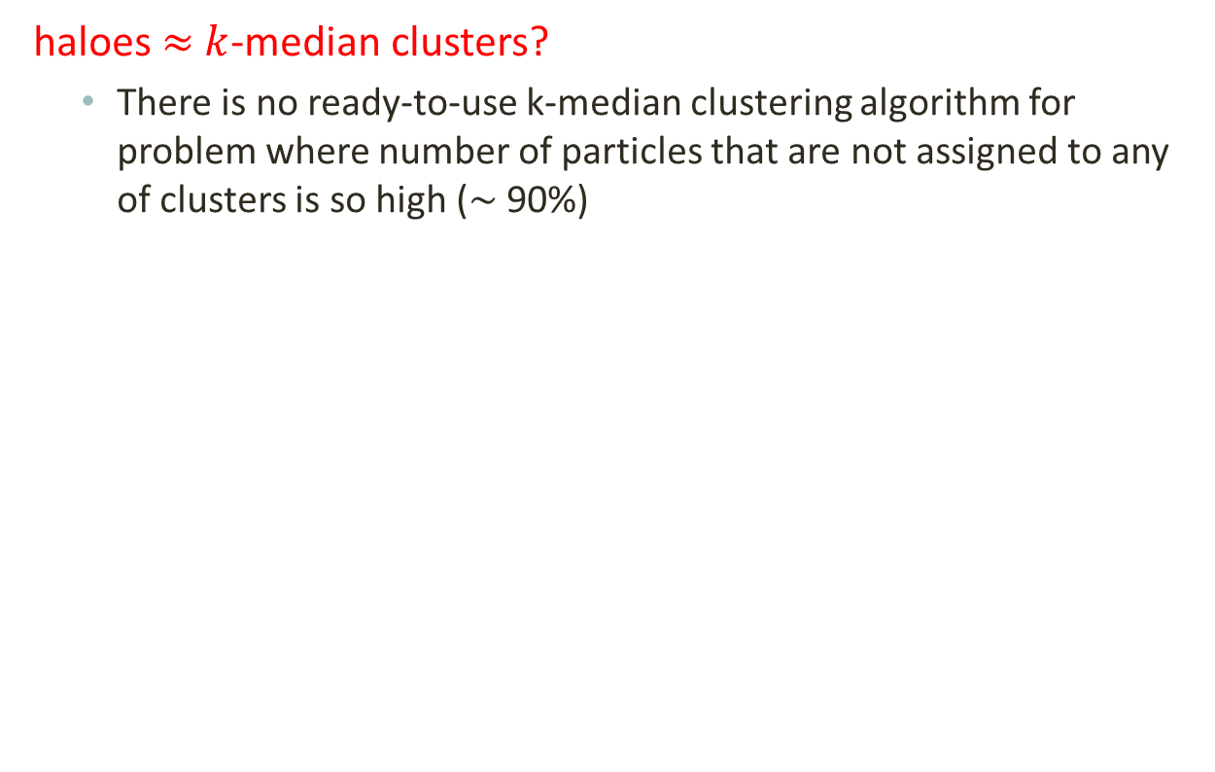
Streaming Solution:
haloes $≈$ $k$-median clusters?
  There is no ready-to-use k-median clustering algorithm for problem where number of particles that are not assigned to any of clusters is so high ($\sim$ 90%)

Slide 34
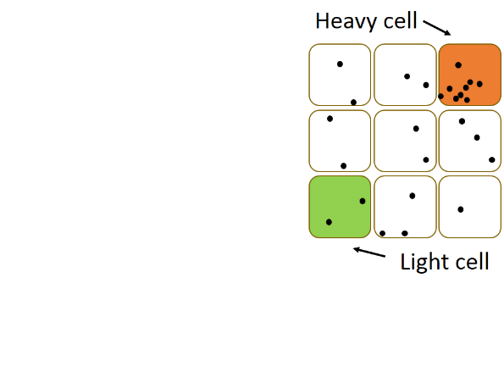

Streaming Solution:
Our goal:
  Reduce halos finding problem to one of the existing problems in streaming setting
  Apply ready-to-use algorithms
haloes $≈$ heavy hitters?
  To make a reduction to heavy hitters we
  need to discretize the space.
  Naïve solution is to use 3D mesh:
    Each particle now replaced by cell id
    Heavy cells represent mass concentration
    Grid size is chosen according to typical halo size

Slide 35
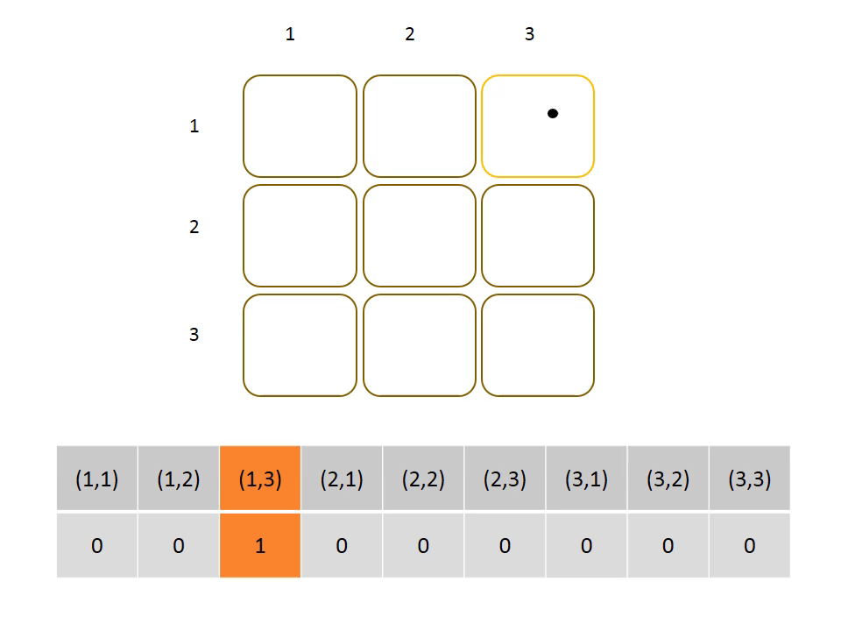
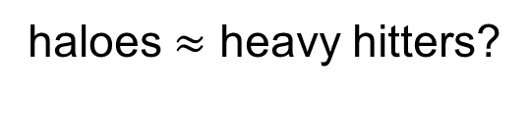
Streaming Solution
haloes $≈$ heavy hitters?

Slide 36
Heavy Hitter Streaming Algorithms
  Count-Sketch Algorithm:
    Maintain a sketch of the data stream to approximate the heavy hitters.
  Pick-and-drop Algorithm:
    Sample a bunch of particles from the stream to approximate the heavy hitters.

Slide 37
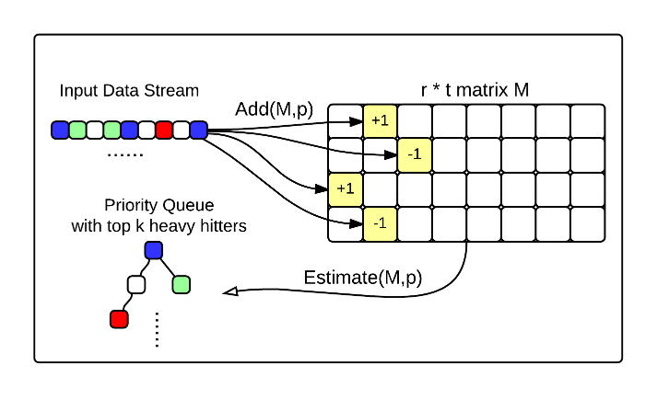
Count Sketch

Slide 38
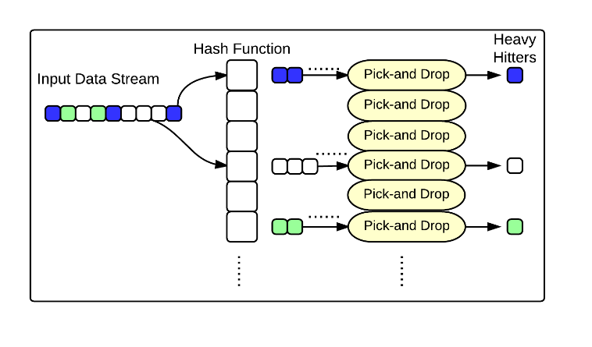
Pick and Drop

Slide 39
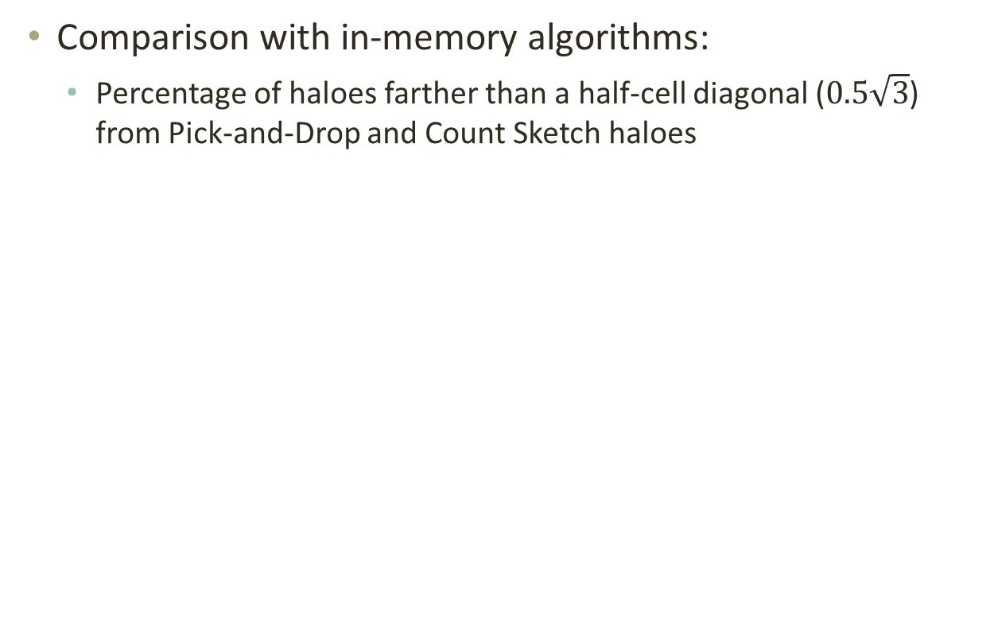
Evaluation
Comparison with in-memory algorithms:
  Percentage of haloes farther than a half-cell diagonal ($0.5\sqrt{3}$) from Pick-and-Drop and Count Sketch haloes

Slide 40
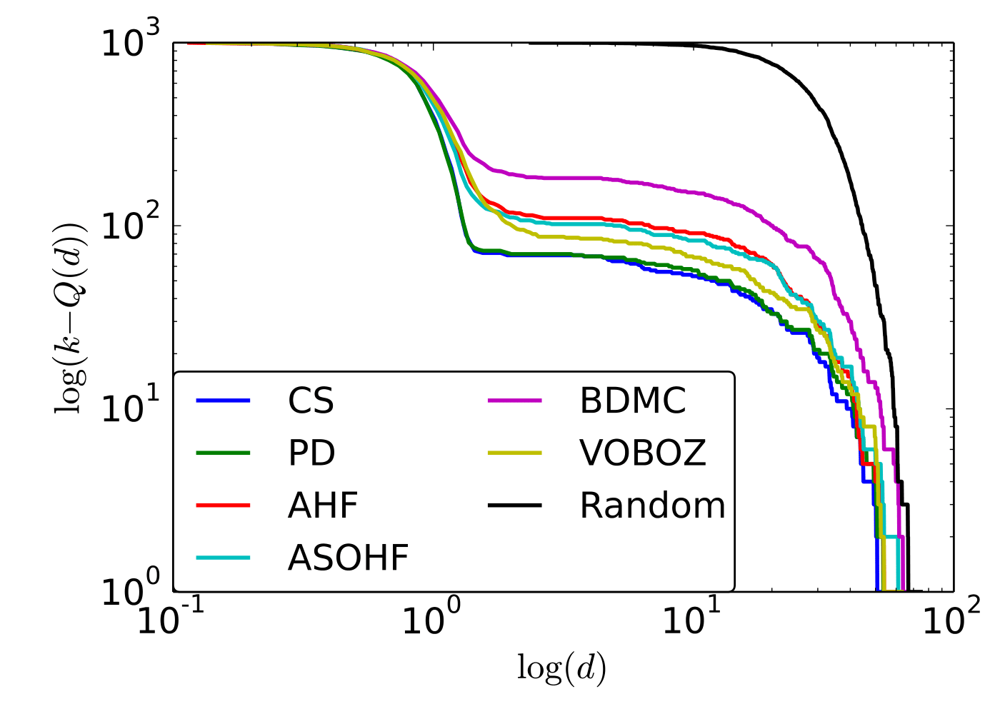
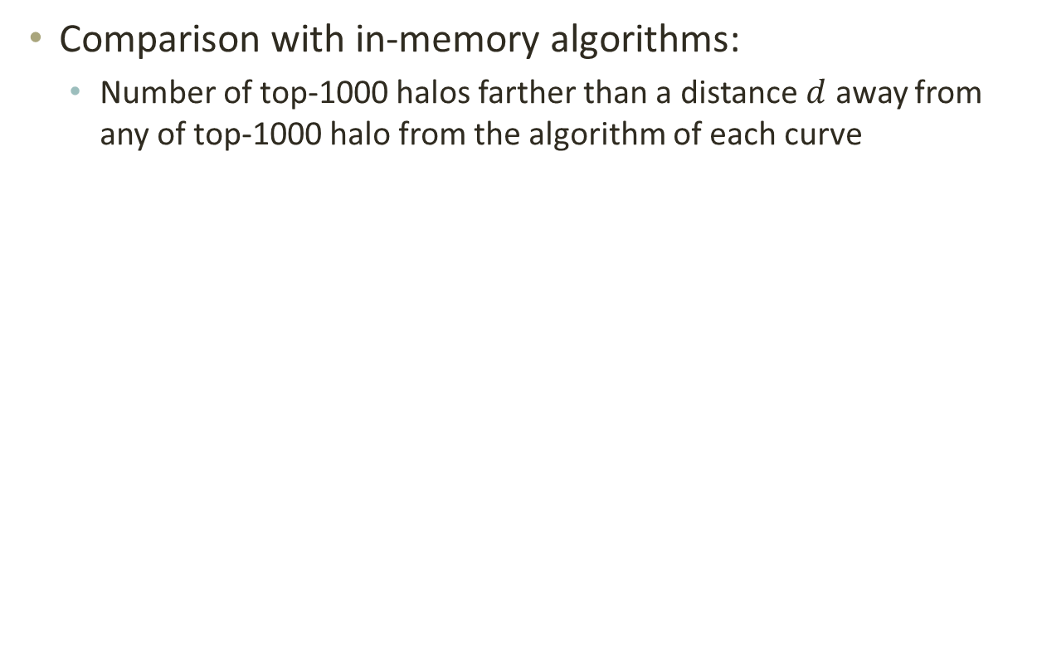
Evaluation
Comparison with in-memory algorithms:
  Number of top-1000 halos farther than a distance $d$ away from any of top-1000 halo from the algorithm of each curve

Slide 41
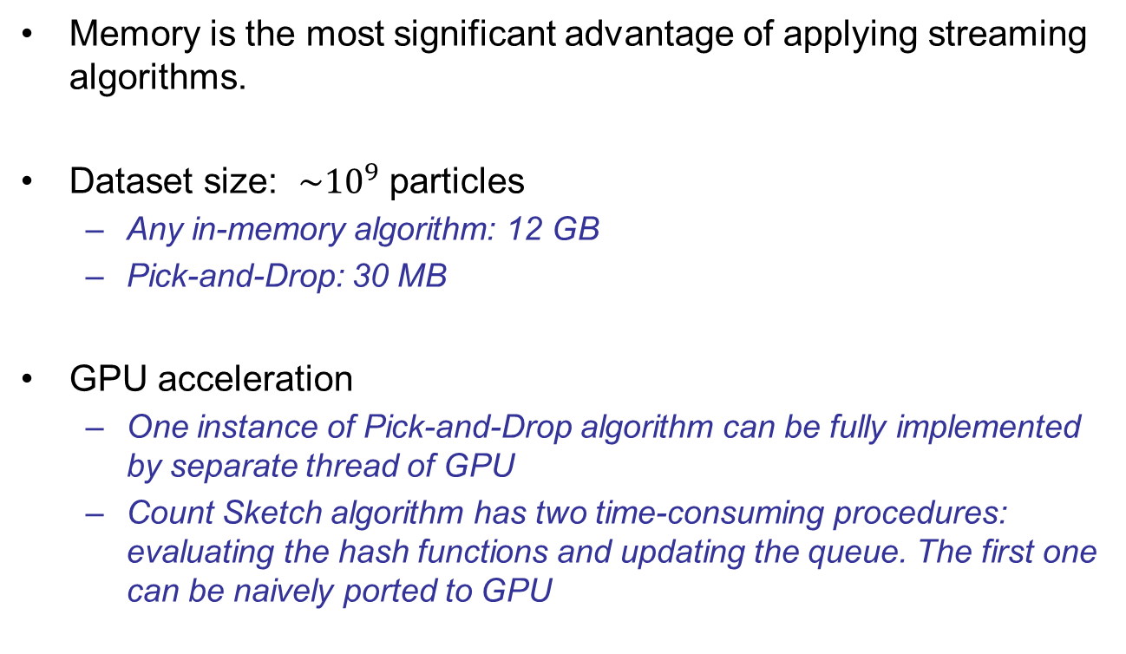
Memory
Memory is the most significant advantage of applying streaming algorithms.
Dataset size: $\sim {10}^{9}$ particles
  Any in-memory algorithm: 12 GB
  Pick-and-Drop: 30 MB
GPU acceleration
  One instance of Pick-and-Drop algorithm can be fully implemented by separate thread of GPU
  Count Sketch algorithm has two time-consuming procedures: evaluating the hash functions and updating the queue. The first one can be naively ported to GPU

Slide 42
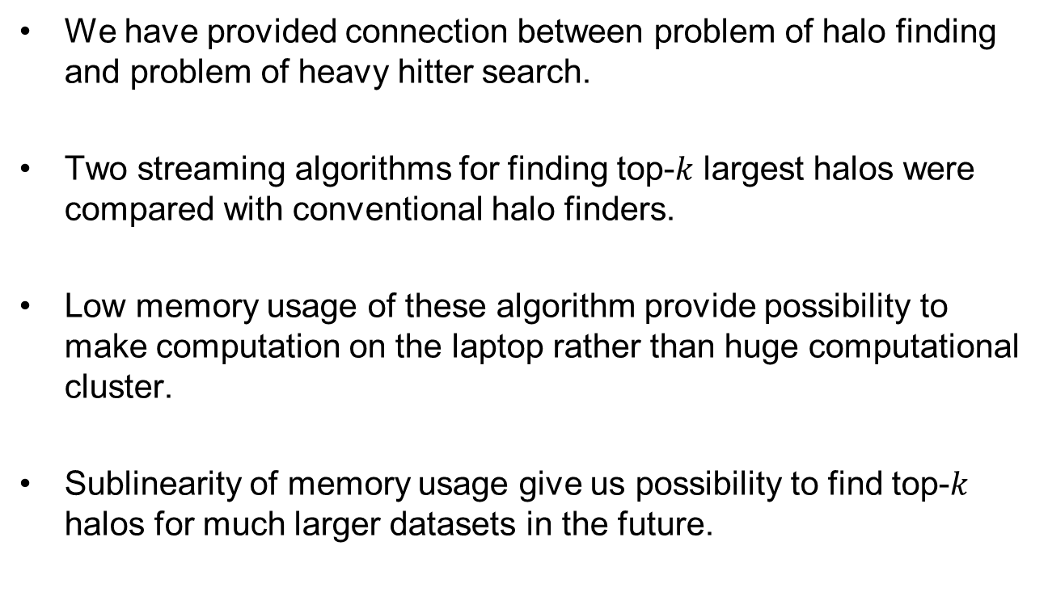
Summary
We have provided connection between problem of halo finding and problem of heavy hitter search.
Two streaming algorithms for finding top-$k$ largest halos were compared with conventional halo finders.
Low memory usage of these algorithm provide possibility to make computation on the laptop rather than huge computational cluster.
Sublinearity of memory usage give us possibility to find top-$k$ halos for much larger datasets in the future.

