Slide 1
Beautiful Data 2022
Class 02

Slide 2
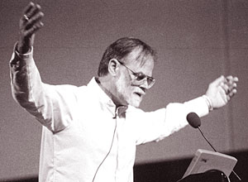
Why Is Astronomy Interesting?
Astronomy has always been data-driven….
now this is becoming more accepted in
other areas as well
“Exciting, since it is worthless!”
— Jim Gray

Slide 3

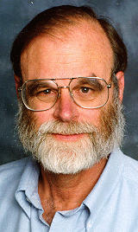
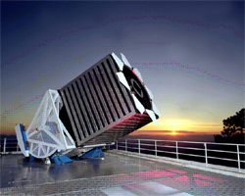
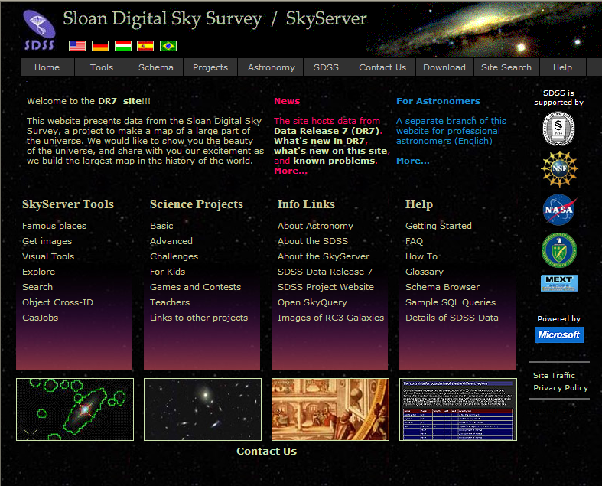
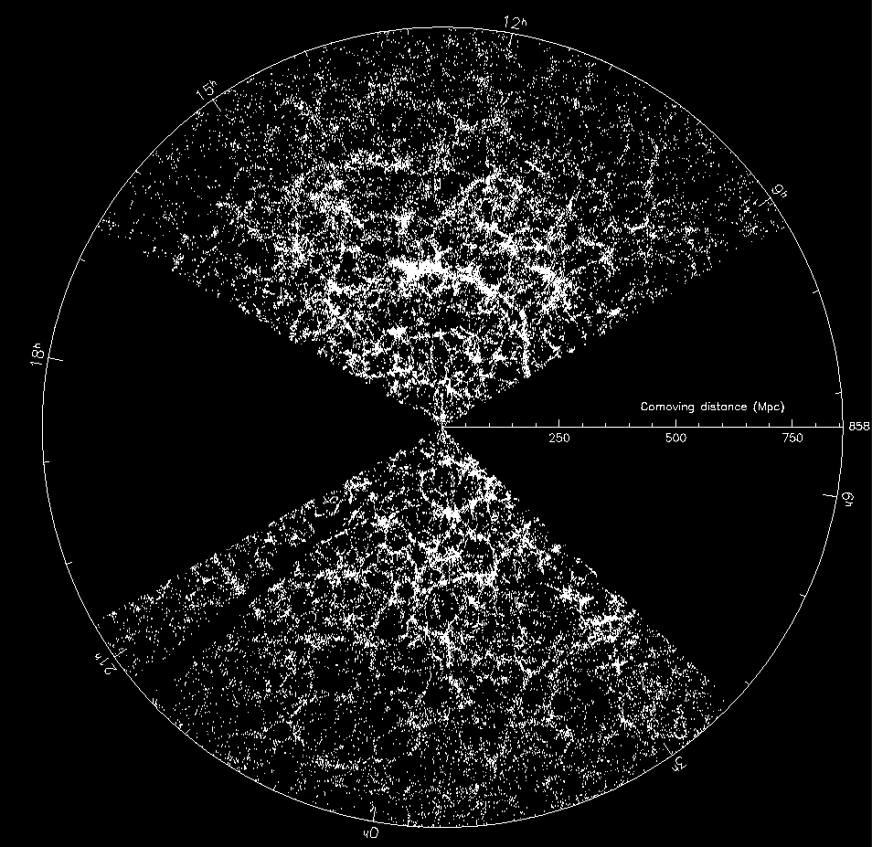
Sloan Digital Sky Survey
“The Cosmic Genome Project”
Started in 1992, SDSS-II finished in 2008
Data is entirely public
  5 Tpix of sky, 100TB processed data
Database built at JHU
Project marked a transition in astronomy
  From manufacturing to mass production of scientific data
Jim Gray
SkyServer
  4B web hits, 554M SQL queries
  9,000+ papers and 500K+ citations
  7M distinct users vs. 15K astronomers
  Emergence of the “Internet Scientist”
  World’s most used astronomy facility

Slide 4
The SDSS Genealogy
Terra Server
SDSS SkyServer
Onco
Space
Life Under Your Feet
CASJobs MyDB
GalaxyZoo
Turbulence DB
Super COSMOS
Hubble
Legacy Arch
SkyQuery
JHU 1K Genomes
GALEX
Pan-STARRS
Millennium
Palomar QUEST
UKIDDS
VO Services
Open SkyQuery
INDRA Simulation
Potsdam
Milky Way Laboratory
MHD DB
VO Footprint
VO Spectrum

Slide 5
Data in HPC Simulations
HPC is an instrument in its own right
Largest simulations approach petabytes
  from supernovae to turbulence, biology and brain modeling
Need public access to the best and latest through interactive numerical laboratories
Creates new challenges in
  How to move the petabytes of data (high speed networking)
  How to look at it (render on top of the data, drive remotely)
  How to interface (smart sensors, immersive analysis)
  How to analyze (value added services, analytics, … )
  Architectures (supercomputers, DB servers, ??)

Slide 6
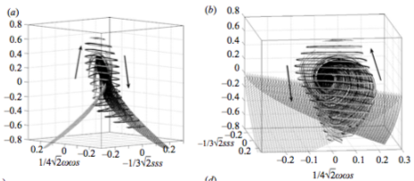
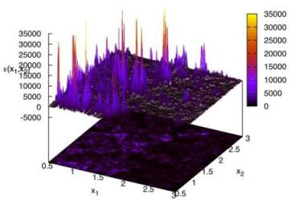
Immersive Turbulence
“… the last unsolved problem of classical physics…”
Understand the nature of turbulence
  Consecutive snapshots of a large
  simulation of turbulence:
  1024⁴ => 30 Terabytes
  Treat it as an experiment, play with
  the database!
  Shoot test particles (sensors) from
  your laptop into the simulation,
  like in the movie Twister
New paradigm for analyzing simulations!
with C. Meneveau, S. Chen (Mech. E), G. Eyink (Applied Math), R. Burns (CS)

Slide 7
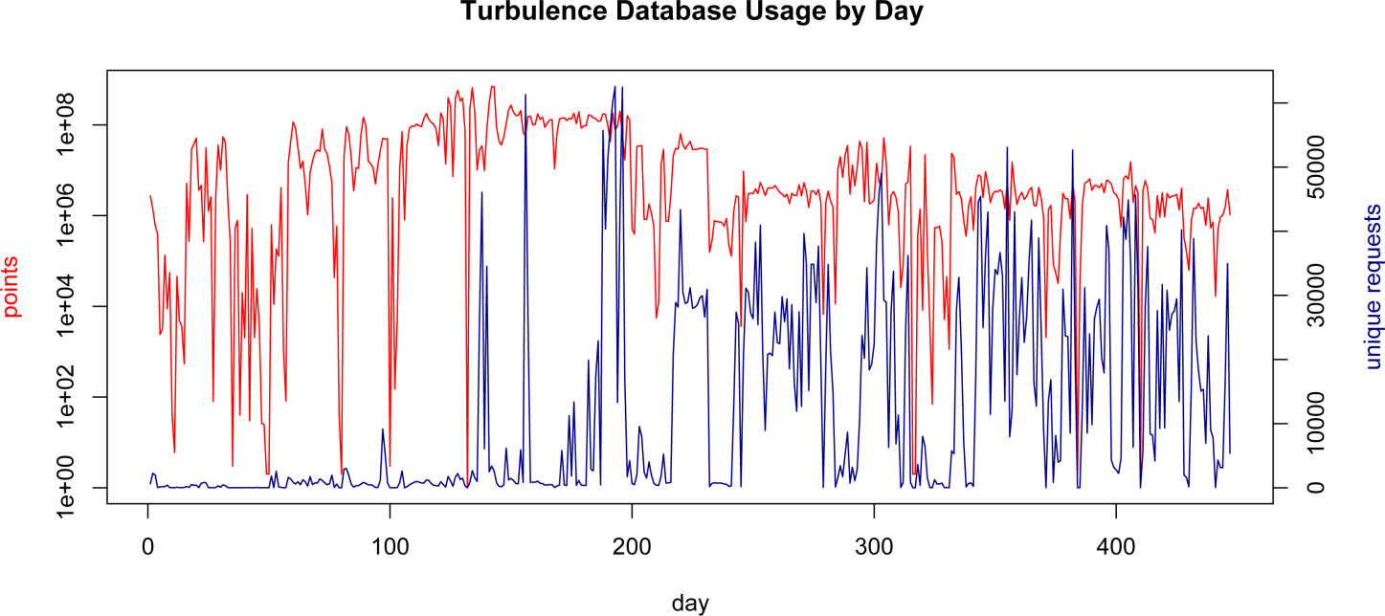
Daily Usage
More than 12 trillion “sensors” delivered to the community

Slide 8
Applications of ML to Turbulence
Renyi divergence
?
Vorticity
clustering,
classification,
anomaly detection
Similarity between regions
J. Schneider, B. Poczos, CMU

Slide 9
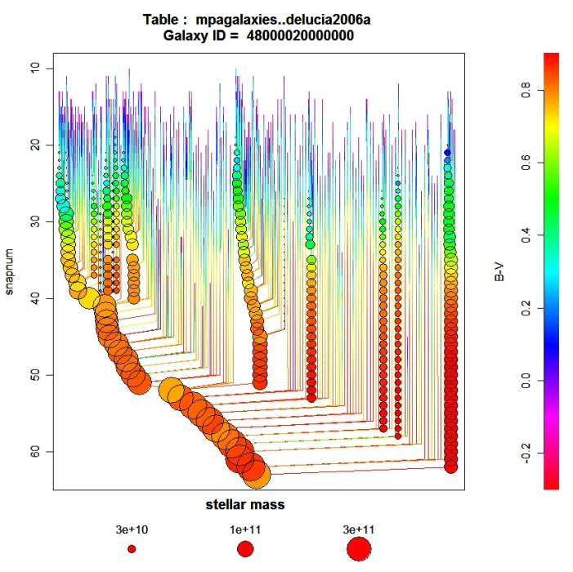
Cosmology Simulations
Millennium DB is the poster child/ success story
  Built by Gerard Lemson (now at JHU)
  600 registered users, 17.3M queries, 287B rows
http://gavo.mpa-garching.mpg.de/Millennium/
  Dec 2012 Workshop at MPA: 3 days, 50 people
Data size and scalability
  PB data sizes, trillion particles of dark matter
Value added services
  Localized
  Rendering
  Global analytics

Slide 10
Simulations in the DB
Amazing progress in 7 years
Millennium and turbulence are showcases
Community is now using the DB as a musical instrument
New challenges emerging:
  Petabytes of data, trillions of particles
  Increasingly sophisticated value added services
  Need a coherent strategy to go to the next level
Not just storage, but integrate access and computation
Filling the gap between DB server and supercomputer

Slide 11
Emerging Challenges
Data size and scalability
  PB, trillion particles, dark matter
  Where is the data located, how does it get there
Value added on-demand services
  Localized (SED, SAM, star formation history, resimulations)
  Rendering (viz, lensing, DM annihilation, light cones)
  Global analytics (FFT, correlations of subsets, covariances)
  Spatial queries
Data representations
  Particles vs hydro
  Particle tracking in DM data
  Aggregates, summary of uncertainty quantification (UQ)
  Covariances, ensemble averages

Slide 12
Exascale Numerical Laboratories
Similarities between Turbulence/CFD, N-body, ocean circulation and materials science
Differences as well in the underlying data structures
  Particle clouds / Regular mesh / Irregular mesh
Innovative access patterns appearing
  Immersive virtual sensors/Lagrangian tracking
  User-space parallel operators, mini workflows on GPUs
  Posterior feature tagging and localized resimulations
  Machine learning on HPC data
  Joins with user derived subsets, even across snapshots
  Data driven simulations/feedback loop/active control of sims

Slide 13
Scalable Data-Intensive Analysis
Large data sets => data resides on hard disks
Analysis has to move to the data
Hard disks are becoming sequential devices
  For a PB data set you cannot use a random access pattern
Both analysis and visualization become streaming problems
Same thing is true with searches
  Massively parallel sequential crawlers (MR, Hadoop, etc)
Spatial indexing needs to be maximally sequential
  Space filling curves (Peano-Hilbert, Morton,…)

Slide 14
The Long Tail
The “Long Tail” of a huge number of small data sets
  The integral of the “long tail” is big!
Facebook: bring many small, seemingly unrelated data to a single place and new value emerges
  What is the science equivalent?
The DropBox lesson
  Simple interfaces are more powerful than complex ones
  Interface is open, public

Slide 15
From Stars to Genes
Strong parallels between genomics today and astronomy 20 years ago
All based on files and manually ran scripts
Metadata stored in file headers and long filenames
Everybody is obsessed with running their own aligners
This works with a small number of genomes, but will break with thousands or millions
Astronomy lessons:
  for statistical processing and collaboration you need a DB, not flat files
  Find a common processing that is “good enough”

Slide 16
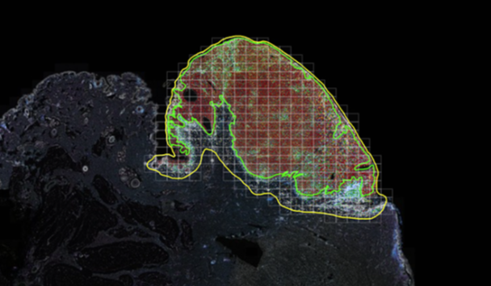
AstroPath: Atlas of Cancer Cells
Astronomy meets Pathology
Study the tumor microenvironment
Transition to the “industrial revolution” of science
Increase data collection by a factor of >1,000
Parallels sky surveys (as of 20 years ago)
  “Disruptive assistance” from astronomy to pathology
  Use techniques astronomers learned the hard way
Interactive viewer like the SkyServer, or Google Maps
All geometries represented as GIS polygons
Dynamic computation of nearest neighbors, spatial relations
Processing workflows mostly automated
Databases linked to SciServer, collaborative Jupyter, Keros/TensorFlow, R, AI

Slide 17
Technology+Sociology+Economics
Technology is changing very rapidly
  Google, tags, sensors, Moore's Law
  Trend driven by changing generations of technologies
Sociology is changing in unpredictable ways
  YouTube vs. MySpace
  In general, people will use a new technology if it is
    Offers something entirely new
    Or substantially cheaper
    Or substantially simpler
    Or all our friends are using it
Funding is essentially level

Slide 18
How to Do with “Less” Data?
Collect less but more relevant data
  Use active learning
  Compressive sensing: nature is sparse
  Random sampling of long tails: stratified sampling
Streaming, sublinear randomized algorithms
  Streaming look at simulations as well
  Not just sequence of snapshots, but world-lines
  Sketching
Automation, machine learning to find relevant data

Slide 19
Probabilistic Approach
Time-to-result: how to trade speed for accuracy
  statistical and algorithmic challenges
  statistical vs systematic errors
  best result in 1 min, 1 hour, 1 day
  Cost of computing is becoming a significant factor
Simulations: how to do better UQ
  from single large realization to ensembles
  (Coyote Universe, INDRA)
  sparsely sampled outputs
Experiments
  from driven by experience (and “feeling”) to objective
  design based on statistics, automated choice of parameters
  Ensembles of experiments optimally sampling parameters

Slide 20
Active Learning
Given our existing data, of all possible experiments which would yield the most new information?
Ross King (2004) drug design study:
  Adam, the Robot Scientist
Personalized Medicine
Finding patterns in large scale simulations

Slide 21
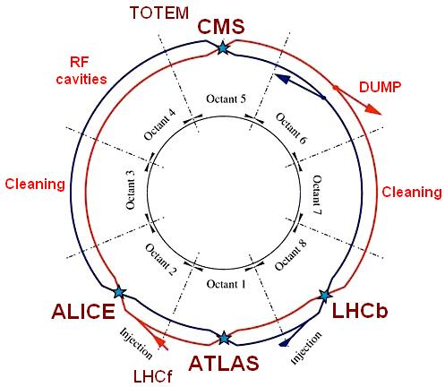
Prioritizing for Relevance
Delicate tradeoff between the scientific value and the cost of preservation
  One extreme – store everything, go bankrupt!
  Other extreme – too little data, not enough for the science!
LHC lesson: single data source, $$$$$
  Multiple experiments tap into the beamlines
“Do you have enough data or would you like to have more?”
In-situ hardware triggers to filter data
  Only 1 in 10M events are saved (9999999:1)
  Took a decade to define the thresholds
Resulting “small subset” analyzed many times off-line
  This is still 10-100 PB
  Keeps the whole community busy for a decade or more
Follow 90-10 rule: 90% of the science value is carried by 10% of the data (or 999-1?)

Slide 22
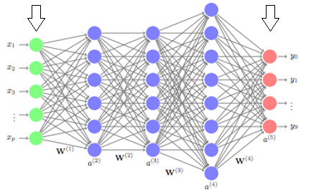

Experimental Design by AI?
Instead of more data we need MORE RELEVANT DATA
Need to dramatically improve experiment design….
Artificial Intelligence in large-scale experiments:
use AI before we collect the data
Example: Next Generation Astronomical Surveys
      Observing spectra is 1,000 times more expensive than imaging
      Use feedback from observed targets and improve target selection via reinforcement learning
Fifth Paradigm: when algorithms make the decisions about our experiments?
Put the telescope in the
reinforcement loop!
Supported by the Schmidt Family Foundation
at JHU and Princeton: Use AI Feedback for the PFS project

Slide 23
Decision Making in Science
Traditionally: human scientists decide what experiments to do next
SDSS Example: the “Black Book”
  Optimization and tradeoffs were done by committee
  In the end >5000 publications, many outside the team
  But: many science projects were never thought of
Given the huge amounts of data, the possible number of new experiments and analyses explodes
But: we cannot do it all, we cannot foresee it all!
Need to involve intelligent tools aiding the scientist

Slide 24
What Will the 5th Paradigm Be?
Next step: not just discovery but experiment design!!!
Probabilistic approach to everything
Accelerated design cycles
Clear cost function driving tradeoffs
How to find and collect the more relevant data?
  The systematic involvement of computational statistics and optimizations in the design of the next generation of “experiments”:
  prediction/Inference/UQ + design/synthesis/fabrication

Slide 25
Nature is Sparse
Many natural processes are dominated by a few processes and described by a sparse set of parameters
Compressed Sensing has emerged to identify in high dimensional data sets the underlying sparse representation (Candes, Donoho, Tao, et al)
This enables signal reconstruction with much less data!
The resolution depends not on the pixel count but on the information content of an image…

Slide 26
Compressed Sensing
Example: sparse signal sampled randomly in Fourier space
Donoho, Candes, Tao…

Slide 27
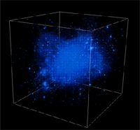
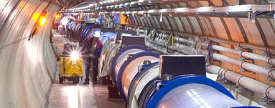

Trends
Broad sociological changes
  Convergence of Physical and Life Sciences
  Data collection in ever larger collaborations
  Virtual Observatories: CERN, IVOA, NCBI, NEON, OOI,…
  Analysis decoupled, off archived data by smaller groups
  Emergence of the citizen/internet scientist (GalaxyZoo…)
Need to start training the next generations
  П-shaped vs I- and T-shaped people
  Early involvement in “Computational thinking”

Slide 28
Summary
Science is increasingly driven by data (big and small)
Changing sociology – surveys analyzed by individuals
From hypothesis-driven to data-driven science
We need new instruments: “microscopes” and “telescopes” for data
There is a major challenge on the “long tail”
A new, Fourth Paradigm of Science is emerging…
SDSS has been at the cusp of this transition

