Slide 1

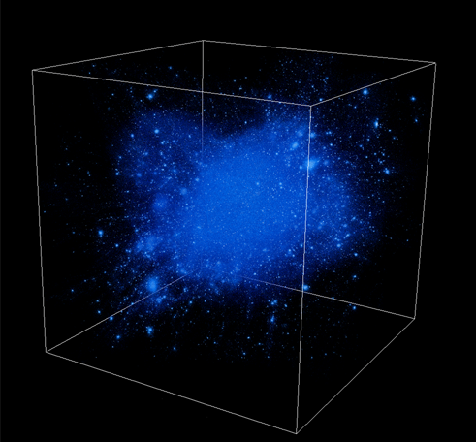
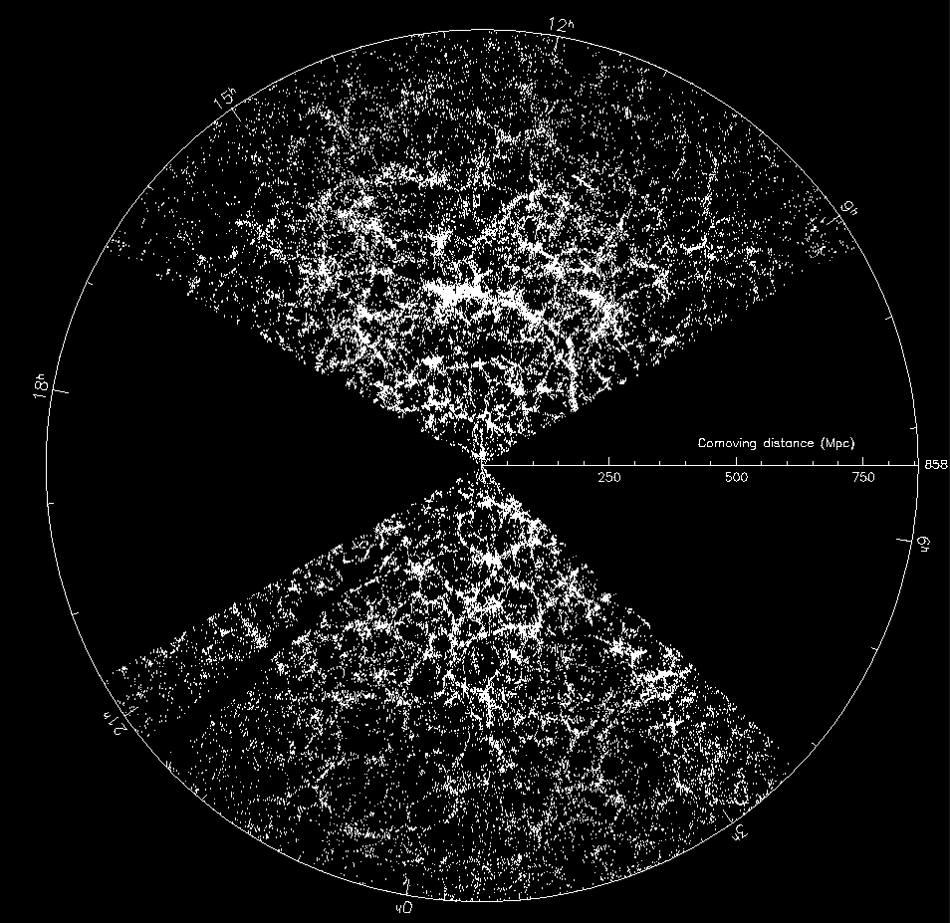
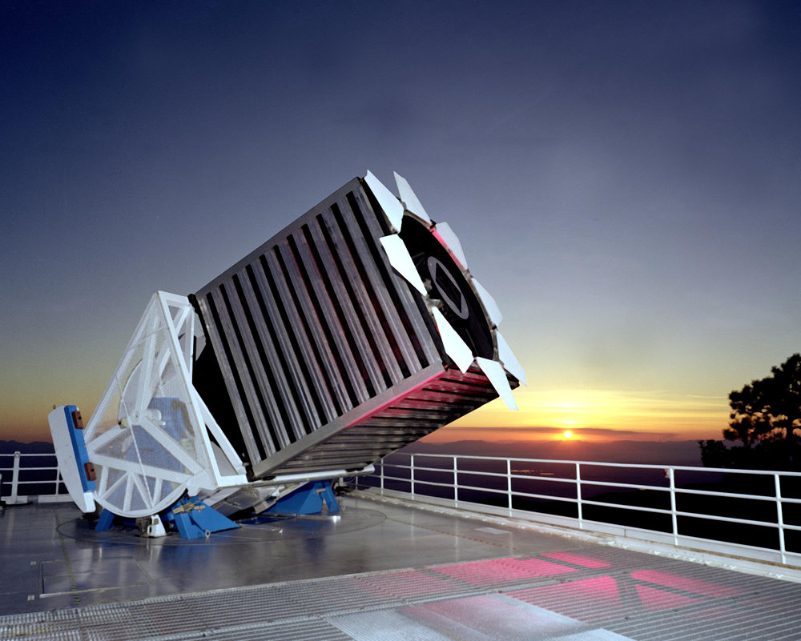
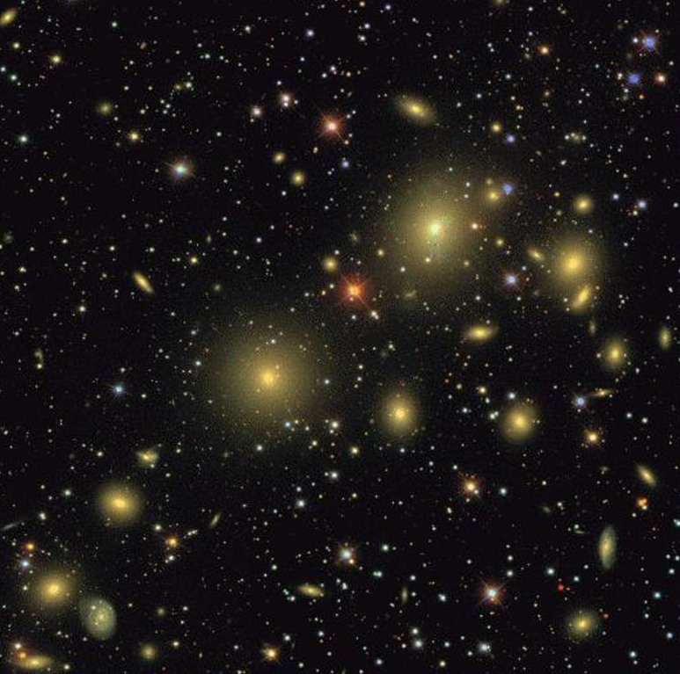
The Era of Surveys and the Fifth Paradigm of Science
Alex Szalay
The Johns Hopkins University

Slide 2
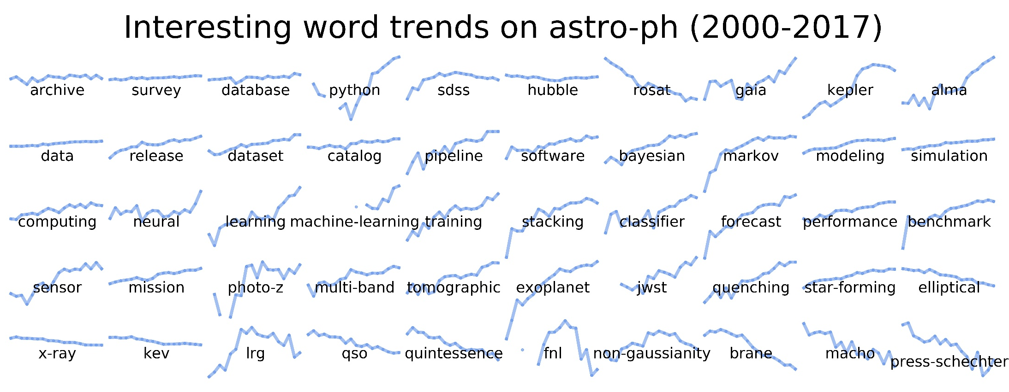
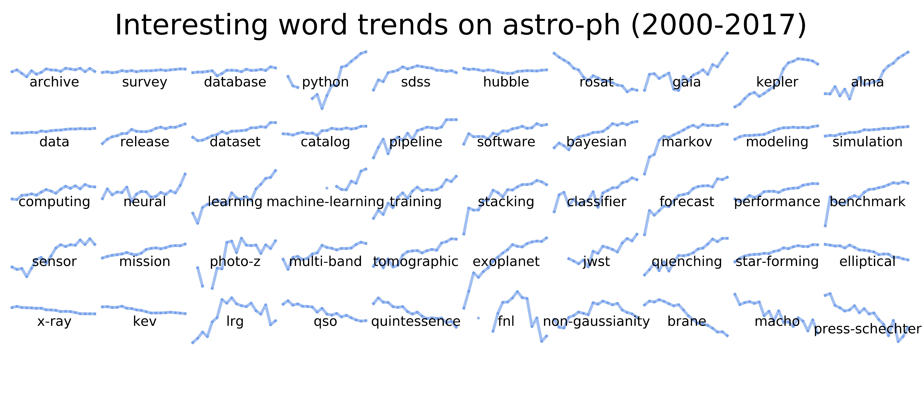

Word Trends from astro-ph
B. Menard
M. Taghizadeh-Popp

Slide 3
Big Data in Science
Data growing exponentially, in all science
All science is becoming data-driven
This is happening very rapidly
Data becoming increasingly open/public
Non-incremental!
Convergence of physical and life sciences through Big Data (statistics and computing)
The “long tail” is important
A scientific revolution in how discovery takes place => a rare and unique opportunity

Slide 4
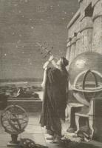
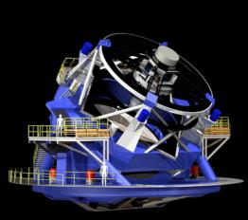
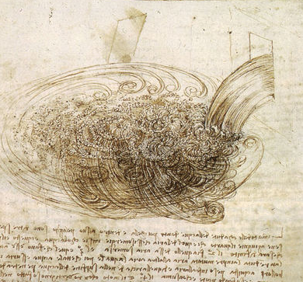
Science is Changing
THOUSAND YEARS AGO
science was empirical describing natural phenomena
LAST FEW HUNDRED YEARS
theoretical branch using models, generalizations
LAST FEW DECADES
a computational branch simulating complex phenomena
TODAY
data intensive science, synthesizing theory, experiment and computation with statistics ►new way of thinking required!

Slide 5
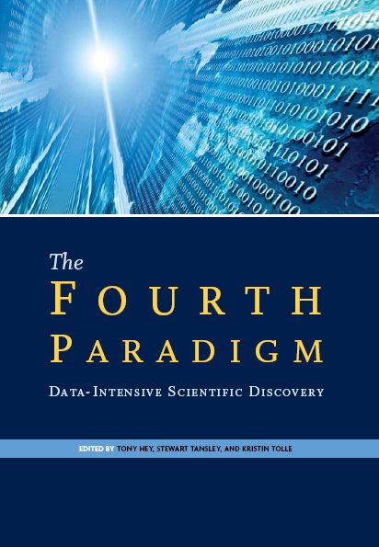
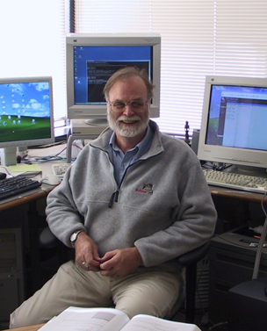
Gray’s Laws of Data Engineering

Slide 6
Scientific Data Analysis Today
Data is everywhere, never will be at a single location
Data grows as fast as our computing power
Need randomized, incremental algorithms => streaming
Best result in 1 min, 1 hour, 1 day, 1 week
Statistical vs systematic errors
Both “exploratory” and “confirmatory” searches needed
Machine Learning taking off, Python emerging
Deep Learning, Neural Networks not a dirty word any more

Slide 7
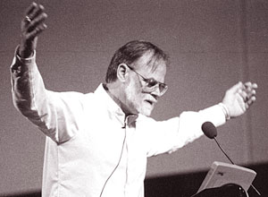
Why Is Astronomy Interesting?
Astronomy has always been data-driven…. now this is becoming more accepted in other areas as well
“Exciting, since it is worthless!”
— Jim Gray

Slide 8


Sloan Digital Sky Survey
“The Cosmic Genome Project”
Started in 1992, SDSS-II finished in 2008
Data is public
2.5 Terapixels of images => 5 Tpx of sky
10 TB of raw data => 100TB processed
0.5 TB catalogs => 35TB in the end
Database and spectrograph built at JHU (SkyServer)
Now SDSS-IV, data served from JHU
SDSS-V starting soon

Slide 9
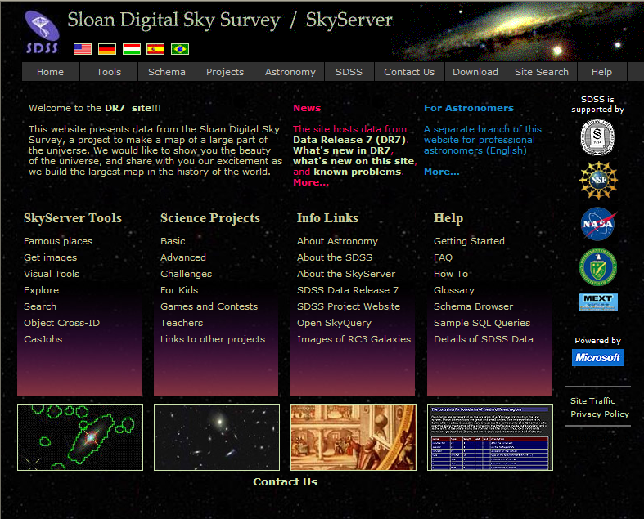
Skyserver
Prototype in 21st Century data access
1.2B web hits in 12 years
435M external SQL queries
7,000 papers and 450K citations
4,000,000 distinct users vs. 15,000 astronomers
The emergence of the “Internet Scientist”
The world’s most used astronomy facility today
Collaborative server-side analysis done by 9K astronomers

Slide 10
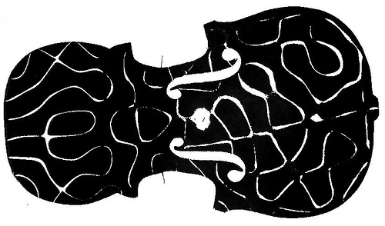
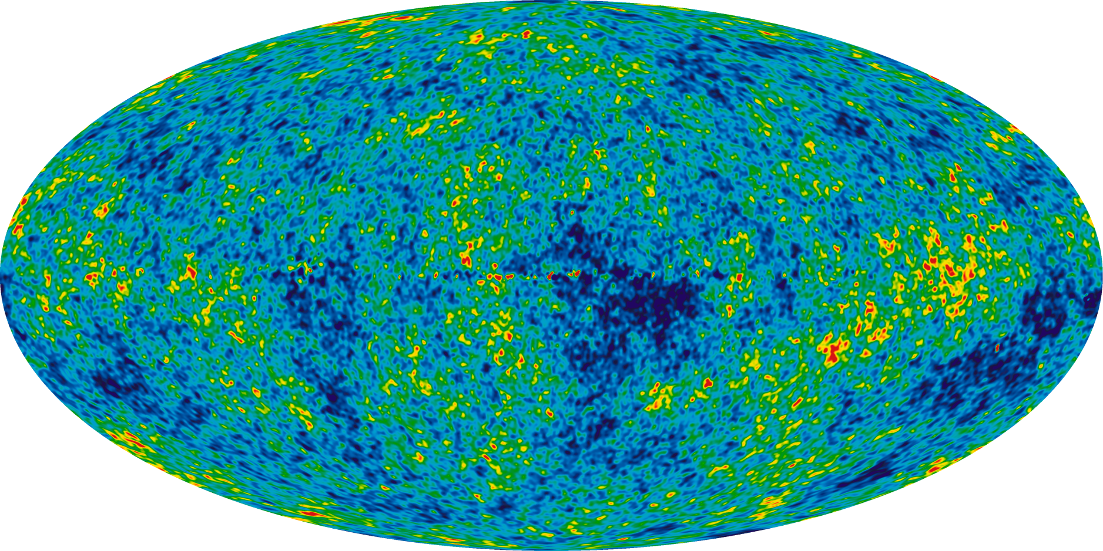
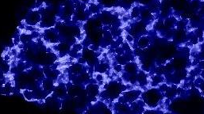
Baryon Acoustic Oscillations
The Early Universe is like a resonant drum or violin
At 300,000 years the oscillating pattern “freezes”
This provides the seeds of galaxy formation
Observed both in the Cosmic Microwave Background and SDSS
CMB
SDSS

Slide 11
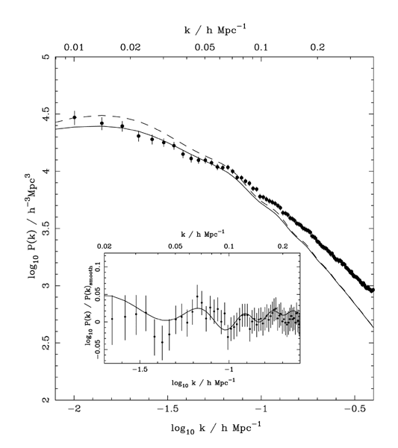
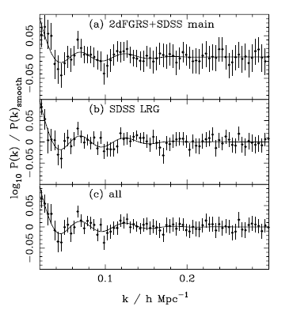
Primordial Sound Waves in SDSS
Power Spectrum
(Percival et al 2006, 2007)
SDSS DR6+2dF
SDSS DR5
800K galaxies

Slide 12
Pixel Window vs Object Position
Expectation: is that objects are more elongated depending on their clock phase
Test: extract 60M stars and bin them by subpixel position
-------------------------------------------------------------
-- also extract the psf moments
-------------------------------------------------------------
select cast(100*(rowc_r-floor(rowc_r)) as int) o,
avg(mE1_r) e1, avg(mE1PSF_r) e1P, count(*) c
into #tmp
from PhotoObj p, run r
where p.run = r.run
and r.stripe between 9 and 47
and rowc_r between 64 and 1425
and type = 6
and psfMag_r between 20 and 22.5
and mE1_r between -1 and 1
group by cast(100*(rowc_r-floor(rowc_r)) as int)
order by 1
go

Slide 13
Adaptive Second Moment
Δm = -0.032
δm = -0.006
Detected the clock phases of the SDSS camera from the ellipticity of 60M stars!

Slide 14
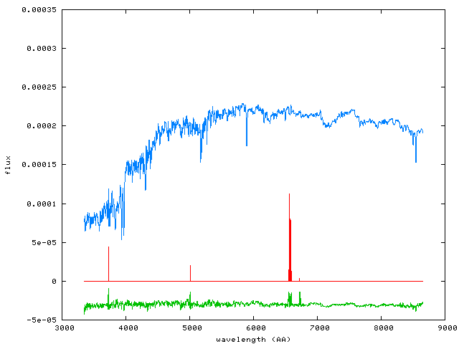
Principal component pursuit
Decompose spectrum into a few broad SEDs (low rank) and a few (sparse) and narrow features
I. Csabai (2012)
Low rank
numerically feasible convex problem (Augmented Lagrange Multiplier)
Sparse
Residual
* E. Candes, et al. “Robust Principal Component Analysis”. preprint, 2009. Abdelkefi et al. ACM CoNEXT Workshop (traffic anomaly detection)

Slide 15
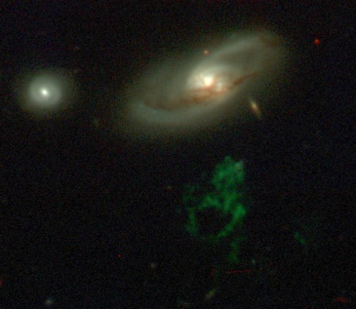
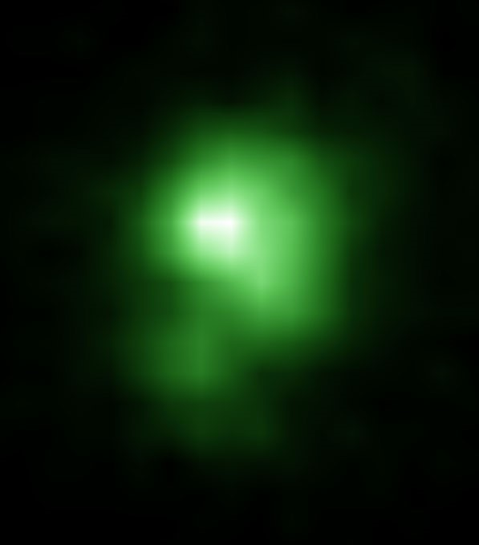
GalaxyZoo
40 million visual galaxy classifications by the public
Good publicity (CNN, Times, Washington Post, BBC)
300,000 people participating, blogs, poems…
Original discoveries by the public (Voorwerp, Green Peas)
Chris Lintott et al

Slide 16
The Era of Surveys
US astronomy transformed by large surveys
Happened over the last 20 years
Both photometric and spectroscopic
SDSS, 2dF, 2MASS, Pan-STARRS, DES, HSC, PTF, ZTF, LSST, WFIRST, Euclid, …
These surveys
Cover a large fraction of the sky
Provide large, open access archives
Took many years to complete, hundreds of people
Multiwavelength is now the norm
Data is in open and free archives
Remarkably fast transition compared to others

Slide 17
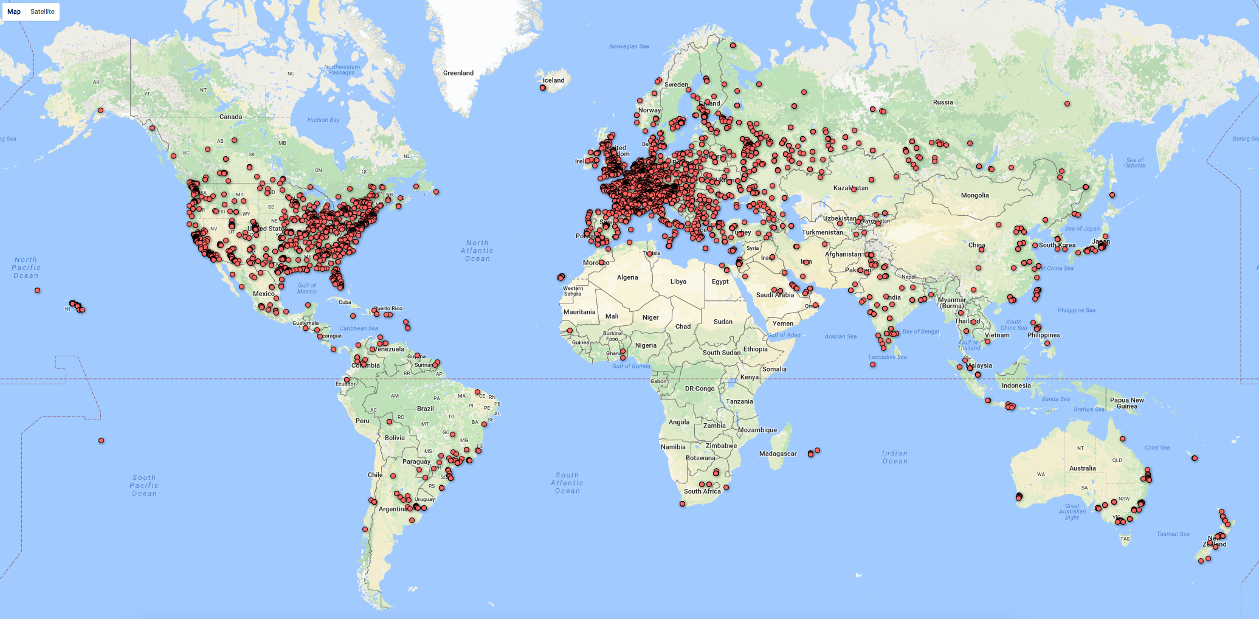
Pan-Starrs Data Usage
M. Postman, STScI

Slide 18
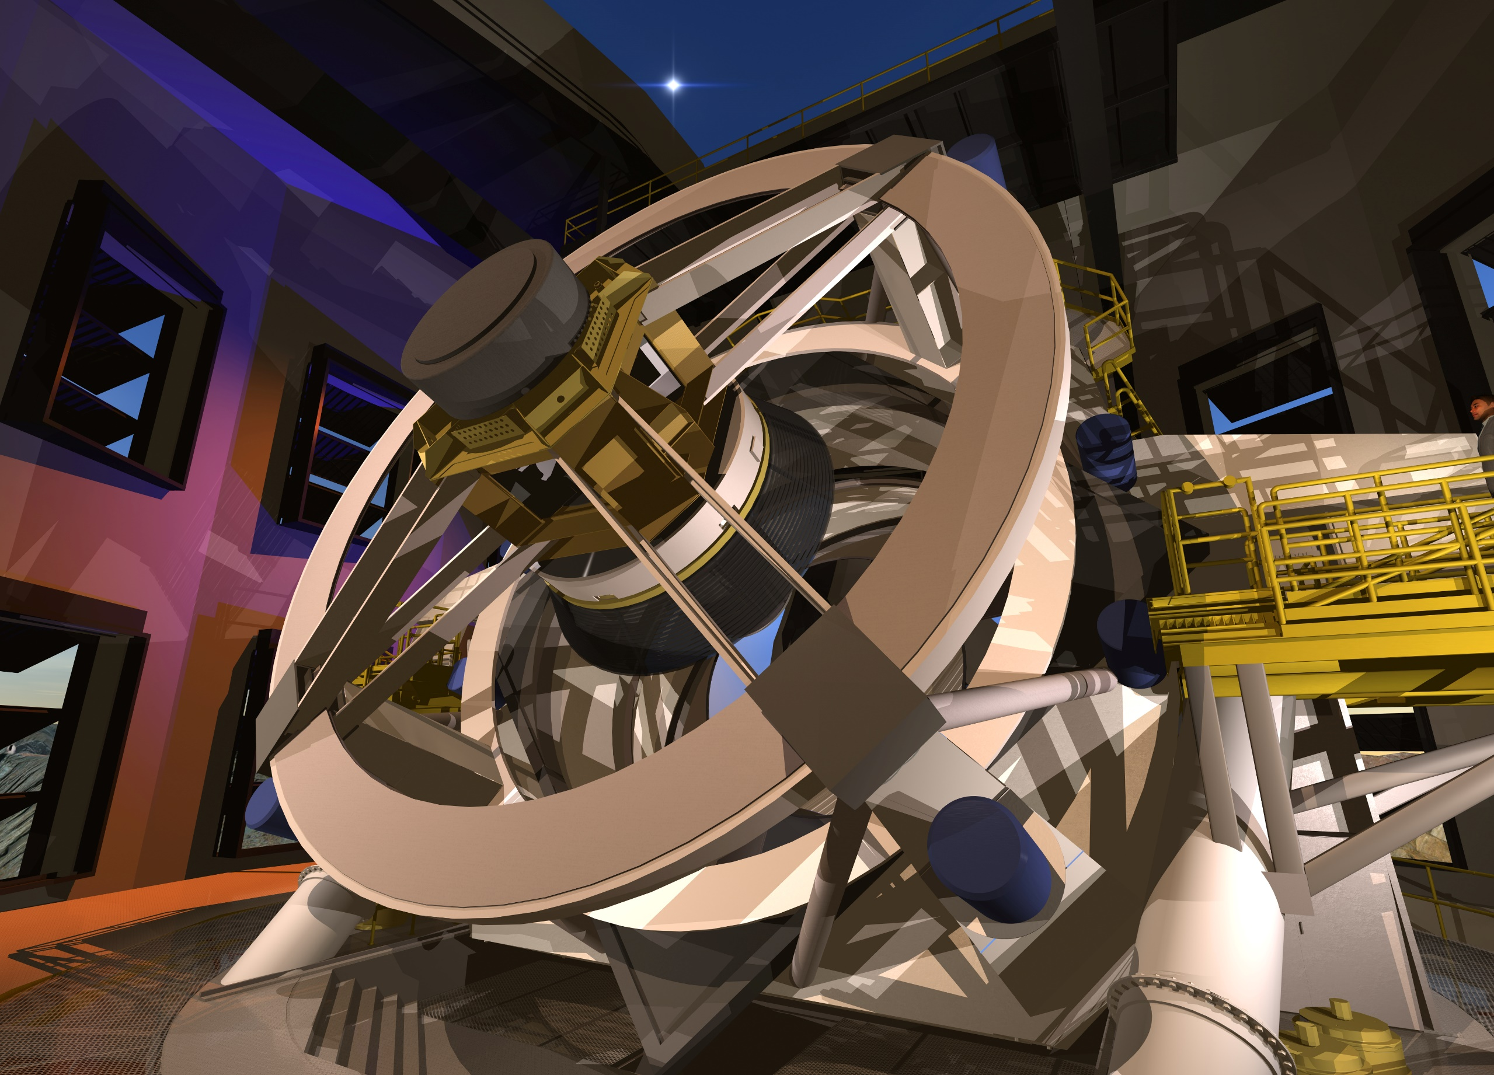
SDSS (2000)
2.4m 0.12Gpixel
PanSTARRS (2010)
1.8m 1.4Gpixel
LSST (2020)
8.4m 3.2Gpixel

Slide 19
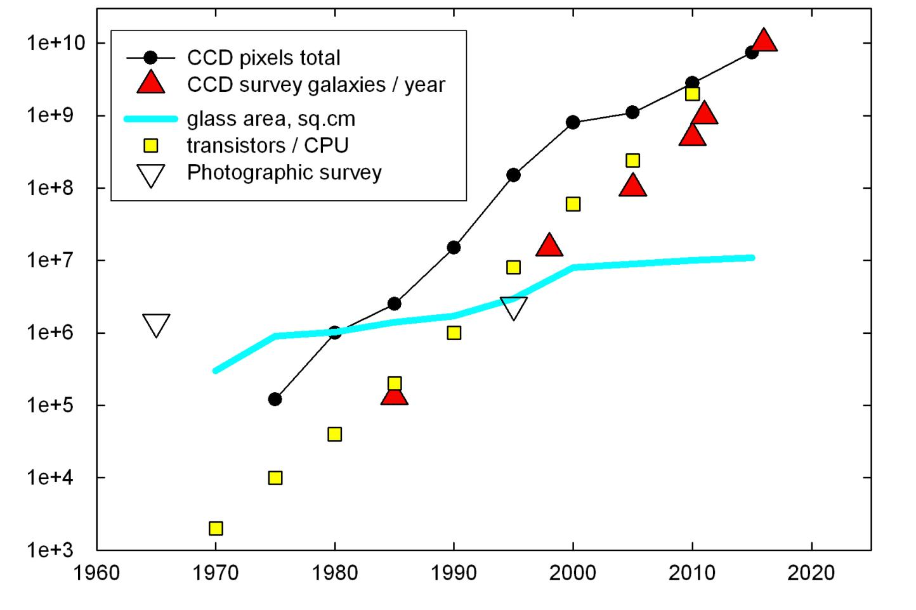
Survey Trends vs Moore’s Law
T.Tyson (2010)
A.Szalay,

Slide 20
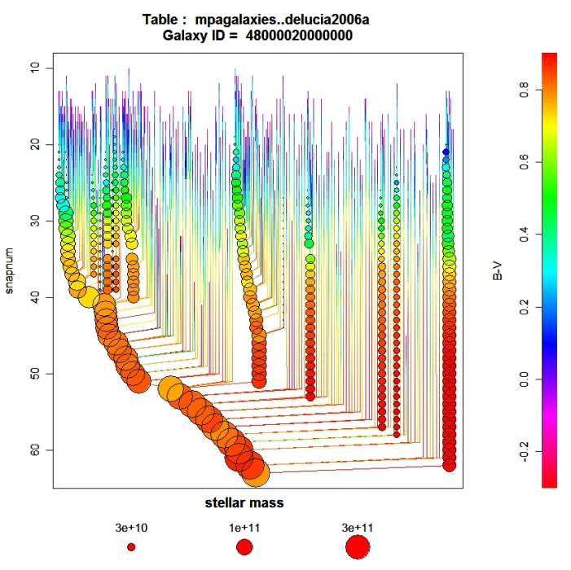
Cosmology Simulations
Millennium DB is the poster child/ success story
Built by Gerard Lemson (now at JHU)
600 registered users, 17.3M queries, 287B rows
http://gavo.mpa-garching.mpg.de/Millennium/
Dec 2012 Workshop at MPA: 3 days, 50 people
Data size and scalability
PB data sizes, trillion particles of dark matter
INDRA simulations:
512 1Gpc simulations with 1B particles each
Over 1.1PB of simulation data
Study ensemble averages and cosmic variance

Slide 21
From SkyServer to SciServer
Service oriented smart data
More collaborative features added
System captures interactivity of science well
Read-only, secure core – free-for-all in MyDB
Increasingly complex analysis patterns
Extensive use by other disciplines
But: signs of service lifecycle after 15 years
=> NSF DIBBS grant ($10M)
Comprehensive overhaul under the hood
Now added iPython+R scripting, running on pool of VMs
Single sign-on to CASJOBS + SciDrive (Dropbox+VOSpace)

Slide 22
Current SciServer Projects

Slide 23
Long Term Lifecycles
There is a Data Lifecycle:
New data standards emerge
Metadata standards change
Usage patterns change
There is also a Service Lifecycle
Survey data presented in Smart Services
Browsers change (HTML5), OS change, DB change
New software platforms (iPython, Jupyter, ML emerging)
Servers become obsolete, disks die

Slide 24
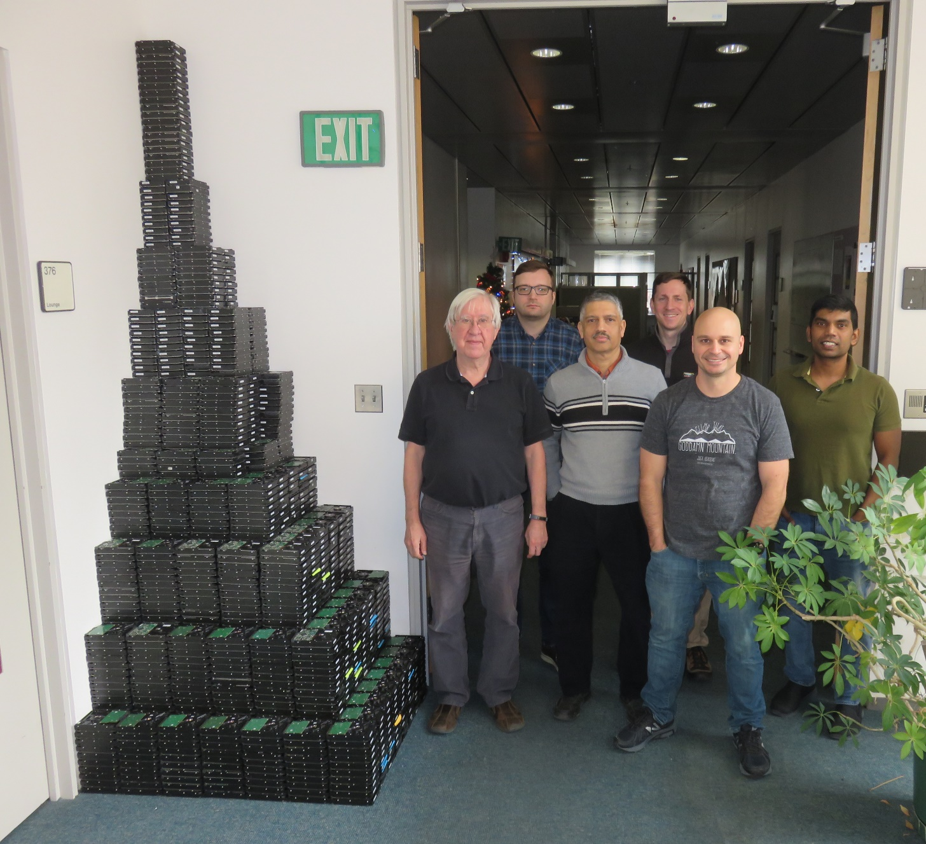
Failed Disks Over 18 Years
1885 drives
~2.5%/year over 18 yrs
1.1 tons of HDD

Slide 25
What is the Value of Data?
What is the value of (usable/accessible) survey data?
Accelerates testing ideas, find objects for followup
Provides a platform for reproducible data
Not possible without a robust access
Produces direct foundation to many papers
Metric: how much science funding does a data set attract?
Typical NSF AST grant is $300K over 3 years
Two refereed papers/year is good performance
Implies: $50K/paper is good
Facilities support probably doubles this: $100K/paper (not $10K and not $1M)

Slide 26
What is the Price of Data?
How much did it take to produce?
OK, so far a few hundred $M, LSST over $1B
SDSS I-IV was probably around $200M total
Price vs Value*Output
SDSS enabled 7,000 refereed papers so far: 7K x 100K = $700M -> cost effective

Slide 27
What is the Cost of Data?
The cost is in long-term preservation (in people, not the bytes)
So far so good, data maintained by live projects
This is about to change: surveys coming to an end
SDSS, Pan-STARRS, DES will all sunset shortly
What happens to the data?
Who will take ownership of it?
Who will remember what it is?
Who will pay for it?
Estimated cost for SDSS is ~$500K/year
Either 5 papers, or 0.25% of the price of data
5% cost overrun in the survey would cover the data for 20 years!

Slide 28
Publishing Models
Traditionally we included the data in the printed publications => “we threw it over the wall for someone to catch it”
Publishers, journals were there to do so … for a profit
This model is cracking
Formal (FAIR) requirements have emerged:
Findable, Accessible, Interoperable, Reproducible
Open scientific data is becoming increasingly mandated by funding agencies
The current for-profit model of scientific publishing is under attack
Transition is inevitable, like in music publishing: LPs -> iTunes-> Pandora
But this is all about publications. What about the data?

Slide 29
The Challenges for Long Term Data Sets
How can we build a shared, common data ecosystem?
FAIR (Findable, Accessible, Interoperable, Reproducible)
Need more automation, manual approach cannot keep up
What happens to large, high-value data sets when they are completed?
The music publishing analogy still holds.
Open/Free, Accessible and Self-sustaining?
Pick any two, and the third is determined!
How can one ensure a steady, long-term support?
Who do we trust with all this irreplaceable data?
How can we decide what to preserve?
National Endowment/ Data Trust for High-Value Data?

Slide 30
What Happens in 30 Years?
Today we spend ~$B to acquire valuable data
Much of these will not be superseded in the foreseeable future/decades
At the end of projects the data sets will be handed off to someone
We need an organization(s) that is
With a long track record with a predictable future
Understands data preservation
Trusted by everyone
Technically capable
Can run under a sustainable model
Has no single points of failure
Consortium of University Libraries + embedded domain scientists?

Slide 31
Astronomy/Machine Learning
Started with photometric redshifts, PCA of spectra
Outlier detection, classification
Star-galaxy separation, high redshift QSO, etc
KNN, Neural Nets, Random Forests,…
Dramatic upturn with iPython and Jupyter (+ML book)
First just incremetal improvements on data analysis
Many Deep Learning projects under way
The Google Brain Team found new exoplanets...

Slide 32
How Do We Prioritize?
Data Explosion: science is becoming data driven
It is becoming “too easy” to collect even more data
Robotic telescopes, next generation sequencers, complex simulations
This also means we have more data to preserve (do we?)
How long can this go on?
“Do you have enough data or would you like to have more?”
No scientist ever wanted less data…
But: Big Data is synonymous with Dirty Data, more systematic errors
How can we collect data that is more relevant ?
We need to improve ideas on survey design….

Slide 33
What is Next?
Artificial Intelligence in large-scale experimental design
Example: Next Generation Astronomical Surveys
Observing spectra is 10,000 times more expensive
Prime Focus Spectrograph (Subaru telescope) following up on HSC
Japan, USA, Germany, France, China, …
Use feedback from observed targets and continuously improve target selection algorithms through machine learning
Reinforcement learning with the telescope in the loop (project just starting at JHU and Princeton)
Fifth Paradigm: when algorithms make the decisions about our experiments (not just driving our cars)?

Slide 34
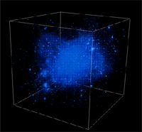


Trends
Broad sociological changes
Convergence of Physical and Life Sciences
Data collection in ever larger collaborations
Virtual Observatories: CERN, IVOA, NCBI, NEON, OOI, LSST…
Analysis decoupled, off archived data by smaller groups
Emergence of the citizen/internet scientist (GalaxyZoo…)
Need to start training the next generations
П-shaped vs I- and T-shaped people
Early involvement in “Computational thinking”

Slide 35
Summary
Science is increasingly driven by data (big and small)
Changing sociology – survey archives analyzed by individuals
From hypothesis-driven to data-driven science
We need new instruments: “microscopes” and “telescopes” for data
The Fourth Paradigm of Science is already here
Astronomy has been at the cusp of this transition
Our next experiments will be designed by algorithms…

Slide 36
