Slide 1
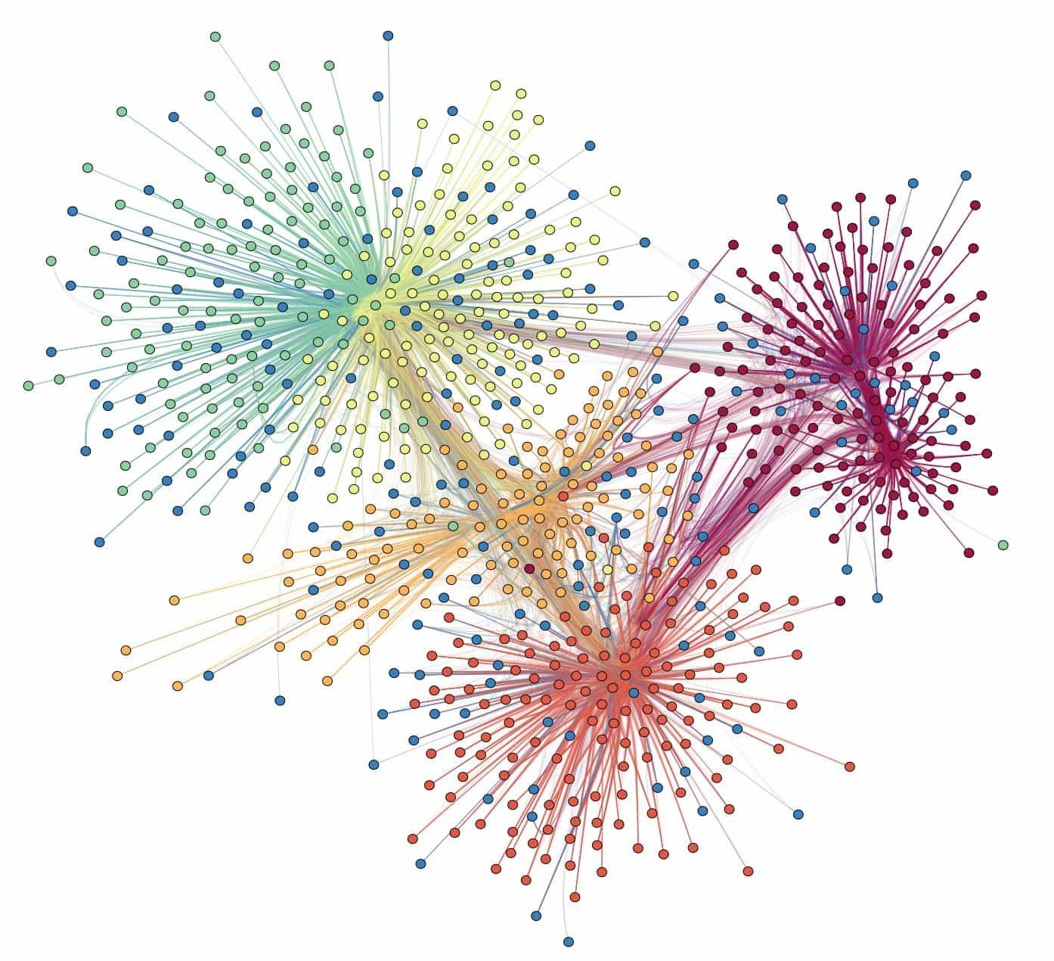
Graphs
Alex Szalay, JHU

Slide 2
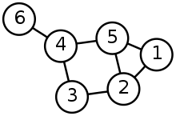
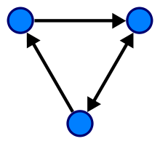
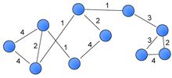
Graph Definitions
Components:
Nodes/vertices (V)
Edges (E)
Nodes:
List of vertices V={1..N}
Edges
List are ordered pairs (i,j)
Connection between i and j
Undirected
Directed
Weighted

Slide 3
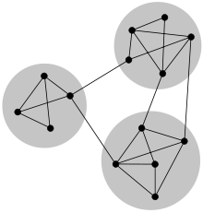
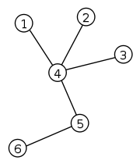
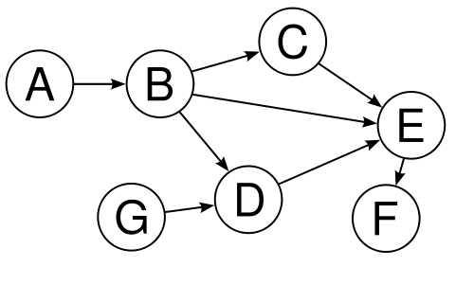
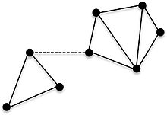
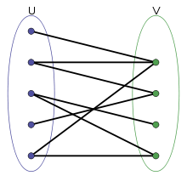
Graph Connectivity
Connected
Directed Acyclic Graph (DAG)
Tree
Disconnected
Bi-Partite

Slide 4
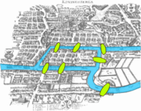
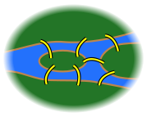
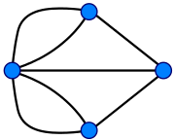
Historical Detour
The Konigsberg Problem (Euler 1736)
Two islands on the river Pregel, seven bridges
Devise a walk through the city that would cross each of those bridges once and only once
Degree of a node of an undirected graph is the number of edges
To traverse through a node ( excluding endpoints) requires an even number of edges
We can have at most two nodes with even ranks => the Konigsberg problem is unsolvable

Slide 5
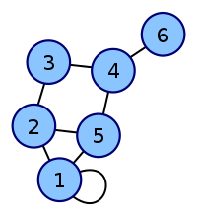
Adjacency Matrix
Graph is represented by a matrix A
Each row and column corresponds to a node
The adjacency matrix of an undirected graph is symmetric
The degree of a node is the sum of the matrix along its row (or column)

Slide 6
Directed Graphs
The adjacency matrix is asymmetric
Columns are incoming edges, rows are outgoing

Slide 7
Degree Matrix
The degree matrix D is a diagonal matrix, contains the degree of each node
D =

Slide 8
Graph Laplacian
The Laplacian L is the difference of the degree and adjacency matrices
The sum of each row and each column is zero

Slide 9
Spectral Graph Theory
Understand graphs through the eigenvalues and eigenvectors of their associated matrices (A, L)
Aid graph partitioning
Simple physical interpretation

Slide 10
Spectral Graph Theory
from Dan Spielman (Yale)

Slide 11
Using the Laplacian
from Dan Spielman (Yale)

Slide 12
Why Does this Work?
Quadratic expression with x(i), i=1..n
Graph is only connected if λ₂>0

Slide 13
Graphs as Spring Networks
from Dan Spielman (Yale)

Slide 14
Graphs as Spring Networks
from Dan Spielman (Yale)

Slide 15
Graphs as Spring Networks
from Dan Spielman (Yale)

Slide 16
Shortest Path
What is the shortest path between nodes
Count the number of hops
Adjacency matrix: nodes exactly one hop away
$$A=\left(\begin{matrix}\begin{matrix}0 & 1 & 0 \\ 1 & 0 & 1 \\ 0 & 1 & 0\end{matrix} & \begin{matrix}0 & 1 & 0 \\ 0 & 1 & 0 \\ 1 & 0 & 0\end{matrix} \\ \begin{matrix}0 & 0 & 1 \\ 1 & 1 & 0 \\ 0 & 0 & 0\end{matrix} & \begin{matrix}0 & 1 & 1 \\ 1 & 0 & 0 \\ 1 & 0 & 0\end{matrix}\end{matrix}\right)$$
Which nodes can we reach from node 5 with a single hop ?
$$R_{5}=A V_{5}$$
$$V_{5}=\left(\begin{matrix}\begin{matrix}0 \\ 0 \\ 0\end{matrix} \\ \begin{matrix}0 \\ 1 \\ 0\end{matrix}\end{matrix}\right)$$
$$A.V_{5}=\left(\begin{matrix}\begin{matrix}0 & 1 & 0 \\ 1 & 0 & 1 \\ 0 & 1 & 0\end{matrix} & \begin{matrix}0 & 1 & 0 \\ 0 & 1 & 0 \\ 1 & 0 & 0\end{matrix} \\ \begin{matrix}0 & 0 & 1 \\ 1 & 1 & 0 \\ 0 & 0 & 0\end{matrix} & \begin{matrix}0 & 1 & 1 \\ 1 & 0 & 0 \\ 1 & 0 & 0\end{matrix}\end{matrix}\right)\left(\begin{matrix}\begin{matrix}0 \\ 0 \\ 0\end{matrix} \\ \begin{matrix}0 \\ 1 \\ 0\end{matrix}\end{matrix}\right)=\left(\begin{matrix}\begin{matrix}1 \\ 1 \\ 0\end{matrix} \\ \begin{matrix}1 \\ 0 \\ 0\end{matrix}\end{matrix}\right)$$

Slide 17
Nodes Reachable in Two Hops
We apply recursion
$$R_{5}\left(2\right)=A.(A. V_{5})$$
$$A.A.V_{5}=\left(\begin{matrix}\begin{matrix}0 & 1 & 0 \\ 1 & 0 & 1 \\ 0 & 1 & 0\end{matrix} & \begin{matrix}0 & 1 & 0 \\ 0 & 1 & 0 \\ 1 & 0 & 0\end{matrix} \\ \begin{matrix}0 & 0 & 1 \\ 1 & 1 & 0 \\ 0 & 0 & 0\end{matrix} & \begin{matrix}0 & 1 & 1 \\ 1 & 0 & 0 \\ 1 & 0 & 0\end{matrix}\end{matrix}\right)\left(\begin{matrix}\begin{matrix}0 & 1 & 0 \\ 1 & 0 & 1 \\ 0 & 1 & 0\end{matrix} & \begin{matrix}0 & 1 & 0 \\ 0 & 1 & 0 \\ 1 & 0 & 0\end{matrix} \\ \begin{matrix}0 & 0 & 1 \\ 1 & 1 & 0 \\ 0 & 0 & 0\end{matrix} & \begin{matrix}0 & 1 & 1 \\ 1 & 0 & 0 \\ 1 & 0 & 0\end{matrix}\end{matrix}\right)\left(\begin{matrix}\begin{matrix}0 \\ 0 \\ 0\end{matrix} \\ \begin{matrix}0 \\ 1 \\ 0\end{matrix}\end{matrix}\right)=\left(\begin{matrix}\begin{matrix}1 \\ 1 \\ 2\end{matrix} \\ \begin{matrix}0 \\ 3 \\ 1\end{matrix}\end{matrix}\right)$$
$$A^{2}=\left(\begin{matrix}\begin{matrix}2 & 1 & 1 \\ 1 & 3 & 0 \\ 0 & 1 & 2\end{matrix} & \begin{matrix}1 & 1 & 0 \\ 2 & 1 & 0 \\ 0 & 2 & 1\end{matrix} \\ \begin{matrix}1 & 2 & 0 \\ 1 & 1 & 2 \\ 0 & 0 & 1\end{matrix} & \begin{matrix}3 & 0 & 0 \\ 0 & 3 & 1 \\ 0 & 1 & 1\end{matrix}\end{matrix}\right)$$
$$\left(\begin{matrix}\begin{matrix}0 & 1 & 1 \\ 1 & 0 & 0 \\ 0 & 1 & 0\end{matrix} & \begin{matrix}1 & 1 & 0 \\ 2 & 1 & 0 \\ 0 & 2 & 1\end{matrix} \\ \begin{matrix}1 & 2 & 0 \\ 1 & 1 & 2 \\ 0 & 0 & 1\end{matrix} & \begin{matrix}0 & 0 & 0 \\ 0 & 0 & 1 \\ 0 & 1 & 0\end{matrix}\end{matrix}\right)$$
$$\left(\begin{matrix}\begin{matrix}0 \\ 0 \\ 0\end{matrix} \\ \begin{matrix}0 \\ 1 \\ 0\end{matrix}\end{matrix}\right)$$
$$=\left(\begin{matrix}\begin{matrix}1 \\ 1 \\ 2\end{matrix} \\ \begin{matrix}0 \\ 0 \\ 1\end{matrix}\end{matrix}\right)$$
Eliminate self-loops

Slide 18
Dijkstra’s Algorithm
Numerical algorithm to find shortest path
Between two given nodes
From a single source node to all other nodes on the graph
Steps
Pick the unvisited vertex with the lowest distance
Calculate the distance to each unvisited neighbor
Update the neighbor's distance if smaller
Mark visited when done with neighbors

Slide 19
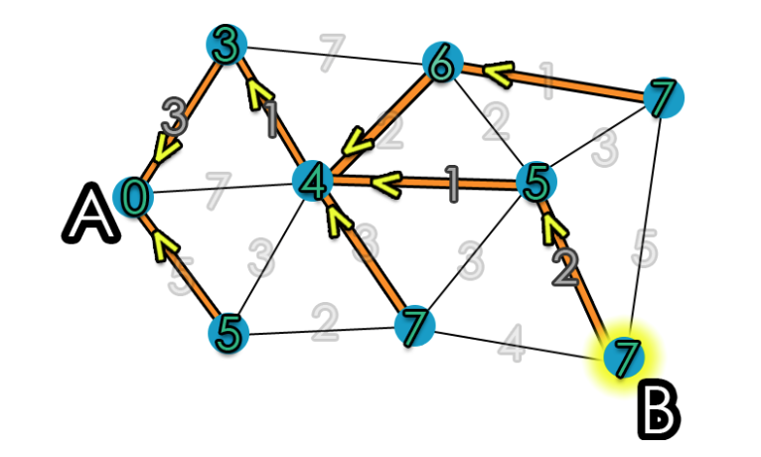
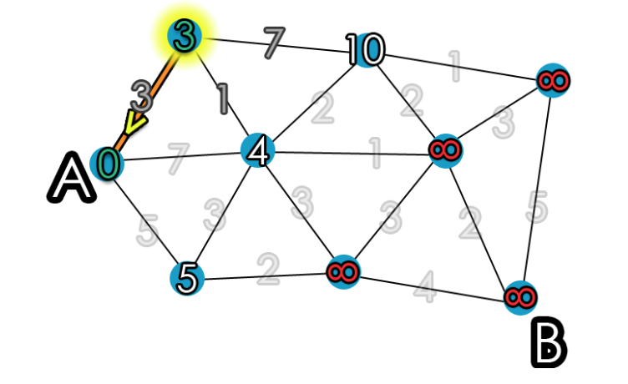
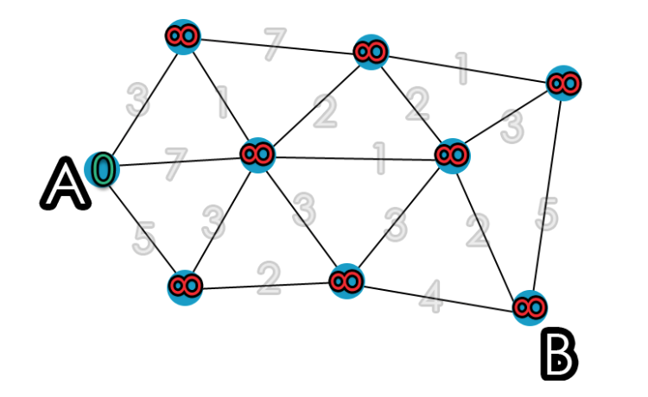
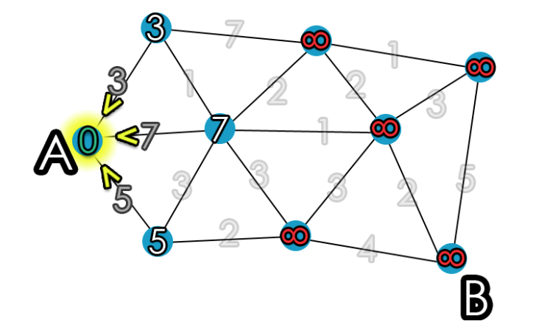
Animation of Dijkstra

Slide 20
Larger Animation
Simple physical analogy
Think of the propagation of a forest fire
Animation from Wikipedia
https://upload.wikimedia.org/wikipedia/commons/2/23/Dijkstras_progress_animation.gif

Slide 21
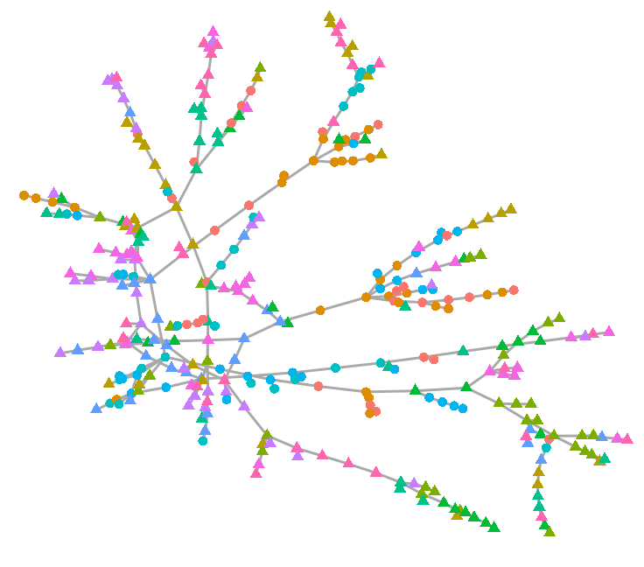
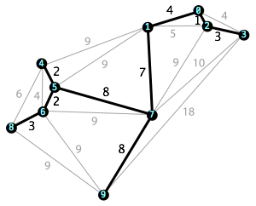
Minimum Spanning Tree
A subset of the edges of a connected, (edge-weighted) undirected graph connecting all vertices together, without cycles (with the minimum possible total edge weight)
Various algorithms, and even more applications
Simplest is Kruskal’s “greedy” algorithm

Slide 22
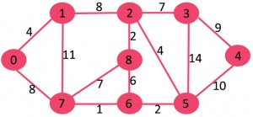
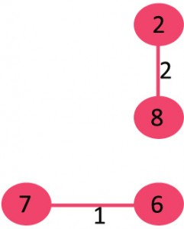
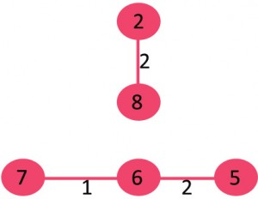
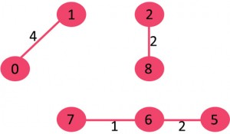
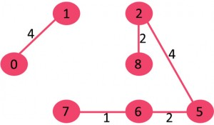
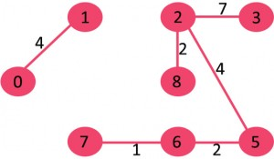
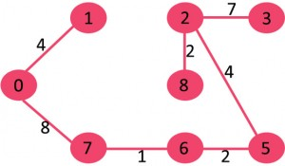
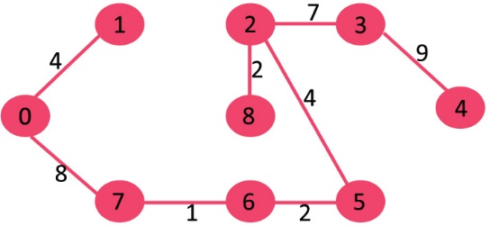
Greedy: Step By Step
1. Pick 7-6
2. Next 8-2, no cycle
3. Pick 6-5, no cycle
4. Pick 0-1, no cycle
5. Pick 2-5, no cycle
6. Pick 8-6, cycle, drop
7. Pick 2-3, no cycle
8. Pick 8-7, cycle, drop
9. Pick 0-7, no cycle
11. Pick 3-4, no cycle
10. Pick 1,2, cycle, drop
From GeeksforGeeks

Slide 23
Summary
Graph properties, nodes/edges
Connectivity
History
Degree of a node
Graph matrices, adjacency, Laplacian
Spectral representations
Spring model
Shortest path
Minimum spanning tree

