Slide 1
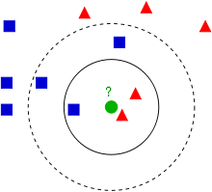
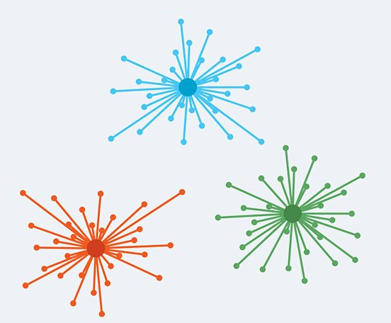
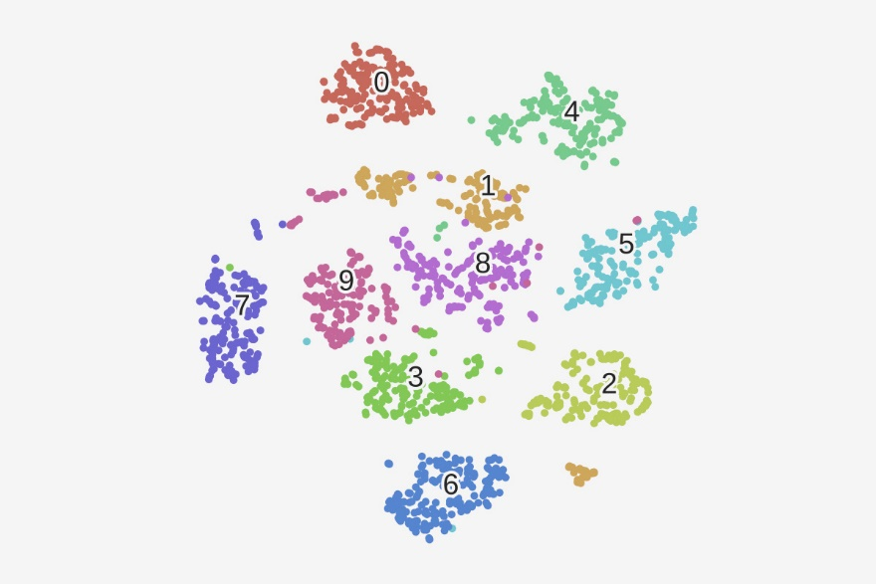
Clustering and Nearest Neighbors
Alex Szalay, JHU

Slide 2
The Curse of Dimensionality
When the dimension of the data becomes large (d>10), everything is different!
E.g. sampling a cube
Take 10 subdivision per dimension
In 3D : 1000 samples, in 10D: 10¹⁰ = 10B
The volume of a d-dimensional hypersphere is
The same for enclosing hypercube is
Their ratio is
The volume of the sphere is insignificant compared to the cube
The distance of the vertices of the cube from the center is
Points in high dimensions are very far apart!
Almost all the points are at the same distance from the center!

Slide 3
Finding Nearest Neighbors
Non-parametric method for regression and classification
k-NN classification: output is a class label
k-NN regression: output is a property value
Decision is based on weighted neighbors
Training:
Store positions and class values of points
Classification:
Query point is assigned the most frequent class (value) of the k nearest neighbors
Majority voting
Sensitive to noise
Good to pick odd k, to avoid ties
Variable kernel size, but always same number of points
Fixed kernel can have no neighbors

Slide 4
Data Preparation
Dimensional reduction => feature extraction
Transform input data into a lower dimensional “feature vector”
Examples:
Principal Component Analysis (PCA)
Wavelet transform
Random projections
Neighbors are found in this feature space

Slide 5
Algorithms
Space partitioning
Approximate nearest neighbors
Greedy search of proximity graphs
Locality sensitive hashing
Projected radial search (use low dimensional projections)
K nearest neighbor search

Slide 6
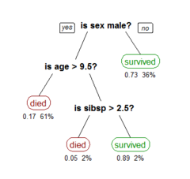
Decision Tree Learning
Classification and Regression Tree (CART)
Training data split by recursive partitioning
Recursion stops when leaves are homogeneous
Advantages
Simple to understand and interpret
Able to handle both numerical and categorical data
Requires little data preparation
Disadvantages
Trees can be very fragile (non-robust) to errors in training data
Easy to generate overly complex trees (overfitting)

Slide 7
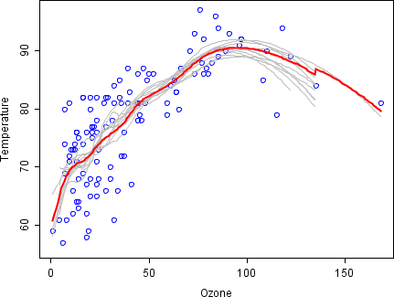
Bootstrap Aggregating
Bootstrap Aggregating (Bagging)
Take training set of size n
Create m subsets of size n’ with replacement
This will create duplicates and missing points in each subsample
Then m models are fitted and results averaged
Bad data points in the training set are “missing” in some samples
Their effect will cause “bad” model fits to be outliers
Results are much more robust
Example:
100 bootstrap samples, polynomial smoother in moving window
Red line is the average of the fits

Slide 8
Random Forest
Invented by Tin Kam Ho, Leo Berman and Adele Cutler
Generalization of Decision Trees
Idea:
Create random subsamples of training data (bagging)
Build a randomized partitioning tree for each
Alternate splits between dimensions randomly
Continue until there is approximately d+1 points at the leaf nodes
Union of trees is a “forest”
Query:
Find leaf node containing Q in each tree, and use neighbors to predict
Result is a probability distribution
Different ways to get a single number: mean, median, mode
Provides an unbiased estimator (mean of the difference over the training set is zero)
An example of “Ensemble Learning”

Slide 9
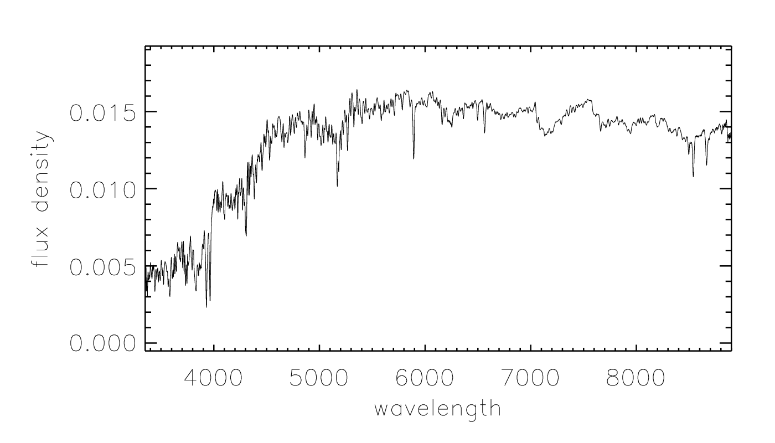
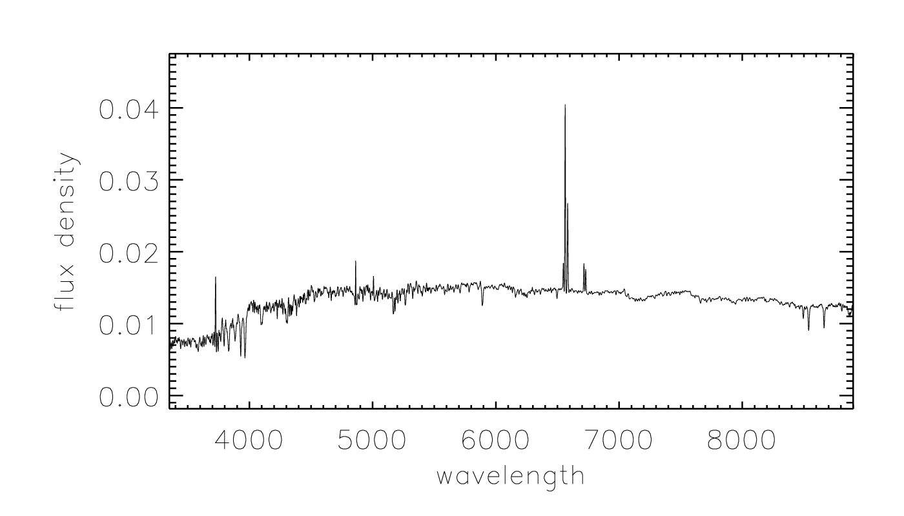
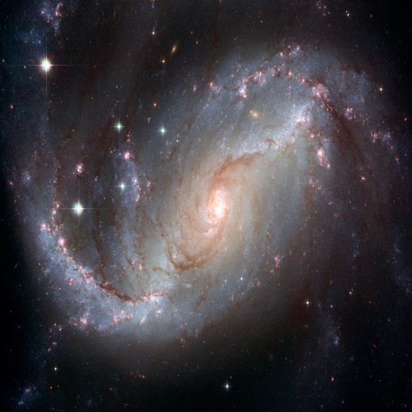
Galaxy Properties from Galaxy Spectra
Spectral Lines
Continuum Emissions

Slide 10
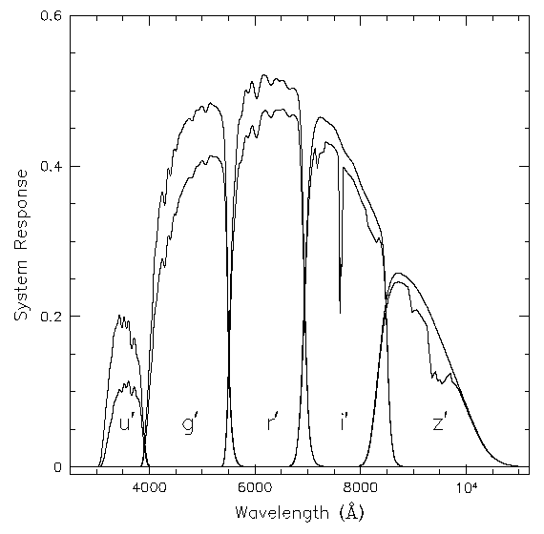
The Photometric Survey
Continuous data rate of 8 Mbytes/sec
Northern Galactic Cap
drift scan of 10,000 square degrees
5 broad-band filters
exposure time: 55 sec
pixel size: 0.4 arcsec astrometry: 60 mas
calibration: 2% at r'=19.8
done only in best seeing (20 nights/year)
Southern Galactic Cap
multiple scans (> 30 times) of the same stripe
u‘ g' r‘ i ' z’
22.3 23.3 23.1 22.3 20.8

Slide 11
Photometric Redshifts
There are spectra for about 1M galaxies in SDSS (90% of time)
There are 500M galaxies in SDSS with 5-band images (10%)
Use these as a 5-band spectrum!
Training set is the 1M SDSS galaxies with spectra
Ground truth about redshift is from the spectrum
Applied to 128M SDSS galaxies
Soon billions from LSST

Slide 12
Photometric Redshifts
Phenomenological (PolyFit, ANNz, kNN, Random Forest)
Simple, quite accurate, fairly robust
Little physical insight, difficult to extrapolate, Malmquist
Template-based (KL, HyperZ…)
Simple, physical model
Calibrations, templates, issues with accuracy
Hybrid (‘base learner’)
Physical basis, adaptive
Complicated, compute intensive
Important for next generation surveys!
We must understand the errors!
Most errors systematic…
Lessons from Netflix challenge…

Slide 13
Photometric Redshifts
Galaxies in SDSS have 5-band images
Use these as a 5-band spectrum
From a training set create regression trees
Random Forest algorithm (Leo Berman):
Use many tree-based regression estimators (50 here)
Average of the tree estimators is the forest estimator
Gaussian errors!!!
Extremely robust
Training set 500K SDSS galaxies with spectra
Applied to 128M SDSS galaxies
Soon billions from LSST

Slide 14
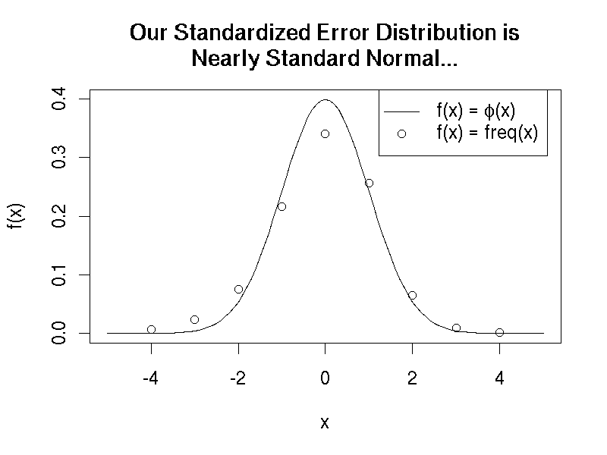
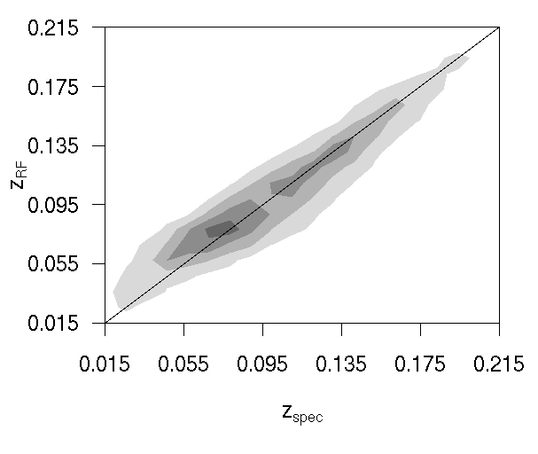
Zspec vs Zrf
Carliles et al 2009

Slide 15
Why Does it Work?
Robustness:
There are always bad points in the training set
Through the random sampling (~50%) these only make it into half of the neighborhoods
Whenever a bad point is there, estimator is on the tail
Whenever bad point is missing, Gaussian
Gaussianity:
Through the sampling and averaging, we are creating a new random variable with much better statistical properties than the original estimates with a high skewness and kurtosis
Central Limit Theorem at work
The main question is, how are we approaching the asymptotic limit?

Slide 16
Why are the RF Errors Gaussian?
The Random Forest technique approximates a kernel density estimator based integration over the training set
The convergence primarily depends on the size of the kernel, i.e. the sampling rate
There has to be an optimum bandwidth (sampling rate), possibly variable over our photo-z domain to minimize the MSE

Slide 17
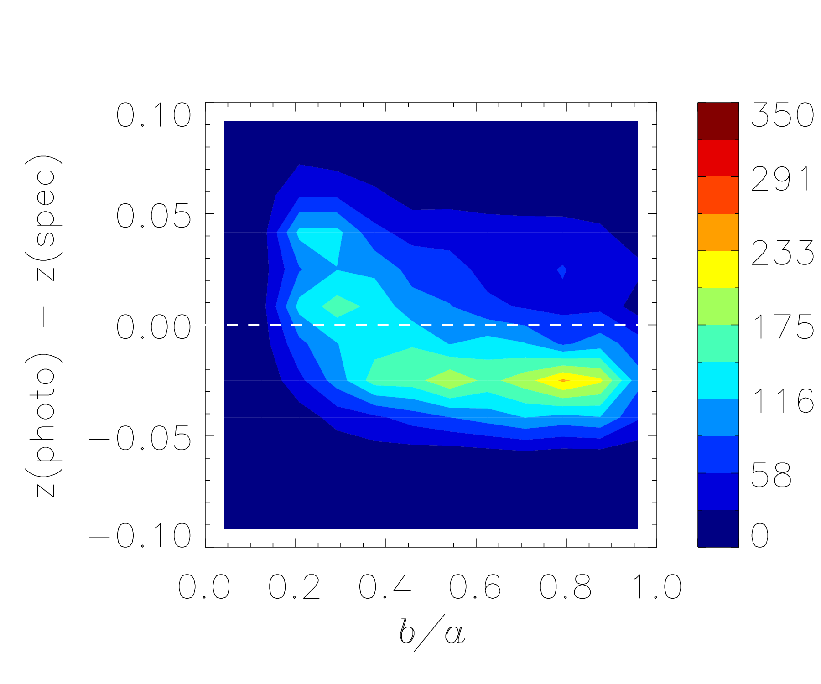
Photo-z Bias vs. Galaxy Inclination
Edge-on galaxies are redder, mimic higher redshift galaxies
SDSS disk galaxies, Δz = 0.05-0.075, a 30% effect!
Photo-z bias is -0.02 for face-on galaxies
Once axial ratio is included in training, the bias goes away
C-W Yip et al. 2011

Slide 18
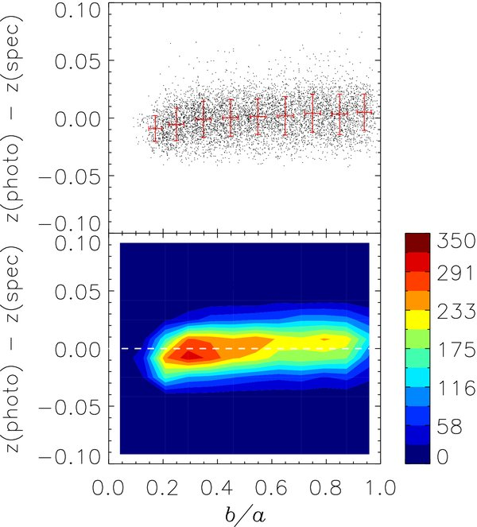
Including a/b ratio
Once axial ratio is included in training, the bias goes away
C-W Yip et al. 2011

Slide 19
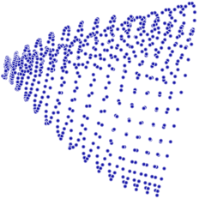
Non-linear Dimensional Reduction
Low dimnensional embeddings
Examples so far
PCA, random projections
Similarity graph Laplacian embedding
Original
PCA
NLDR

Slide 20
Locally Linear Embedding
Reconstruct the original high-dimensional data using lower-dimensional points while maintaining geometric properties of the neighborhoods in the original data
Determine the neighbors of each point.
K nearest neighbors.
Construct a neighborhood graph.
Each point is connected to other if it is a K nearest neighbor.
Edge length equal to Euclidean distance.
Compute shortest path between two nodes
Compute lower-dimensional embedding

Slide 21
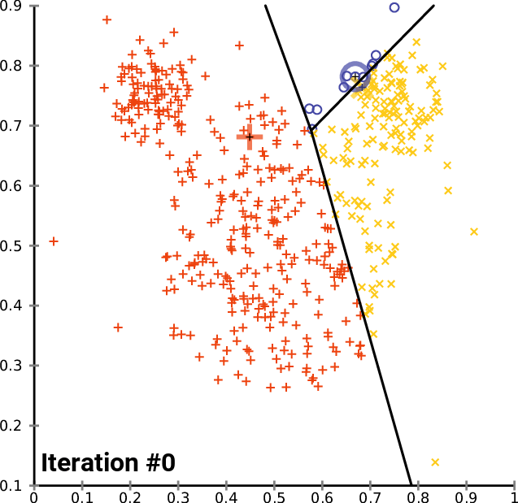
K-means Clustering
“Vector quantization”
Partition n observations into k clusters in which each observation belongs to the cluster with the nearest mean
Given an initial set of k means m₁⁽¹⁾,...,m_{k}⁽¹⁾ (see below), the algorithm proceeds by alternating between two steps
Assign each observation to the cluster with the nearest mean: that with the least squared Euclidean distance (partition the observations by the Voronoi diagram
\generated by the means)
Update means for observations assigned to each cluster
The algorithm has converged when the assignments no longer change

Slide 22
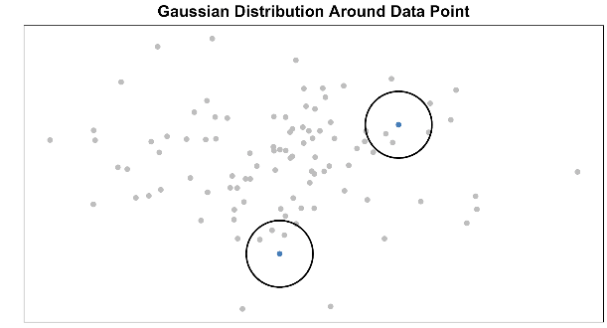
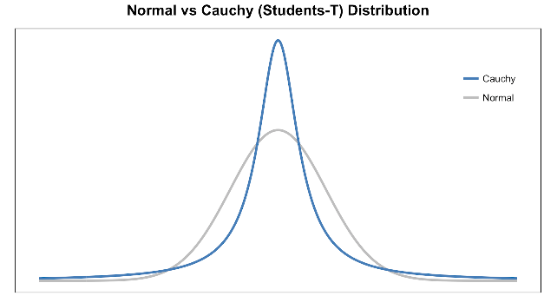
T-SNE
T-distributed Stochastic Neighbor Embedding
Select a low-dimensional subset of the feature space (PCA)
Measure similarities in high-dimensions with Gaussian kernel
Use a Cauchy (t) kernel to define neighborhoods in the low-dimensional space
If two points are close in lowD, but far away in highD, repulse
If points are close in both, attract
Use mutual information (entropy) as the cost function

Slide 23
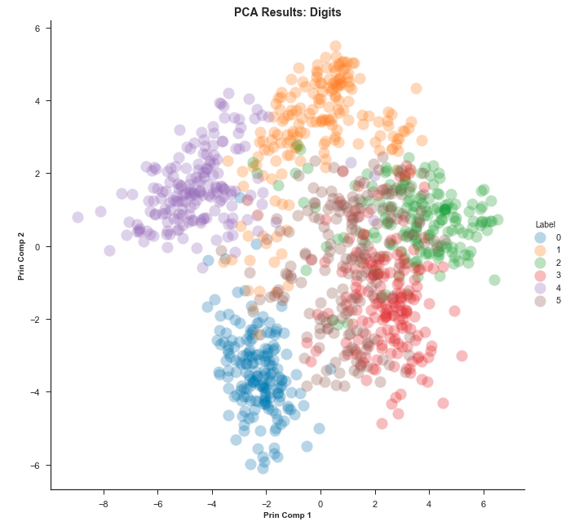
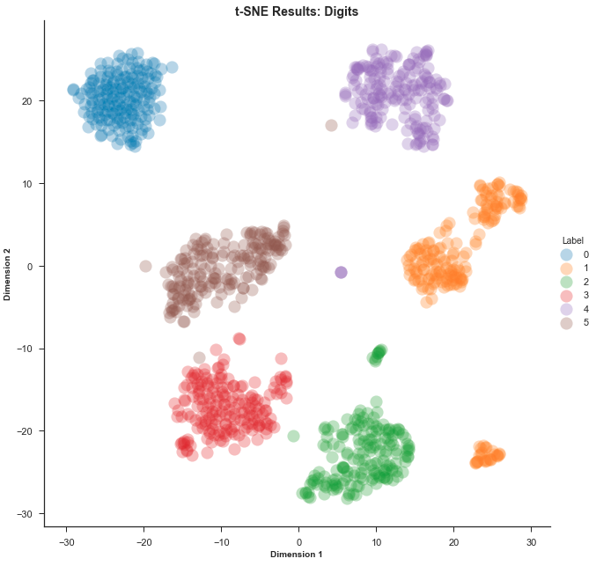
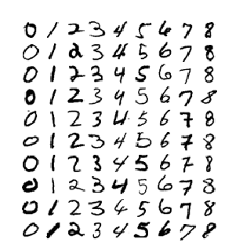
Compare t-SNE to PCA

Slide 24
UMAP
t-SNE does not scale well
Only works well in 2-3 projection dimensions (only good for viz)
UMAP uses exponential probabilities in the high dimensions
Effective number of nearest neighbors
UMAP uses binary cross-entropy (CE) as a cost function instead of the KL-divergence like t-SNE does
UMAP assigns initial low-dimensional coordinates using Graph Laplacian
ρ_{i} is the distance to the nearest neighbor

Slide 25
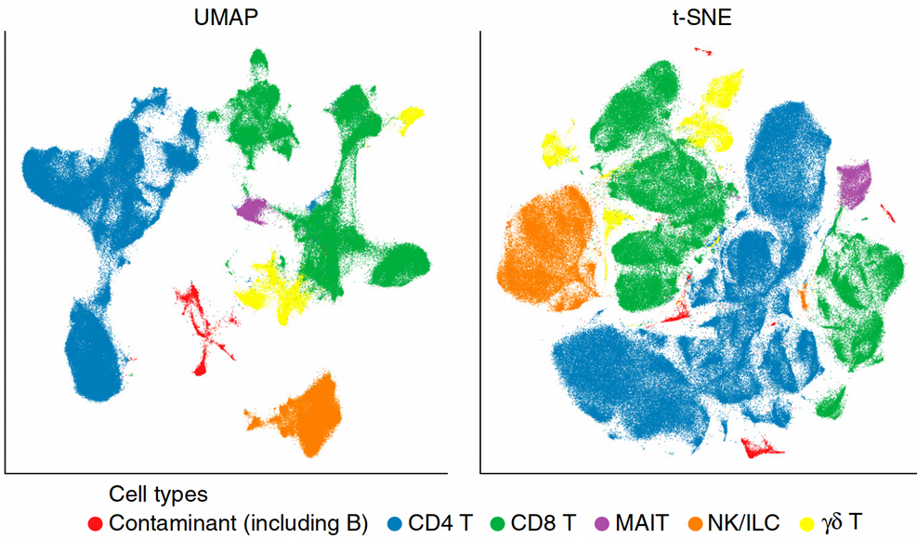
UMAP vs t-SNE

Slide 26
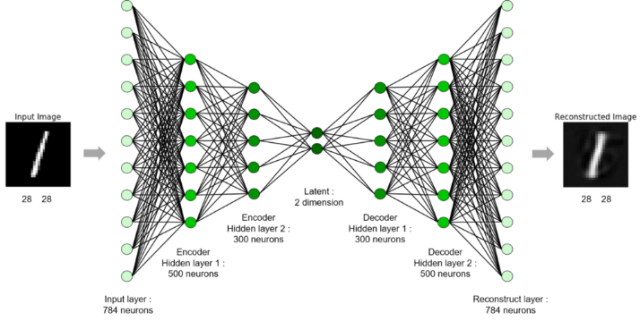
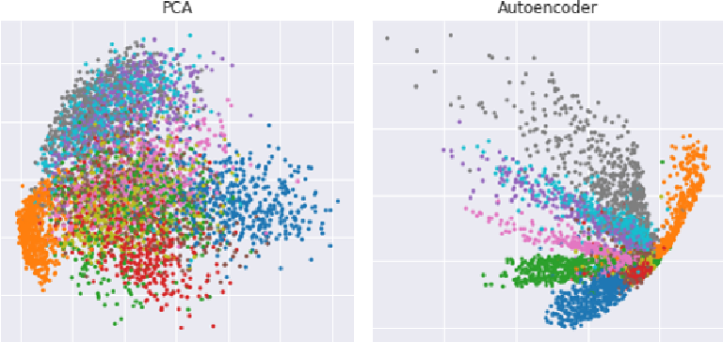
Autoencoder
Convolutional neural net for dimensional reduction
Three parts: encoder, latent layer, decoder
The narrow cross section is the latent
Number of nodes is the dimensionality
Output is trained to reproduce input

Slide 27
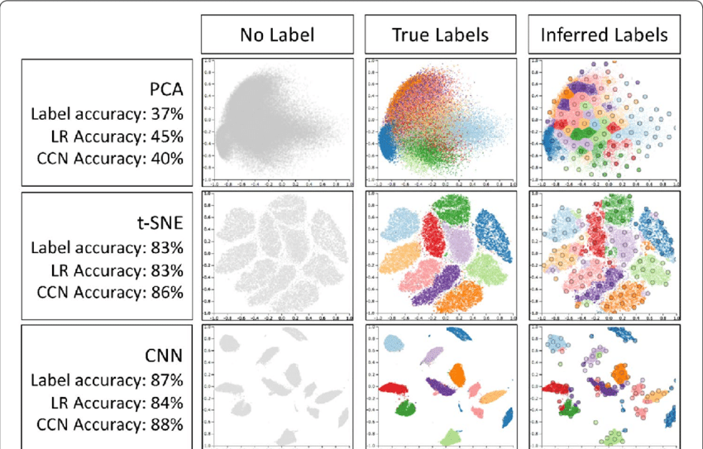
Comparison

