Slide 1
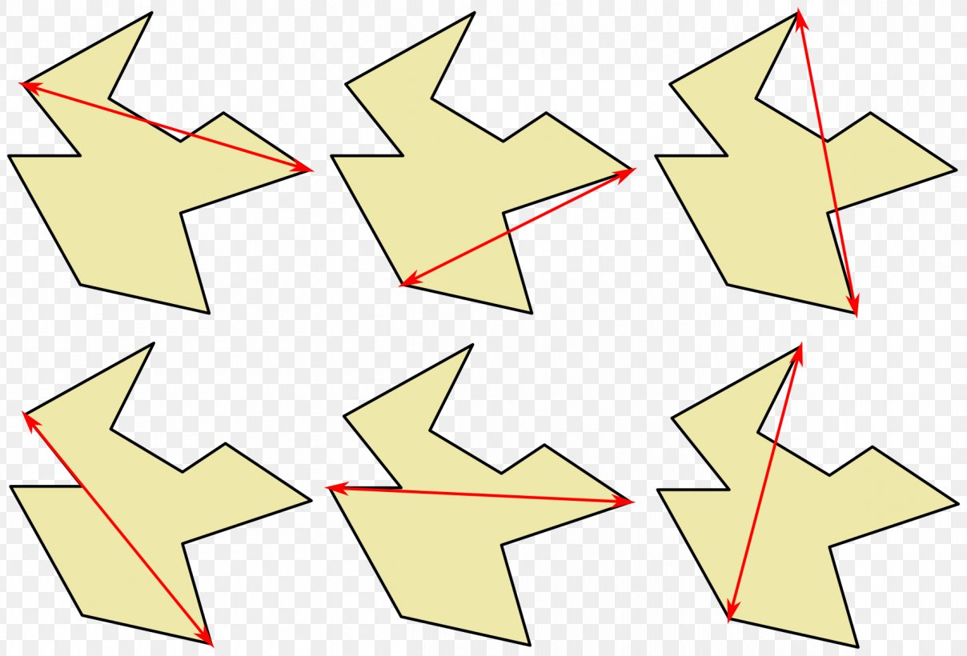
Computational Geometry
Alex Szalay, JHU

Slide 2
What is Computational Geometry?
Distribution of geometric objects in space (2D/3D)
Space partitioning
  Partitioning trees
  Voronoi tessellation
  Delauney triangulation
  Convex hull
  Alpha shapes
  Polygon triangulation
Geometric queries
  Spatial relations
  Nearest neighbor problem
  Spatial searches
  Collision detection
  Ray tracing
Relevance in:
Computer graphics
Computer games
Robotics
Computer vision
Computational topology

Slide 3

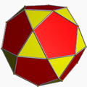
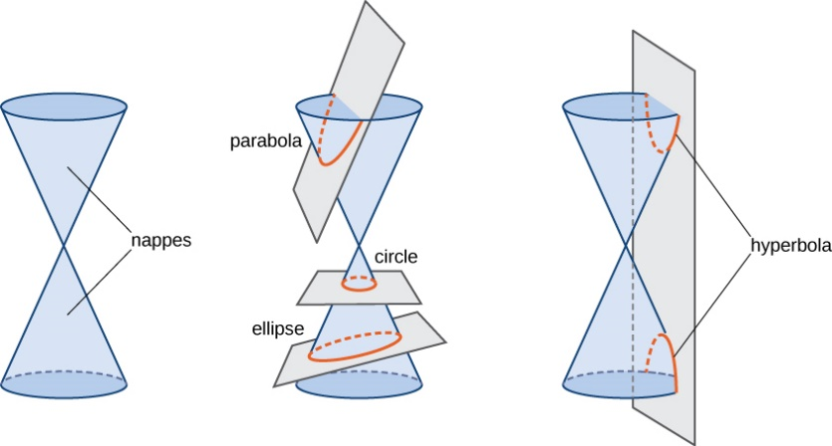
Elements of CG
Basic geometric objects
  Point
  Line, line segment
  Polygons
  Polyhedra
  Higher order surfaces
    circles, ellipses, parabolas, hyperbolas
    Spheres, ellipsoids, conical segments

Slide 4
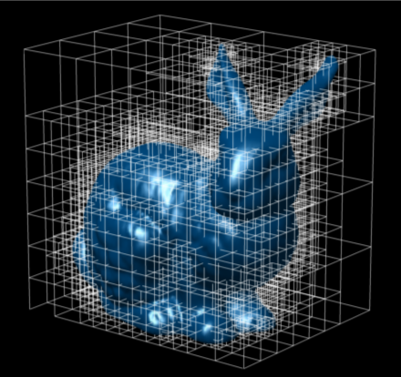
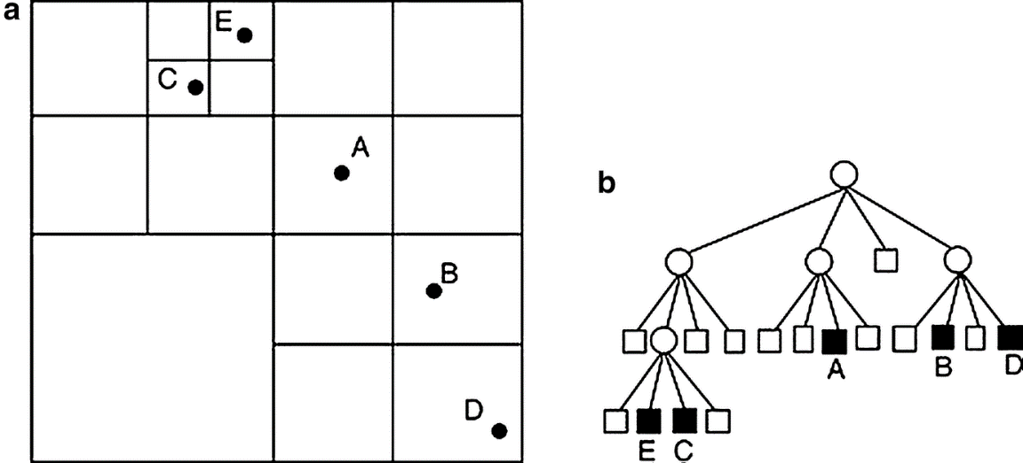
Space Partitioning
Divides space into non-overlapping regions
Any point in space is in exactly one of the regions
Space partitioning is often hierarchical
Space partitioning trees
  Quad/Octrees
  K-d trees
  Binary Space Partitioning (BSP) trees

Slide 5
k-d Tree
Tree to organize data in k-dimensional space
Useful for searches in multidimensional space
Discovered by Jon Bentley (1975)
Each non-leaf node is an axis-parallel hyperplane
Binary splits alternate among the axes

Slide 6
Construction
Each level has a “cutting dimension”
Each node contains a point
Only compare in the “cutting dimension”

Slide 7
Nearest Neighbor Search
Find the point on the tree closest to query point Q
But: nearest point is space to Q may be far away on the tree
We have to search the whole tree

Slide 8
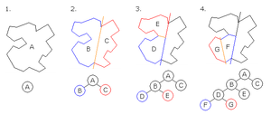
Binary Space Partitioning
Recursively subdivide space into two parts
Used in computer graphics for front-to-back detections

Slide 9
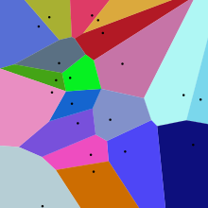
Voronoi Tessellation
Partition plane into regions closest to a
set of points (seeds)

Slide 10



Fortune’s Algorithm
Fortune’s algorithm
Sweep-line and a beach-line (d=y)
Beech-line is equidistant from the sweep line and a point
Beech-line is a parabola!
When two parabolas intersect, they
become part of the edges
$$d^{2}=x^{2}+{\left(a−y\right)}^{2}=y^{2}$$
y
$$x^{2}+a^{2}−2ay=0$$
d
x
a
$$y=\frac{x^{2}+a^{2}}{2a}$$

Slide 11
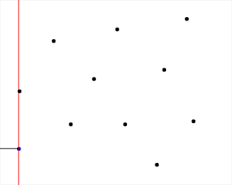
Animation

Slide 12
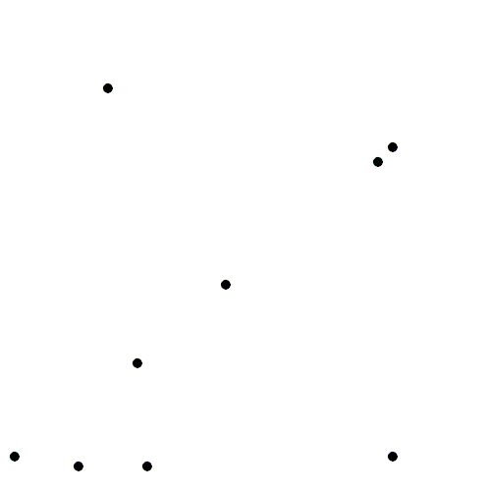
Seed Growing Algorithm

Slide 13
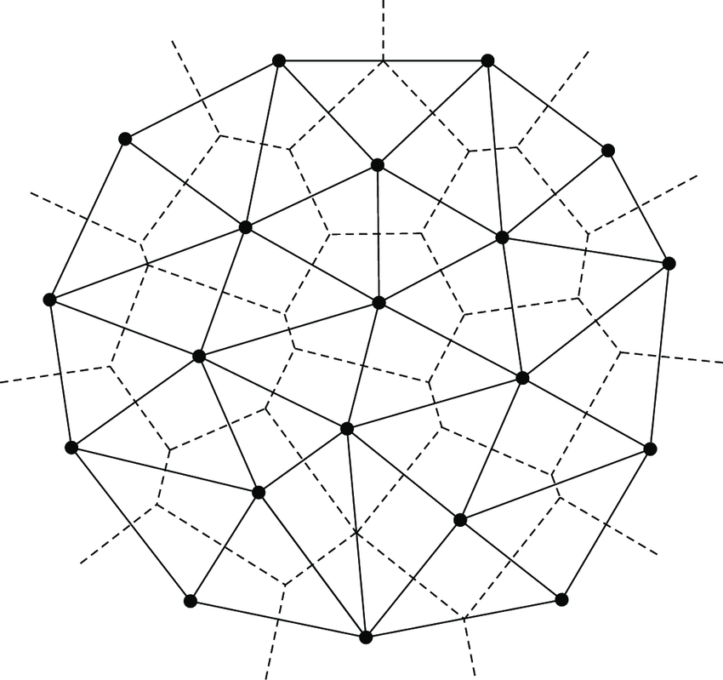
Delauney Triangulation
Dual of the Voronoi Tessellation
Optimal triangulation of the Voronoi seeds
Each vertex on the edges of the VT has three incoming edges
These vertices are centers of
the circumcircles of the DT
Each circle defines a triangle
Special:
  Maximizes the minimum angle
  Least elongated triangles

Slide 14
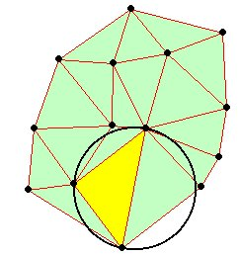
Interpolation
Create Delaunay triangulation
Find points to get interpolated values
Find enclosing triangle
Compute barycentric weights
Use these to interpolate the function
x = w_{a} a+w_{b} b + w_{c} c
F(x) = w_{a} F(a)+w_{b} F(b) + w_{c} F©

Slide 15
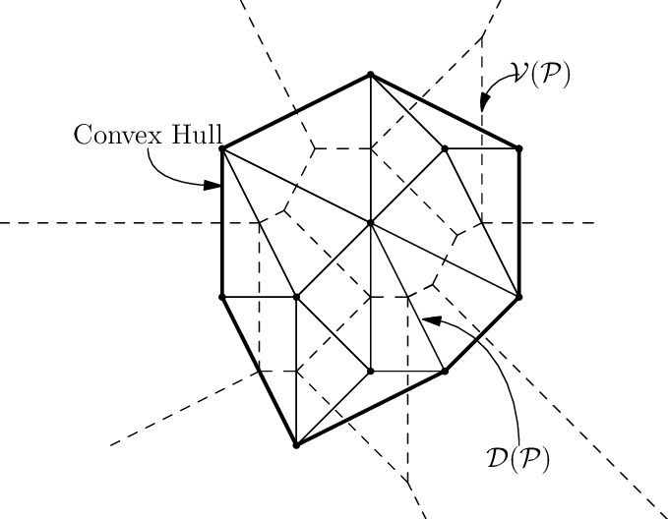
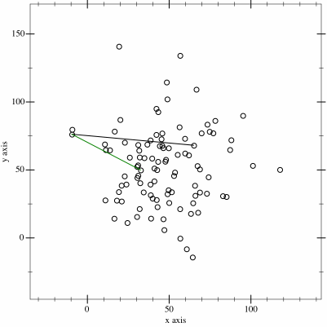
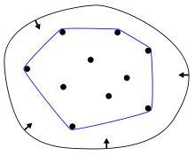
Convex Hull
The union of the Delauney triangles
Rubber-band analogy
The smallest convex set that contains
all the points
Gift-wrapping algorithm (find leftmost point)
Animation by Maonus, Own work, CC BY-SA 4.0

Slide 16
Simple Geometric Explanation

Slide 17
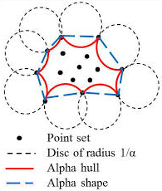
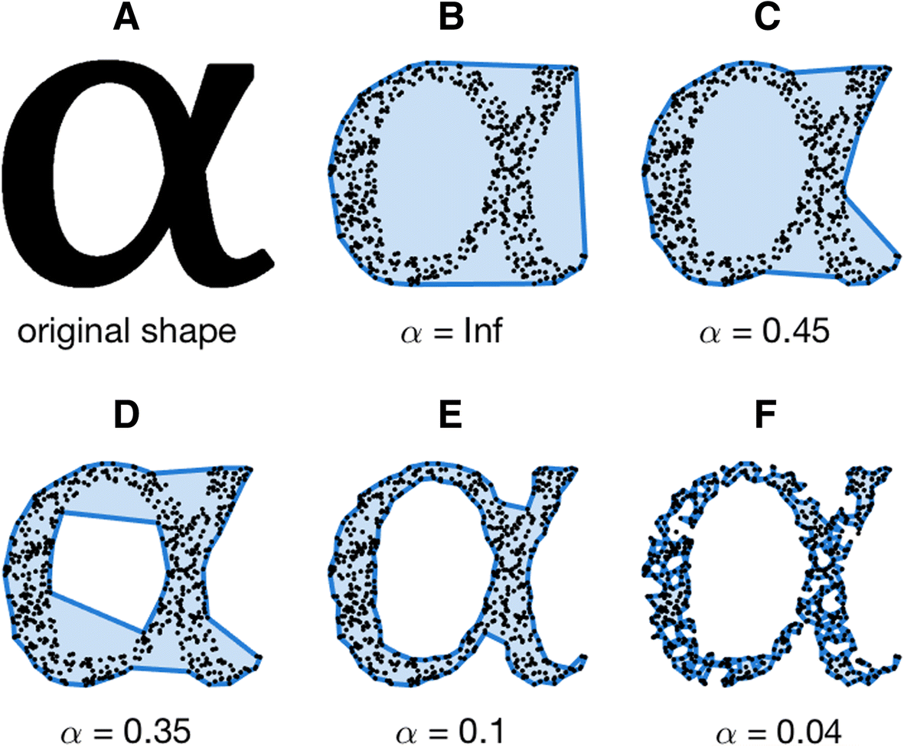


Alpha Hull, Alpha Shape
We would like a finer tracing of point cloud outlines
H. Edelsbrunner – Alpha Hull
Genereralization of convex hull
Convex hull is
$$α=∞$$
$$α$$

Slide 18
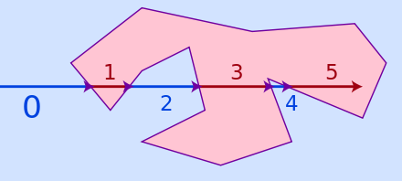
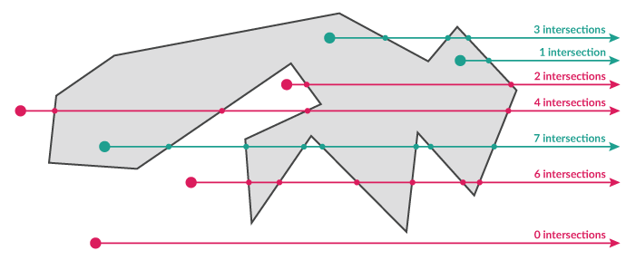
Point in Polygon Query
How to determine if a point is inside our outside a polygon?
Draw an arbitrary half-line, and count the number of inter-sections with the boundary
  Odd: inside
  Even: outside

Slide 19
Closest Pair Problem
Given n points in d dimensions, find two whose mutual distance is smallest
1D problem can be solved by sorting, but this does not generalize to higher dimensions
Divide and conquer algorithm
Split points at the median, so that all p<q
Recursively compute closest pair in S1 and S2, separated by δ
Following S. Suri (UCB)

Slide 20
Divide and Conquer
Closest is (p1,p2) or (q1,q2) or (p3,q3)
If m is the dividing coordinate, then p3,q3 must be within δ
There can only be at most one point in S1. Same for S2!
Following S. Suri (UCB)

Slide 21
In Higher Dimensions
Set δ = min(δ₁, δ₂)
At the boundary at most 6 comparisons
Following S. Suri (UCB)

Slide 22
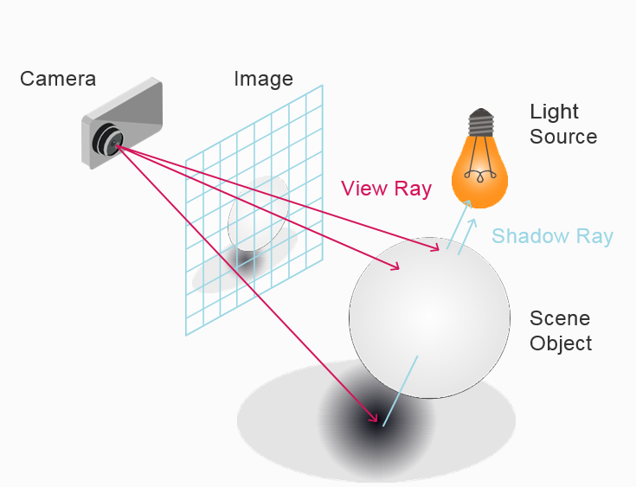
Ray Tracing
A rendering technique for generating an image by tracing rays of light onto an image plane
Simulate the effects of its encounters with virtual objects
Heavy use of BSP trees
Various optical properties:
  Diffuse, Reflective, Phong
Refraction (lens) effect
Heavy use of partitioning trees
Much of it in now in hardware

