Slide 1

Database Indexing Techniques
Alex Szalay, JHU

Slide 2
Indexing
The indexing has various attributes:
Access Types: This refers to the type of access such as value based search, range access, etc.
Access Time: It refers to the time needed to find particular data element or set of elements.
Insertion Time: It refers to the time taken to find the appropriate space and insert a new data.
Deletion Time: Time taken to find an item and delete it as well as update the index structure.
Space Overhead: It refers to the additional space required by the index

Slide 3
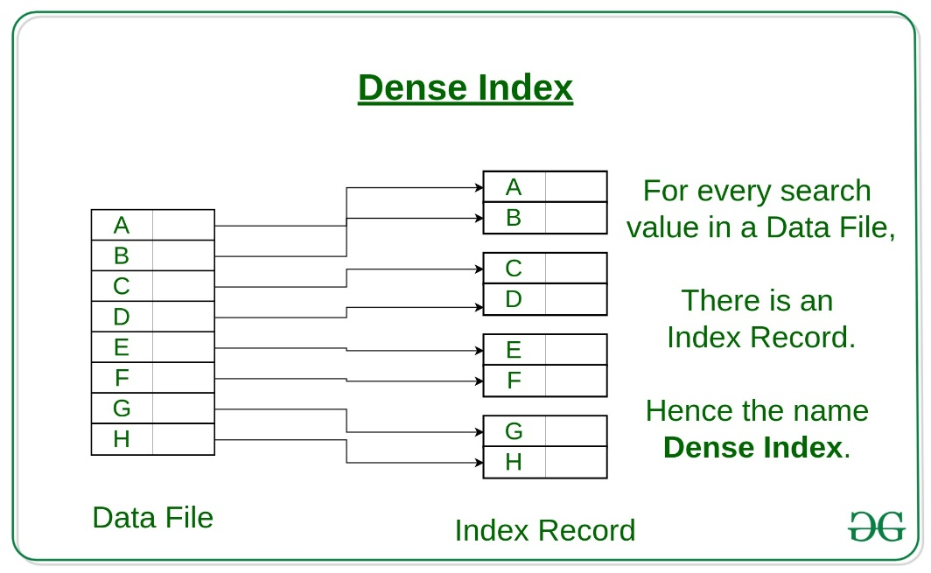
Ordered Dense Index
Sequential File Organization or Ordered Index File
Based on a sorted ordering of the values
  For every search key in the data file, there is an index record.
  This record contains the search key and also a reference to the first data record with that search key value.
https://www.geeksforgeeks.org/

Slide 4
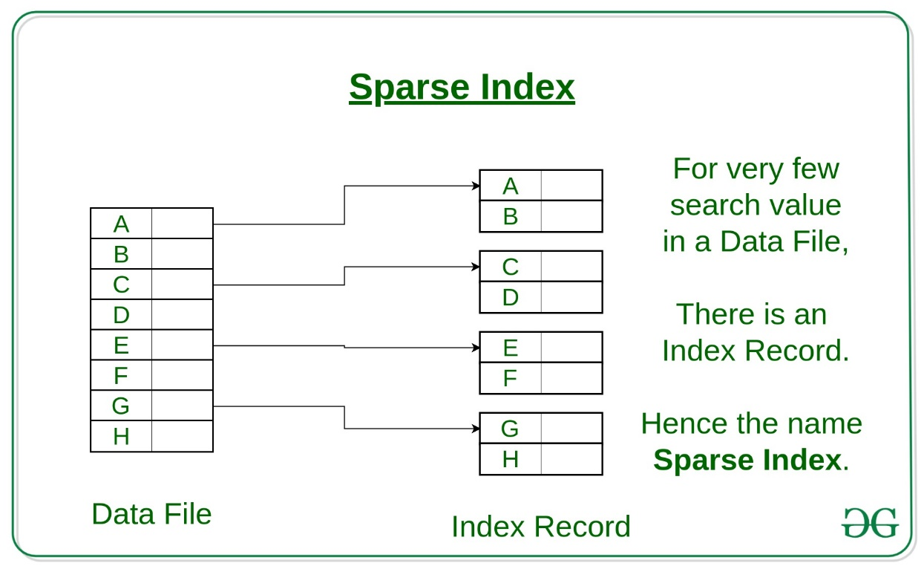
Sparse Index
Data is saved in sequential order, but stored in blocks on the disk
We build an index on the first record in every block
We can quickly find the block containing the data
https://www.geeksforgeeks.org/

Slide 5
Indexing Methods
There are primarily three methods of indexing:
  Clustered Indexing
  Non-Clustered or Secondary Indexing
  Multilevel (hierarchical) Indexing
Searches are performed using search trees

Slide 6
Clustering Index
Clustering index is defined on an ordered data file. The data file can be ordered on a non-key field.
Multiple records related to the same thing are stored at one place
In some cases, the index is created on non-primary key columns which may not be unique for each record.
In such cases, in order to identify the records faster, we will group two or more columns together to get the unique values and create index out of them. This method is known as the clustering index.

Slide 7
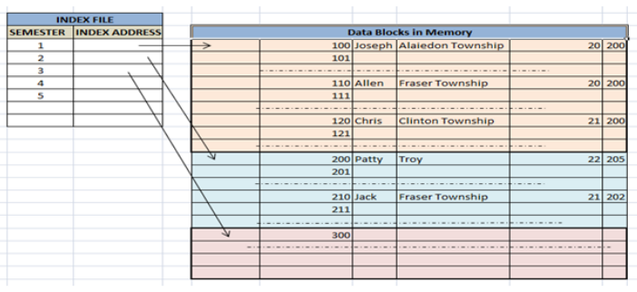

Slide 8
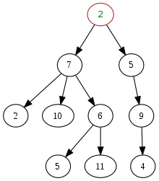
Tree Structures
A tree is a data type that simulates a hierarchical tree structure
A tree consists of a set of nodes linked with edges
  Root
  Subtrees of children
  Parent node
  Leaf nodes
Each node is a data structure
consisting of a value and pointers

Slide 9



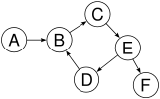

Which of this is a Tree?

Slide 10
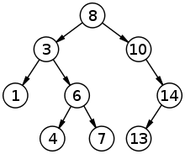
Search Trees
A search tree is a tree data structure used for locating specific keys from within a set.
In order for a tree to function as a search tree, the key for each node must be greater than any keys in subtrees on the left, and less than any keys in subtrees on the right
Binary search tree:
  each node contains a key and two subtrees
  the left subtree's key must be less than the node's key
  the right subtree's key must be greater than the node's key
  The worst-case time complexity for searching a binary
  search tree is the height of the tree, O(log n)
  for a tree with n elements

Slide 11
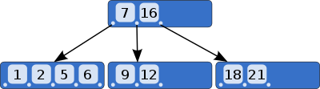


B-trees
B-tree is a self-balancing tree data structure that maintains sorted data and allows searches, sequential access, insertions, and deletions in logarithmic time.
Allows for nodes with more than two children
According to Knuth's definition, a B-tree of order m is a tree which satisfies the following properties:
  Every node has at most m children.
  Every non-leaf node (except root) has at least ⌈m/2⌉ child nodes.
  The root has at least two children if it is not a leaf node.
  A non-leaf node with k children contains k − 1 keys.
  All leaves appear in the same level and carry no information.
Rudolf Bayer and Edward M.McCreight

Slide 12
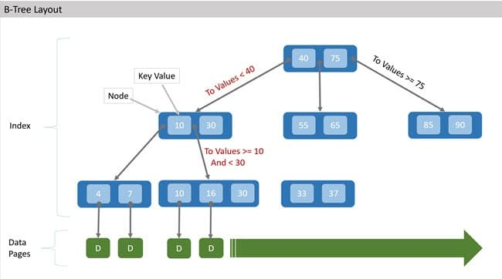
B-tree search
Look for the value with key=20

Slide 13
Access Patterns
Sequential scan
Range query
Bookmark lookup
select * from censusData
select * from censusData
where population between 100000 and 1000000
select * from censusData
where state=‘Maryland’
and county=‘Baltimore City’
How do we do multidimensional searches?

Slide 14
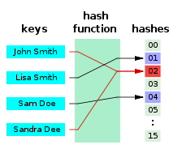
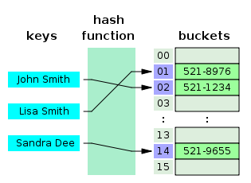
Hash Functions
Used to map data of arbitrary size to fixed-size values
The values returned by a hash function are called hash values,
The values are used to index a fixed-size hash table
Use of a hash function to index a hash table is called hashing
A hash function performs three functions:
  Convert variable length keys into fixed length
  Scramble the bits of the key so that the
  resulting values are uniformly distributed
  The hash should be smaller than the data
Hash tables
  Consist of hash buckets
  Cost for each lookup is independent
  of the number of elements stored in the table!

Slide 15
Properties of Hash Functions
Uniformity
  A good hash function should map the expected inputs as evenly as possible over its output range
  A small number of collisions is virtually inevitable
Efficiency
  The hash function be computable with minimum latency and in a minimum number of instructions
Universality
  The probability of a collision of any two distinct keys is 1/m, where m is the number of distinct hash values desired—independently of the two keys
Deterministic
  for a given input value it must always generate the same hash value

Slide 16
Birthday Problem (Hash Collisions)
Compute the approximate probability P(A) that in a group of n people at least two have the same birthday
Instead, get the probability that no two people in the room have the same birthday P(A’)=1-P(A)
Common wisdom is that n=23 gives P(A)=0.5

Slide 17
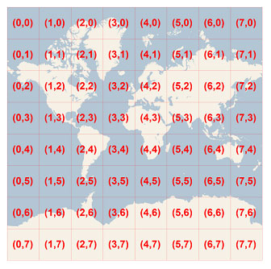
Geometric Hashing
Example: create 2D grid, convert (x,y)-> h=x+(N)*y
This is uniform spatially, but no guarantee that data will
be uniformly balanced (oceans)
Hierarchical hashing

Slide 18
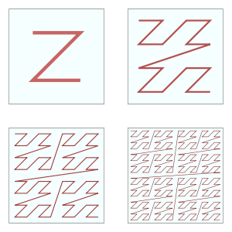
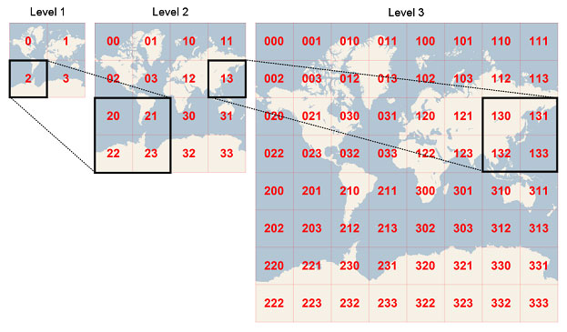
Hierarchical Hashing
Spatial quadtrees: each bucket has 4 children
Morton z-index
Space-filling curves

Slide 19
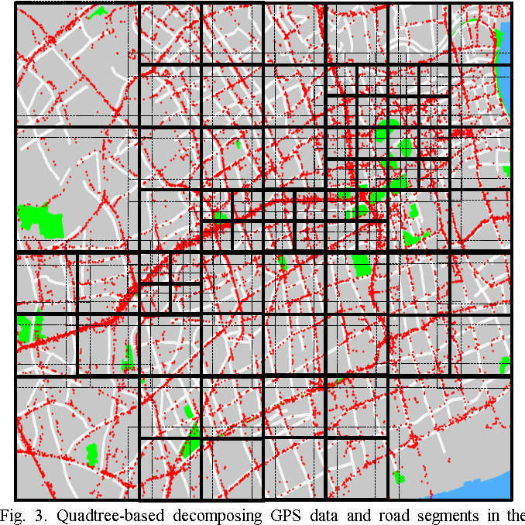
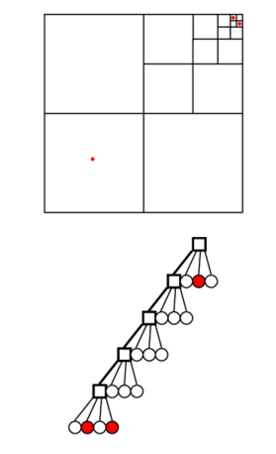
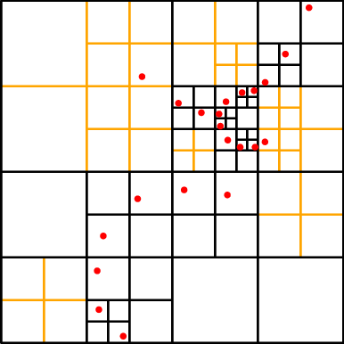
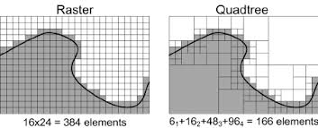
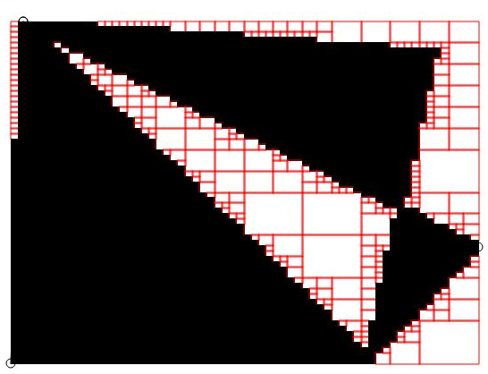
Quadtree Examples

Slide 20
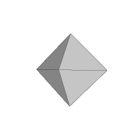
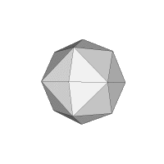
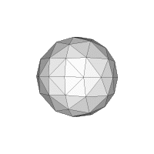
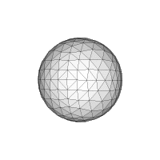
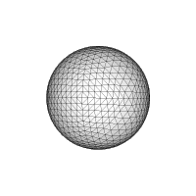
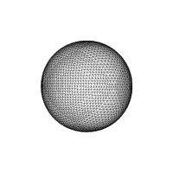
Hierarchical Triangular Mesh
Cover the sky with hierarchical pixels
COBE – start with a cube
Hierarchical Triangular Mesh (HTM) uses trixels
  Samet
Start with an octahedron, and
split each triangle into 4 children,
down to 20 levels deep
Smallest triangles are 0.3”
Each trixel has a unique htmID
2,3,0
2,3,0
2,0
2,3,0
2,0
2,0
2,3,1
2,3,1
2,3,1
2,3,2
2,3,2
2,3,2
2,3,3
2,3,3
2,3,3
2,1
2,1
2,1
2,2
2,2
2,2
2,3
2,3
2,3

Slide 21
Writing Spatial SQL
User Defined Function fHtmCover(@area) gives a list of hierachical hash buckets
Each bucket is represented as a range of hash keys
Translated to a union of range queries over all buckets
included in the query
-- region description is given by @area
INSERT @Objects
SELECT o.ra, o.dec, 1 as flag, o.objid
FROM (SELECT specobjID as objid, cx,cy,cz,ra,[dec]
FROM SpecObjAll q JOIN dbo.fHtmCover(@area) AS c
ON q.htmID between c.HtmIdStart and c.HtmIdEnd
) AS o
WHERE NOT EXISTS (
SELECT convexID
FROM @region AS p
WHERE (o.cx*p.x + o.cy*p.y + o.cz*p.z < p.c)
GROUP BY convexID
)

