Slide 1
Introduction to Databases
Alex Szalay, JHU

Slide 2
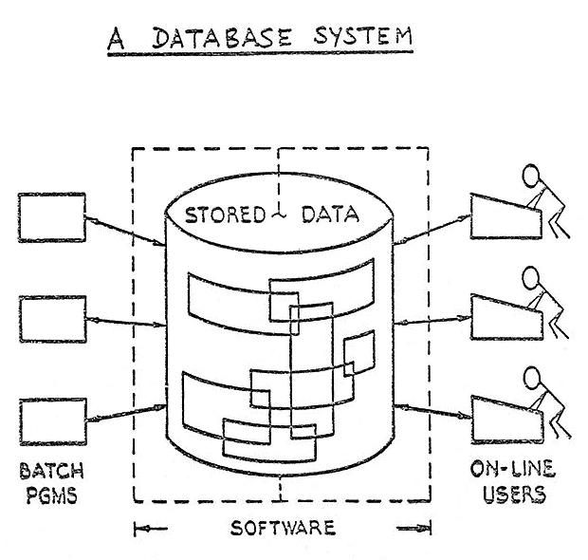
History
The modern relational database was invented by Ted Codd around 1970 at the IBM Almaden Research Center
Present the data to the users as relations (tables)
Provide relational operators to manage the system
Most relational databases use SQL
Structured Query Language
They implement a formal relational algebra

Slide 3
Codd’s 12 Rules
0. The foundation rule
The information rule
The guaranteed access rule
Systematic treatment of null
Dynamic online catalog
The comprehensive data sublanguage rule
6. The view updating rule
7. Insert, update and delete
8. Physical date independence
9. Logical data independence
10. Integrity independence
11. Distribution independence
12. The non-subversion rule

Slide 4
0: The Foundation Rule
For any system that is advertised as, or claimed to be, a relational data base management system, that system must be able to manage data bases entirely through its relational capabilities

Slide 5
1: The Information Rule
All information in a relational database is represented explicitly at the logical level and in exactly one way – by values in tables.

Slide 6
2:The Guaranteed Access Rule
Each and every datum (atomic value) in a relational database is guaranteed to be logically accessible by resorting to a combination of table name, primary key value and column name.

Slide 7
3:Systematic Treatment of null
Null values (distinct from the empty character string or a string of blank characters and distinct from zero or any other number) are supported in fully relational DBMS for representing missing information and inapplicable information in a systematic way, independent of data type.

Slide 8
4: Dynamic Online Catalog Based on the Relational Model
The database description is represented at the logical level in the same way as ordinary data, so that authorized users can apply the same relational language to its interrogation as they apply to the regular data.

Slide 9
5: The Comprehensive Data Sublanguage Rule
A relational system may support several languages and various modes of terminal use (for example, the fill-in-the-blanks mode). However, there must be at least one language whose statements are expressible, per some well-defined syntax, as character strings and that is comprehensive in supporting all of the following items:
Data definition
View definition
Data Manipulation
Integrity constraints
Authorization
Transaction boundaries

Slide 10
11:Distribution Independence
The end-user must not be able to see that the data is distributed over various locations. Users should always get the impression that the data is located at one site only.

Slide 11
Elements of an RDBMS
Relational Data Base Management System
Data is organized into one or more Tables (“relations”) of Columns and Rows
Rows are also called Tuples
Columns are also called Attributes, same datatype
Each table represents one “Entity”
Each row represents a separate Instance
Each column represents a Value corresponding to that instance
Typically each row has its unique key

Slide 12
Example of Table
GEOId | fips | State | County | Population | HousingUnits | TotalArea | WaterArea | LandArea | Popdensity | HouseDensity
0100000US | 12 | Florida | NULL | 18801310 | 8989580 | 65757.7 | 12132.94 | 53624.76 | 350.6 | 167.6
0100000US | 13 | Georgia | NULL | 9687653 | 4088801 | 59425.15 | 1911.67 | 57513.49 | 168.4 | 71.1
0100000US | 15 | Hawaii | NULL | 1360301 | 519508 | 10931.72 | 4509.09 | 6422.63 | 211.8 | 80.9
0100000US | 16 | Idaho | NULL | 1567582 | 667796 | 83568.95 | 925.83 | 82643.12 | 19 | 8.1
0100000US | 17 | Illinois | NULL | 12830632 | 5296715 | 57913.55 | 2394.62 | 55518.93 | 231.1 | 95.4
0100000US | 18 | Indiana | NULL | 6483802 | 2795541 | 36419.55 | 593.44 | 35826.11 | 181 | 78
0100000US | 19 | Iowa | NULL | 3046355 | 1336417 | 56272.81 | 415.68 | 55857.13 | 54.5 | 23.9
0100000US | 20 | Kansas | NULL | 2853118 | 1233215 | 82278.36 | 519.64 | 81758.72 | 34.9 | 15.1
0100000US | 21 | Kentucky | NULL | 4339367 | 1927164 | 40407.8 | 921.46 | 39486.34 | 109.9 | 48.8
0100000US | 22 | Louisiana | NULL | 4533372 | 1964981 | 52378.13 | 9174.23 | 43203.9 | 104.9 | 45.5
0100000US | 23 | Maine | NULL | 1328361 | 721830 | 35379.74 | 4536.82 | 30842.92 | 43.1 | 23.4
0100000US | 24 | Maryland | NULL | 5773552 | 2378814 | 12405.93 | 2698.69 | 9707.24 | 594.8 | 245.1
Primary Key: fips, unique to each row
NULL value: no value exists
Views: partial access to a table

Slide 13
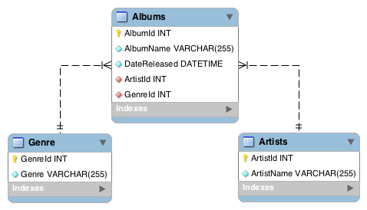
The Database Schema
There is a set of tables, linked to each other by keys
Primary key: unique to a table
Foreign key: pointer to another table

Slide 14
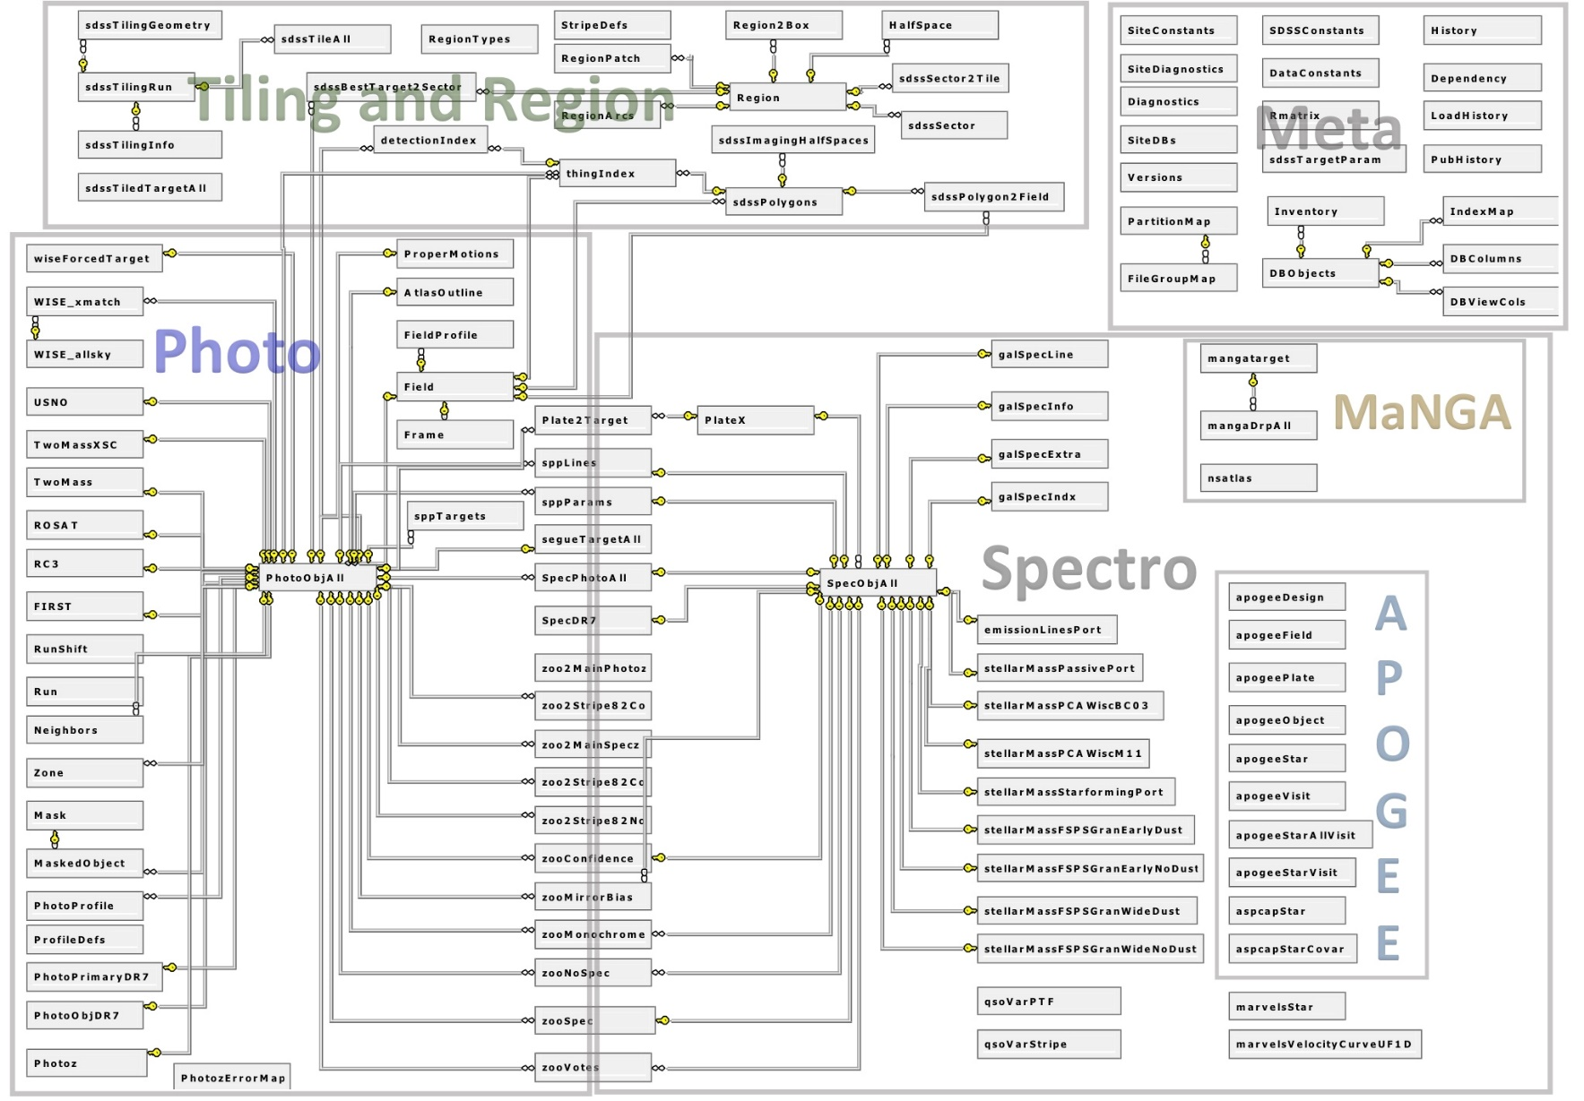
Schemas Can Get Complex

Slide 15
Data Types
Exact
bigint, int, smallint, tinyint, decimal, bit
Floating
float, real
Date and time
date, datetime
Character, string
char, varchar, nchar, nvarchar
Others
geometry, table
User defined…

Slide 16
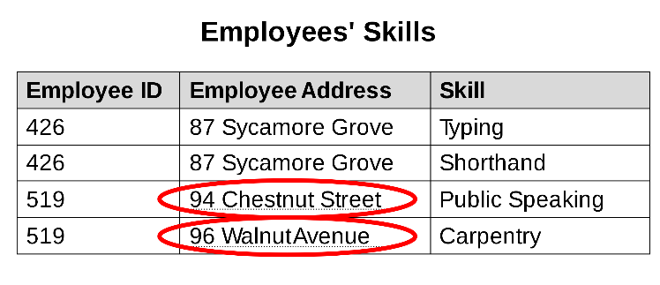
Database Normalization
The same information can be expressed on multiple rows; therefore updates to the relation may result in logical inconsistencies!
Normalization
=> multiple unique tables

Slide 17
Constraints in RDBMS
Part of the schema definition
Primary Key (Entity Integrity)
Each Primary key is unique
Foreign Key (Referential Integrity)
Each FK->PK relationship is correct
Unique
The value of a column must be unique in each row
NOT NULL
The value MUST exist, cannot be missing
Check (expr)
The expression must evaluate to TRUE

Slide 18
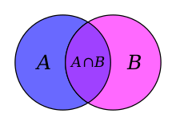
Relational Algebra
Databases create their own query plans
Declarative programming
Very different from procedural programming
You operate on SETs
Mathematical foundation: relational algebra
Tables are SETs, you can operate on them with set operations:
SET UNION
SET DIFFERENCE
CARTESIAN PRODUCT (cross join)
SELECTION
PROJECTION

Slide 19
Database Organization
Tables can be sorted (by primary keys)
There is an underlying tree structure (B-tree) resulting in logarithmic search times
We can also build indexes
Subset of columns (cover) sorted by order of keys
Each index ALWAYS includes the Primary Key
GEOId | fips | State | County | Population | HousingUnits | TotalArea | WaterArea | LandArea | Popdensity | HouseDensity
0100000US | 12 | Florida | NULL | 18801310 | 8989580 | 65757.7 | 12132.94 | 53624.76 | 350.6 | 167.6
0100000US | 13 | Georgia | NULL | 9687653 | 4088801 | 59425.15 | 1911.67 | 57513.49 | 168.4 | 71.1
0100000US | 15 | Hawaii | NULL | 1360301 | 519508 | 10931.72 | 4509.09 | 6422.63 | 211.8 | 80.9
0100000US | 16 | Idaho | NULL | 1567582 | 667796 | 83568.95 | 925.83 | 82643.12 | 19 | 8.1
0100000US | 17 | Illinois | NULL | 12830632 | 5296715 | 57913.55 | 2394.62 | 55518.93 | 231.1 | 95.4
0100000US | 18 | Indiana | NULL | 6483802 | 2795541 | 36419.55 | 593.44 | 35826.11 | 181 | 78
0100000US | 19 | Iowa | NULL | 3046355 | 1336417 | 56272.81 | 415.68 | 55857.13 | 54.5 | 23.9
0100000US | 20 | Kansas | NULL | 2853118 | 1233215 | 82278.36 | 519.64 | 81758.72 | 34.9 | 15.1
0100000US | 21 | Kentucky | NULL | 4339367 | 1927164 | 40407.8 | 921.46 | 39486.34 | 109.9 | 48.8
0100000US | 22 | Louisiana | NULL | 4533372 | 1964981 | 52378.13 | 9174.23 | 43203.9 | 104.9 | 45.5
0100000US | 23 | Maine | NULL | 1328361 | 721830 | 35379.74 | 4536.82 | 30842.92 | 43.1 | 23.4
0100000US | 24 | Maryland | NULL | 5773552 | 2378814 | 12405.93 | 2698.69 | 9707.24 | 594.8 | 245.1

Slide 20
Access Patterns
Table scan
Scan the entire table along the primary key
Range Query
Extract a range of an index key
Bookmark Lookup
Look up individual rows (records)

Slide 22
Creating a Table
CREATE TABLE census (
fips int NOT NULL,
State varchar(128) NOT NULL,
County varchar(50) NULL,
Population int NOT NULL,
LandArea real NOT NULL
)
…
INSERT census values( 2,’Alaska’,,710231,570640.9 )
INSERT census values(11,’DC’,,601723,61.05 )
INSERT census values(24,’Maryland’,,5773552,9707.24 )
INSERT census values(34,’New Jersey’,,8791894,7354.22 )
INSERT census values(36,’New York’,,19378102,47126.4)
INSERT census values(40,’Oklahoma’,,3751351,68594.92 )
…

Slide 23
Querying a Table
select * from census
select state, county, population from census
Projection: choosing which columns are returned
select state, population from census
where state=’Maryland’
Selection: choosing which rows are returned
CREATE TABLE census (
fips int NOT NULL,
State varchar(128) NOT NULL,
County varchar(50) NULL,
Population int NOT NULL,
LandArea real NOT NULL
)

Slide 24
Sorting
select fips, state, population from census
where fips<100
order by population
desc
select fips, state, county, population from census
where fips>100
order by state asc, county desc
CREATE TABLE census (
fips int NOT NULL,
State varchar(128) NOT NULL,
County varchar(50) NULL,
Population int NOT NULL,
LandArea real NOT NULL
)

Slide 25
Refining WHERE
select fips, state, population from census
where fips<100
and state=‘Maryland’
( or state=’California’)
select fips, state, population from census
where fips>=30 and fips<=40
select fips, state, population from census
where fips between 30 and 40
select fips, state, population from census
where county is NULL

Slide 26
Expressions in SELECT
select fips, state,
log(population) logPop,
log(LandArea) logArea
from census
where fips<100
order by fips
select fips, state,
log(population) logPop,
log(LandArea) logArea
from census
where fips>100
order by population
select fips, state, county,
log(population) logP,log(LandArea) logArea
log(population)-log(LandArea) logDens
from census
where fips>100
order by population

Slide 27
Expressions in WHERE
select fips, state, county,
log(population) logP,log(LandArea) logA,
log(population)-log(LandArea) logD
from census
where fips>100
and log(population)-log(LandArea)
-1.0331*log(Population) + 6.7577>1.7
select fips, state, county, logP, logA, logD, logD-trendline delta
from (
select fips, state, county,
log(population) logP,log(LandArea) logA,
log(population)-log(LandArea) logD,
1.0331*log(Population) - 6.7577 trendline
from census
where fips>100
) x
where x.logD -x.trendline>1.7

Slide 28
Next Week
We will continue with SQL, and explain JOINs and also what goes on inside the database engine
In the mean time (by Monday), please go to http://skyserver.org/ and do the SQL tutorial
http://skyserver.sdss.org/dr16/en/help/howto/search/searchhowtohome.aspx

Slide 29
Most Important SQL Commands
SELECT - extracts data from a database
UPDATE - updates data in a database
DELETE - deletes data from a database
INSERT INTO - inserts new data into a database
CREATE DATABASE - creates a new database
ALTER DATABASE - modifies a database
CREATE TABLE - creates a new table
ALTER TABLE - modifies a table
DROP TABLE - deletes a table
CREATE INDEX - creates an index (search key)
DROP INDEX - deletes an index

Slide 30
Database Flavors
Relational Databases (RDBMS)
Object Oriented Databases (OODBMS)
Object-relational Databases (ORDB)
Graph databases
Column stores
Distributed databases
NoSQL databases (key-value stores)
Cloud databases
(Hbase, BigTable)

Slide 31
COVIDNYT database
Database with Covid19 data has been created
Based upon the NYT data in github
Integrated with county data from the US Census Bureau
Also contains policy decisions by the states
You can access it through the SciServer CasJobs
Select the COVIDNYT context
You can type in a SQL query (or cut/paste)
Use first the [Quick] button to execute queries
Later you can save it to your own DB

Slide 32
Text Searches
select distinct state, county
from StatsC
where county like '%Baltimore%'
select distinct state, county
from statsC
where (county like '%York%')
or (county like '%City%')
select distinct state, county
from statsC
where county in ('Jackson','Wayne')
NULL testing
select *
from censusData
where county is NULL

Slide 33
Mathematical Functions
All trigonometric functions (in radians), PI()
Transcendental functions: EXP, LOG, LOG10
Rounding: FLOOR, CEILING, ROUND, SIGN, ABS
Powers: POWER, SQRT, SQUARE
Arithmetic operators: (+, - , * , / , %(mod) )
select fips, log(cases)/log(2.0) logcases
from statsS
where state='New York'
order by dd
select dd, cast(cases as float) cases
from statsC
where county='New York City'
order by dd

Slide 34
String Functions
select replace(county,'York', 'Yourk')
from censusData
where county='New York City'
select charindex('Y',county)
from censusData
where county='New York City'
select state, county, len(county) len
from censusData
where state='Maryland‘
select state, county
from censusData
where state='Maryland'
and county like '%''%'
select state, county, charindex(' ',county,1) c,
substring(county,charindex(' ',county,1),
charindex('''',county,1)-charindex(' ',county,1))
from censusData
where state='Maryland'
and county like '%''%'

Slide 35
Aggregate Functions
select count(*) c
from statsS
where dd=74
and cases>0
select sum(cases) cases
from statsS
where dd=74
select avg(cases) a, avg(deaths) d
from statsS
where dd=74
and cases>0
select avg(cases) a, stdev(cases) s,
min(cases) mn, max(cases) mx
from statsS
where dd=74
and cases>0
select count(distinct state)
from statsC

Slide 36
GROUP BY
We can create groups by certain attributes and calculate aggregate functions
select state, count(*) c
from statsS
where cases>0
group by state
order by c desc
select state, sum(cases) s
from statsC
where dd=74 and cases>10
group by state
having sum(cases)>1000
order by s desc
What is the first day with more than 10 cases in a county?
select top 100 min(fips) fips, state, county, min(dd) d10
from statsC
where cases>10
group by state, county
order by d10

Slide 37
Subqueries
select top 10 *, (logPop-logArea) logDensity
from (
select fips, state, log(LandArea)/log(2.0) logArea,
log(population)/log(2.0) logPop
from censusData
) x
order by logPop
select sum(cases) c, sum(deaths) d
from statsS
where fips in (
select top 10 fips from censusData
where county is NULL
order by population desc
)
select sum(cases) c, sum(deaths) d
from statsS
where fips in (
select top 10 fips from censusData
where county is NULL
order by population asc
)

Slide 38
UNION
select 'States' n, sum(cases) c, sum(deaths) d
from statsS
union all
select 'Counties' n, sum(cases) c, sum(deaths) d
from statsC
select * from (
select top 10 'hi' cat, fips from censusData
where county is NULL
order by population desc
) x
UNION ALL
select * from (
select top 10 'lo' cat, fips from censusData
where county is NULL
order by population asc
) y

Slide 39
JOINS
select s.code, c.population
from censusData c, States s
where c.fips = s.fips
order by code
select s.code, c.population
from censusData c JOIN States s
on c.fips = s.fips
order by code
select s.fips,
min(d.state) state,
min(d.county) county,
max(cases) c,
avg(d.popDensity) pd
from statsC s, censusData d
where s.fips=d.fips
and d.popDensity>3000
group by s.fips
order by c desc

Slide 40
SciServer CasJobs
Upon login go to CasJobs instead of Compute
Select the COVIDNYT context
Type in a simple query
Press the [Quick] button on the upper right hand
You will see the result on the bottom
Below the data select [csv] as your format
Press [Save As], and you will see the csv file appear
With HTML you get the data into the browser window
select * from censusData where fips<100

Slide 41
Query Execution
select * from states
where state='Maryland'
select count(*) from censusData
You can execute the selected part of the query panel
select * from states
where state='Maryland'
select count(*) from censusData
You can also execute a whole script in one go
select log(population) logP, log(popDensity) logD
into pops
from COVIDNYT.censusData
where fips<100
and population>0
and popDensity>0
You can also work from the MyDB context

Slide 42
Using the SciServer.MyDB
You have your own database (MyDB)
You can direct the query output into a new table there
select state, count(*) c
from statsS
where cases>0
group by state
order by c desc
select state, count(*) c
into MyDB.scounts
from statsS
where cases>0
group by state
order by c desc
Click on MyDB, you will see it there
You can download it, or use it in another query
select top 10 *
from MyDB.scounts
order by c desc

Slide 43
Status and History
In myDB you can look at the status of a query
The whole history is stored in the DB, no need to take notes
You can go back to failed queries and fix them by clicking on the JobID

Slide 44
Modifying the Database
You can change everything in a DB in SQL (remember Ted Codd’s 12 rules!)
You can update a value, delete and insert rows
Add indexes, drop indexes
Create new tables, delete tables
Add columns, delete columns

Slide 45
You Can Alter Your DB
You can drop (delete) a table in your database
This requires your context to be set to MyDB
You can update values in a row
drop table scounts
select * from scounts
where state='Maryland'
update scounts
set c=32
where state='Maryland'
31
select * from scounts
where state='Maryland'
update scounts
set c=32
where state='Maryland‘
select * from scounts
where state='Maryland'
update scounts
set c=32
where state='Maryland'
32

Slide 46
Most Important DDL Commands
UPDATE - updates data in a database
DELETE - deletes data from a database
INSERT INTO - inserts new data into a database
CREATE DATABASE - creates a new database
ALTER DATABASE - modifies a database
CREATE TABLE - creates a new table
ALTER TABLE - modifies a table
DROP TABLE - deletes a table
CREATE INDEX - creates an index (search key)
DROP INDEX - deletes an index
TRUNCATE TABLE – removes the rows from a table

Slide 47
Database Flavors
Relational Databases (RDBMS)
Object Oriented Databases (OODBMS)
Object-relational Databases (ORDB)
Graph databases
Column stores
Distributed databases
NoSQL databases (key-value stores)
Cloud databases
(Hbase, BigTable)

