Slide 1
Class 04
Probability Distributions
Alex Szalay, JHU

Slide 2
Probability Distributions
Give the probabilities of different outcomes for an experiment
Sample space: the set of all possible outcomes
Probability mass function
  Discrete (coin toss, dice, count statistics)
  Continuous (weight, height, sensors)
Properties of a probability distribution
  Non-negative
  Sum over all outcomes is 1
Probabilites over disjoint sets add up

Slide 3
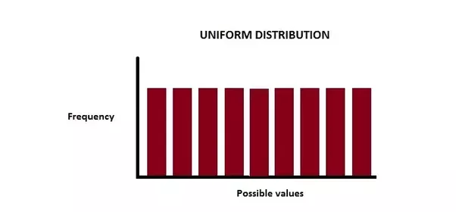
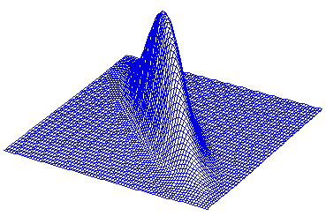
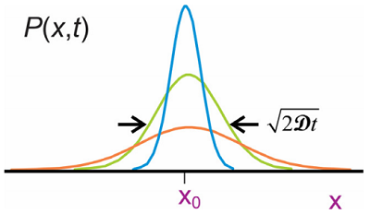
Probabilities
Different dimensions (# of random variates)
  One-dimensional - univariate
  Two-dimensional – bi-variate
  Many-dimensional – multivariate

Slide 4
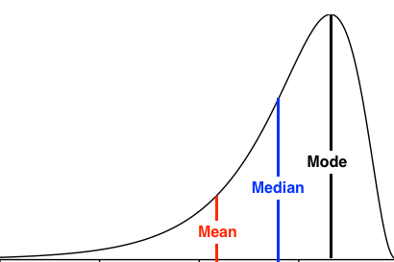
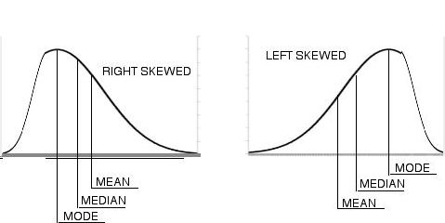
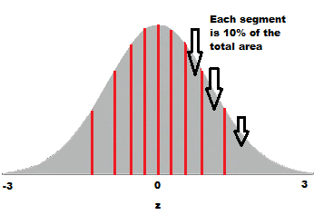
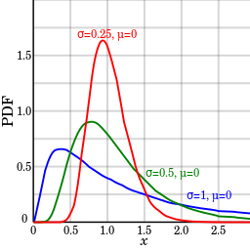
Properties of a PDF
Mode
Median
Mean
Variance
Standard Deviation
Quantile
Skewness
Kurtosis
Tail
Support

Slide 5
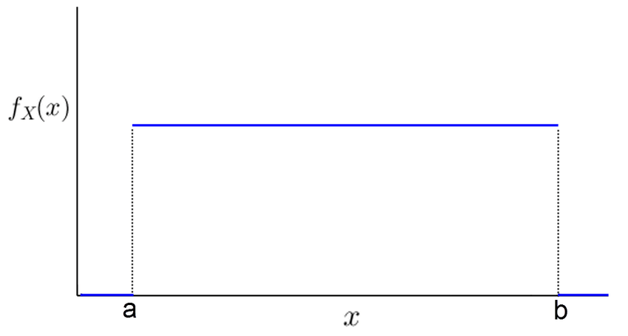


Uniform Distribution
The probability of any value
between a and b is the same
Total probability is 1
What is the height of the blue
line on the figure?
p(x) is the probability density
Independent variables
$$\int_{−∞}^{∞}{dx p\left(x\right)=1}$$
$$p\left(x_{1},x_{2}\right)=p\left(x_{1}\right)p\left(x_{2}\right)$$

Slide 6
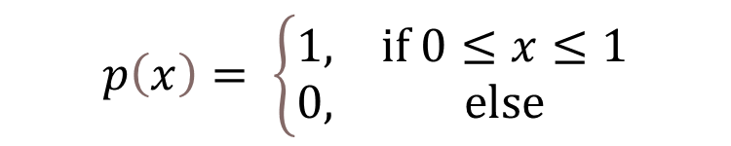
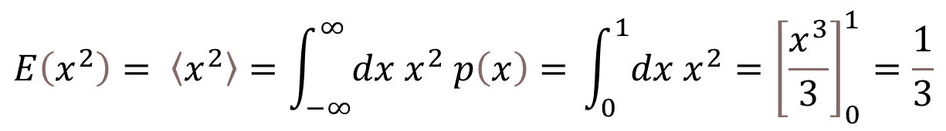
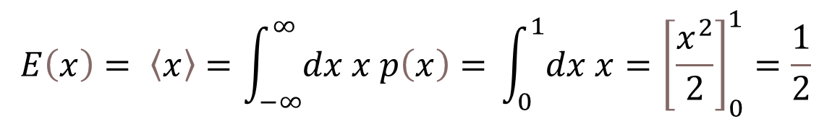
Simplest Example
Uniform random over [0,1]
Expectation value
$$p\left(x\right)= \left\{\begin{matrix}1, & if 0≤x≤1 \\ 0, & else\end{matrix}\right.$$
$$E\left(x\right)= 〈x〉=\int_{−∞}^{∞}{dx x p\left(x\right)=} \int_{0}^{1}{dx x}={\left[\frac{x^{2}}{2}\right]}_{0}^{1}=\frac{1}{2}$$
$$E\left(x^{2}\right)= 〈x^{2}〉=\int_{−∞}^{∞}{dx x^{2} p\left(x\right)=} \int_{0}^{1}{dx x^{2}}={\left[\frac{x^{3}}{3}\right]}_{0}^{1}=\frac{1}{3}$$

Slide 7


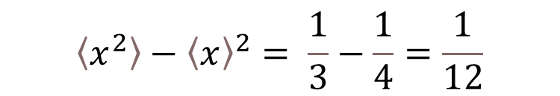
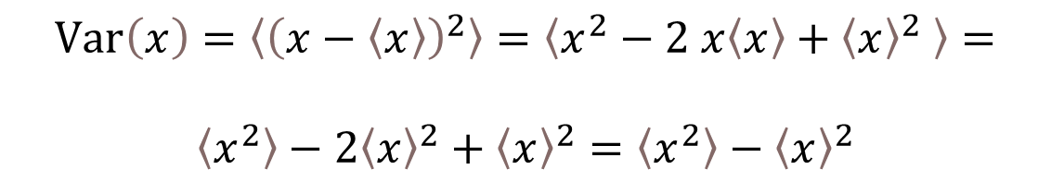
Identities
$$〈c x〉=c〈x〉$$
For the Uniform distribution
$$〈x−a〉=〈x〉−〈a〉=〈x〉−a$$
$$〈x−〈x〉〉=〈x〉−〈〈x〉〉=〈x〉−〈x〉=0$$
$$Var\left(x\right)=〈{\left(x−〈x〉\right)}^{2}〉=〈x^{2}−2 x〈x〉+{〈x〉}^{2} 〉=$$
$$〈x^{2}〉−2{〈x〉}^{2}+{〈x〉}^{2}=〈x^{2}〉−{〈x〉}^{2}$$
$$〈x^{2}〉−{〈x〉}^{2}= \frac{1}{3}−\frac{1}{4}=\frac{1}{12}$$

Slide 8
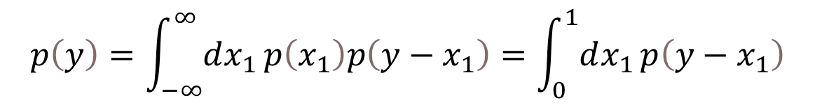

Sum of Two Randoms
Given two independent uniform randoms x₁, x₂,
what is the distribution of their sum y=x₁+x₂?
They are independent
$$p\left(x_{1},x_{2}\right)=p\left(x_{1}\right)p\left(x_{2}\right)$$
Let us try and guess the result…
Formally: we can switch to x₁ and y-x₁= x₂
$$p\left(y\right)=\int_{−∞}^{∞}{dx_{1}}p\left(x_{1}\right)p\left(y−x_{1}\right)=\int_{0}^{1}{dx_{1}}p\left(y−x_{1}\right)$$

Slide 9
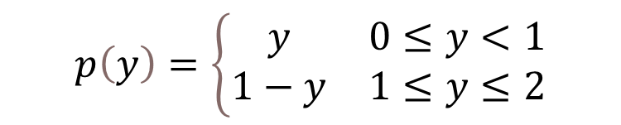
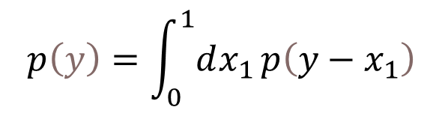
Evaluating the Integral
$$p\left(y\right)=\int_{0}^{1}{dx_{1}}p\left(y−x_{1}\right)$$
x₂
What is the height? Use the area of the triangle…
1
y=2
1
x₁
0
1
y=1/2
y=1
y=0
0
1
2
$$p\left(y\right)=\left\{\begin{matrix}y & 0≤y<1 \\ 1−y & 1≤y≤2\end{matrix}\right.$$

Slide 10



What is the mean and the variance?
We could do this by integration (takes too long)
Guess the mean!
More formally:
$〈y〉=〈x_{1}+x_{2}〉=〈x_{1}〉+〈x_{2}〉=2∗\frac{1}{2}=1$
0
1
2
Now the second moment:
$〈y^{2}〉=〈{\left(x_{1}+x_{2}\right)}^{2}〉=〈x_{1}^{2}〉+〈x_{2}^{2}〉+2〈x_{1}x_{2}〉$
What is $〈x_{1}x_{2}〉$ ?
$$〈x_{1}x_{2}〉=〈x_{1}〉〈x_{2}〉={〈x〉}^{2}$$
Now the variance:
$$Var\left(y\right)=〈y^{2}〉−{〈y〉}^{2}=2〈x^{2}〉+2{〈x〉}^{2}−4{〈x〉}^{2}=2 Var\left(x\right)$$

Slide 11



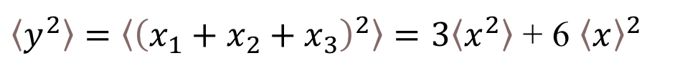
How about three randoms?
$$y=x_{1}+x_{2}+x_{3}$$
$$〈y〉=〈x_{1}+x_{2}+x_{3}〉=3〈x〉$$
$〈y^{2}〉=〈{\left(x_{1}+x_{2}+x_{3}\right)}^{2}〉=3〈x^{2}〉$ + 6 ${〈x〉}^{2}$
$$Var\left(y\right)=〈y^{2}〉−{〈y〉}^{2}=3〈x^{2}〉−3{〈x〉}^{2}=3 Var\left(x\right)$$
How about N randoms?
$$Var\left(y_{N}\right)=N Var\left(x\right)$$

Slide 12


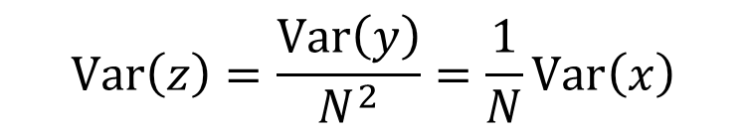

Estimating the mean
We do N repeated experiments from p(x) and estimate the mean
$$z=\frac{1}{N}\sum_{n=1}^{N}{x_{n}}$$
$$z=\frac{1}{N}\sum_{n=1}^{N}{x_{n}= \frac{1}{N}}y$$
$$Var\left(y\right)=N Var\left(x\right)$$
$$Var\left(z\right)=\frac{Var\left(y\right)}{N^{2}}=\frac{1}{N}Var\left(x\right)$$

Slide 13
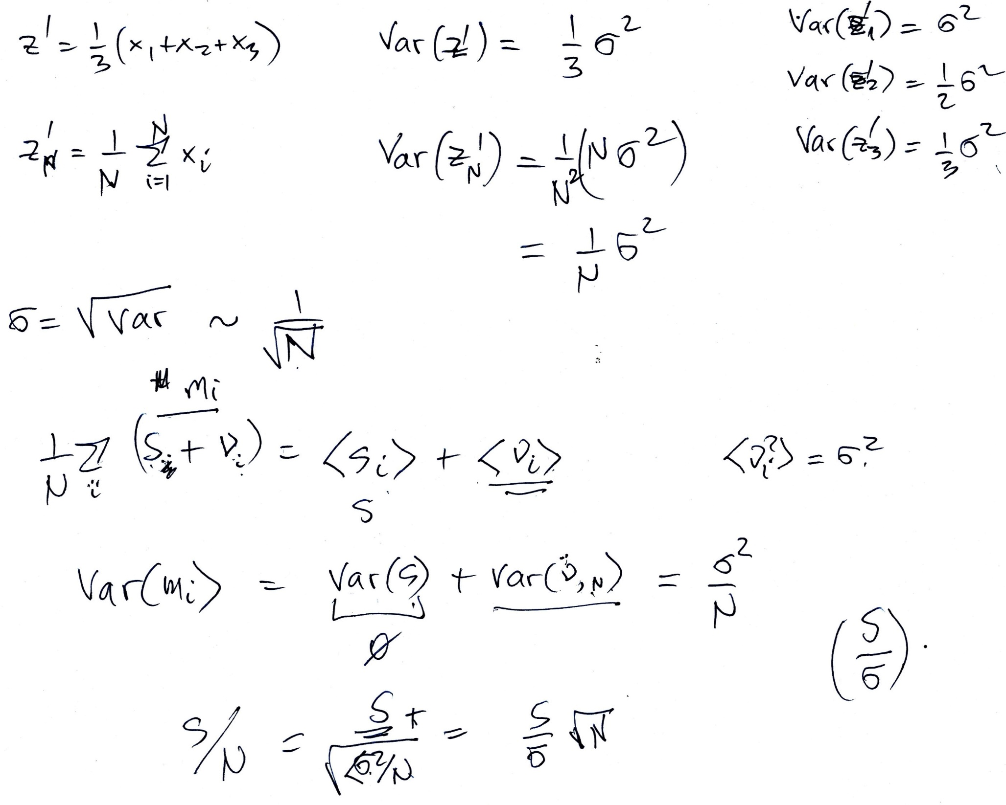

Slide 14
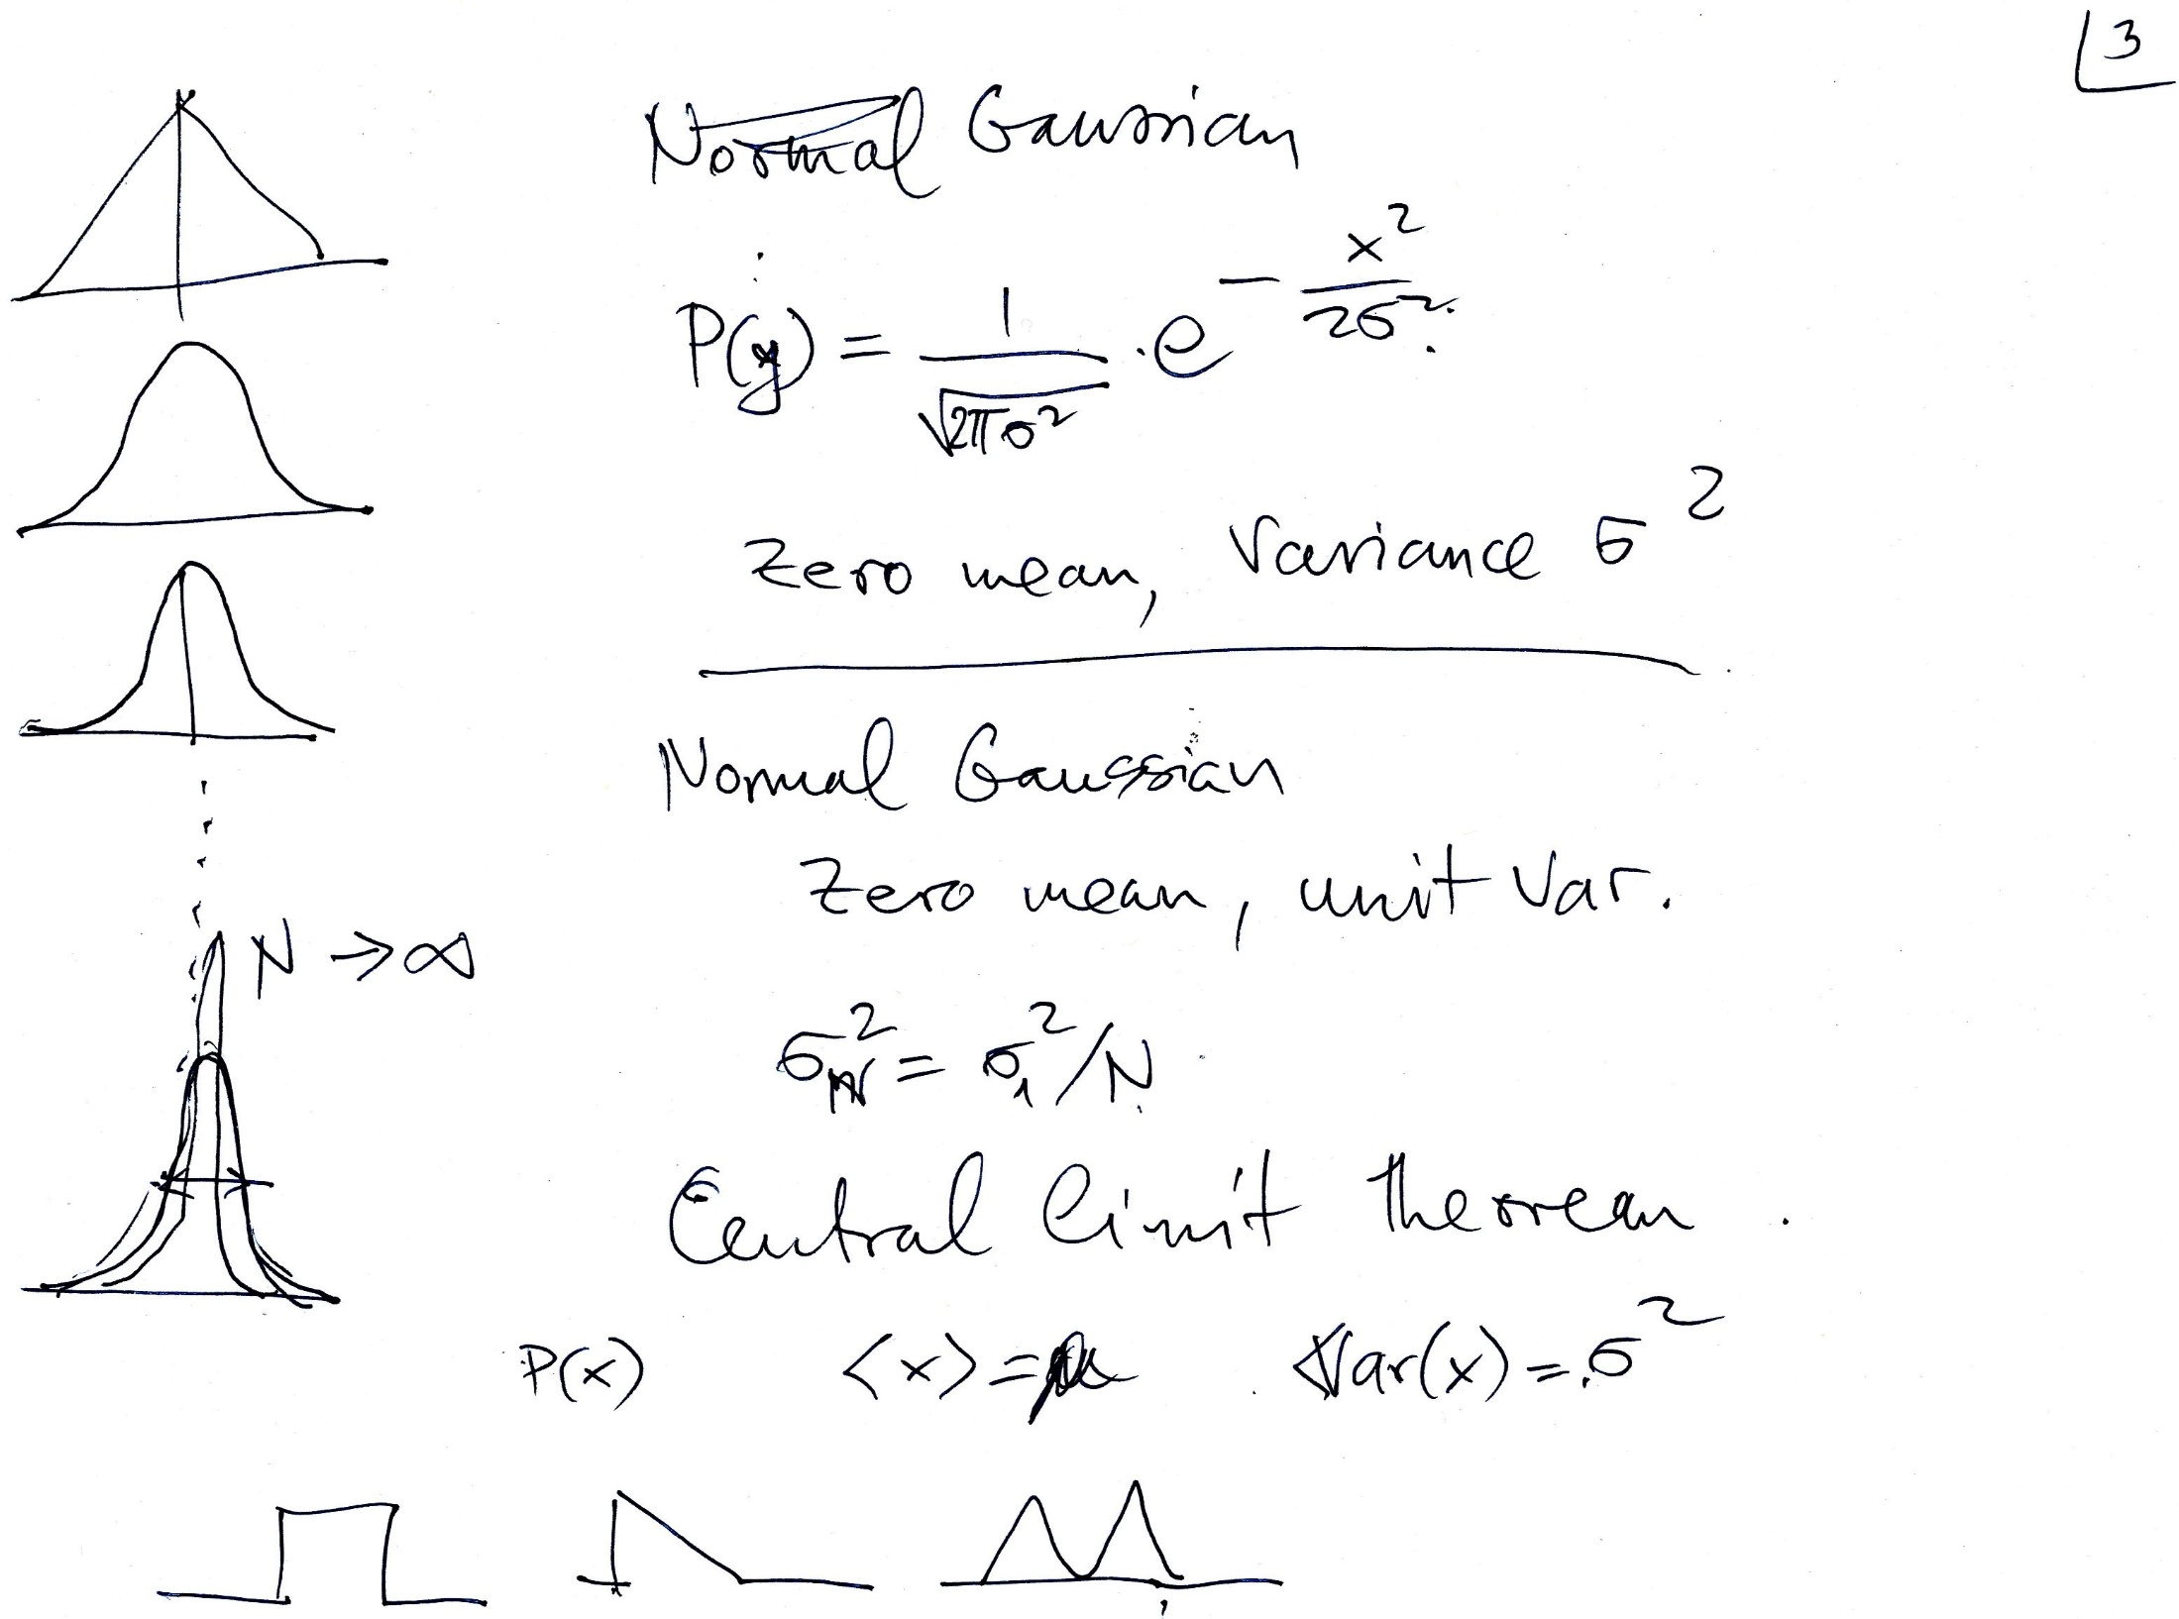

Slide 15
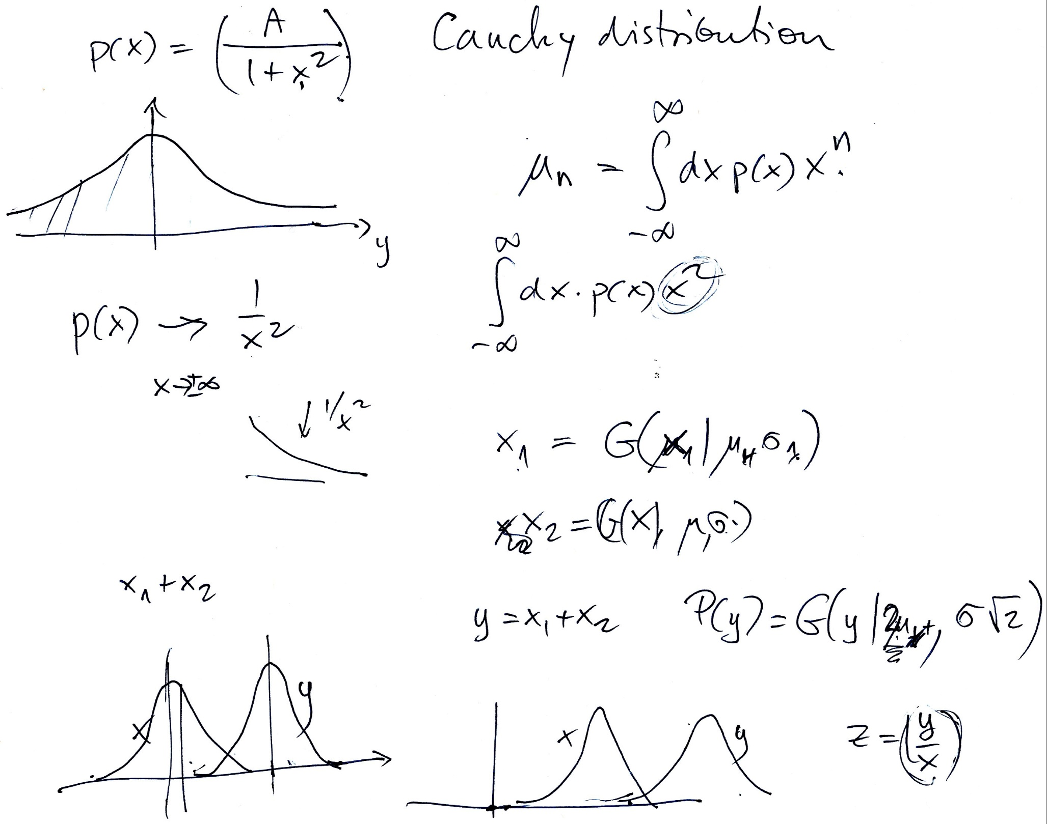

Slide 16
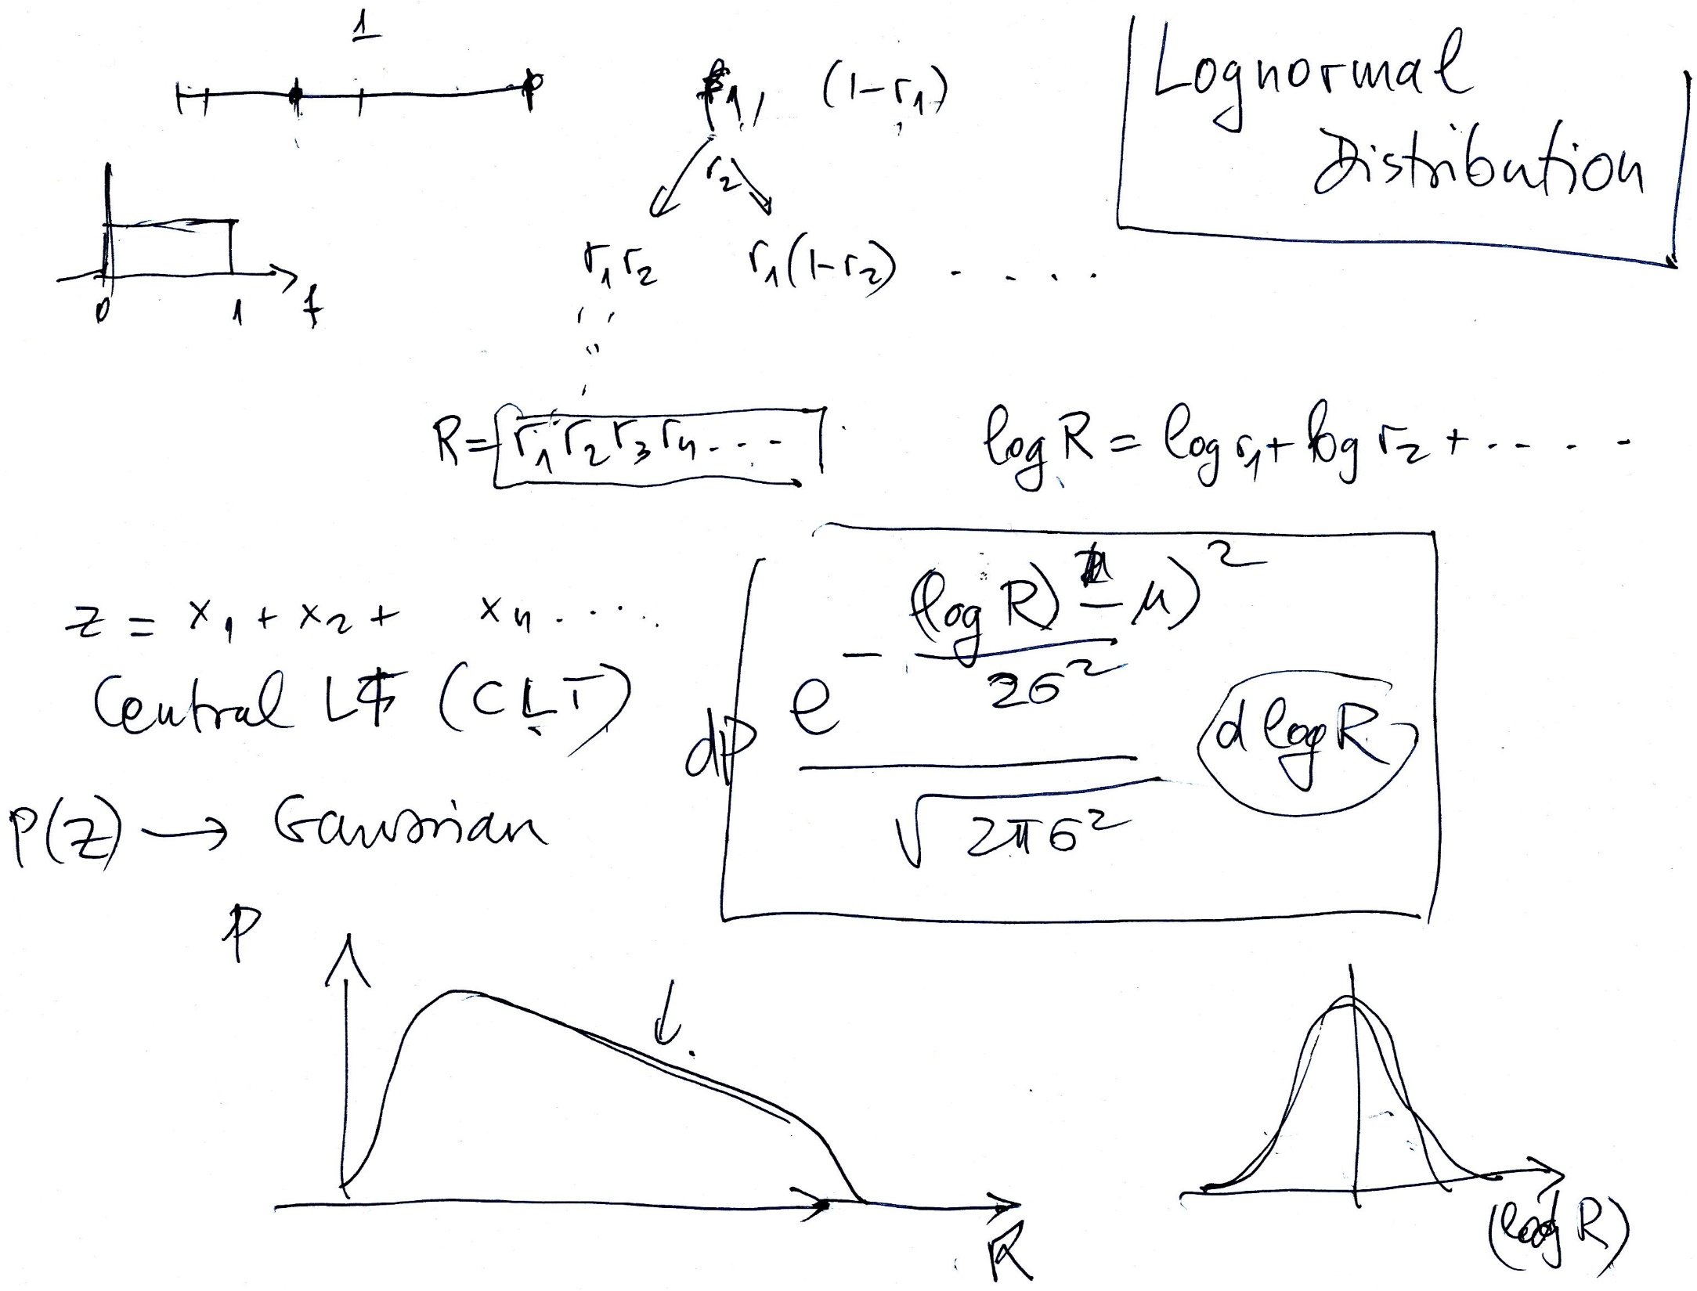

Slide 17
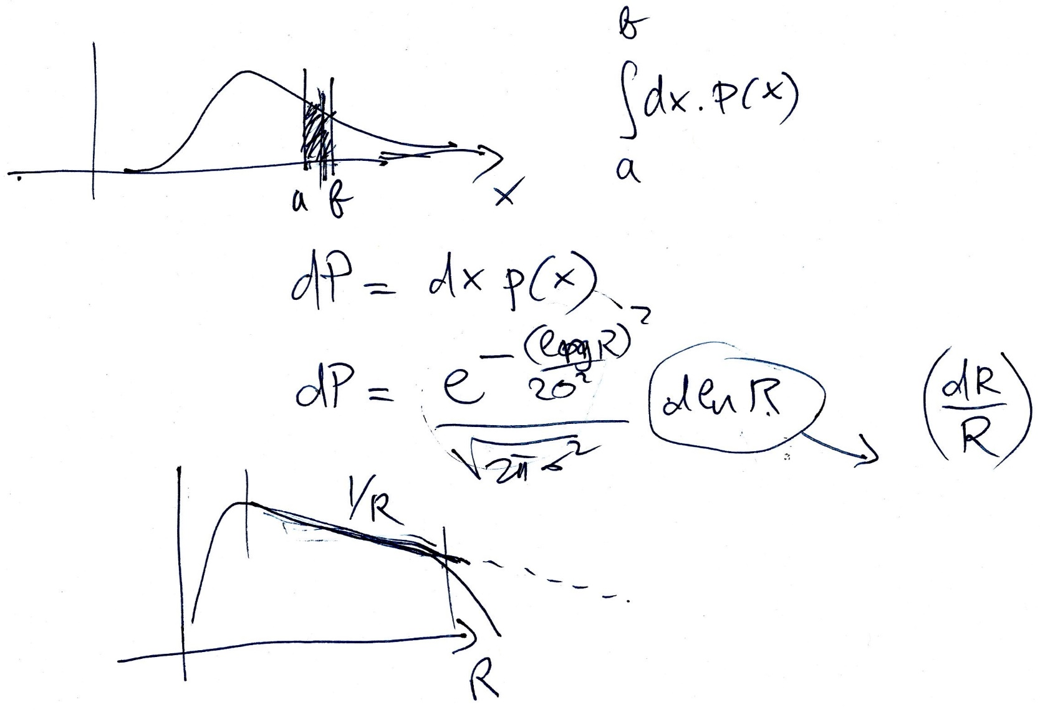

Slide 18
