Slide 1
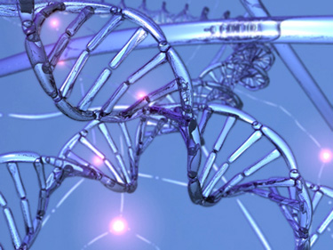


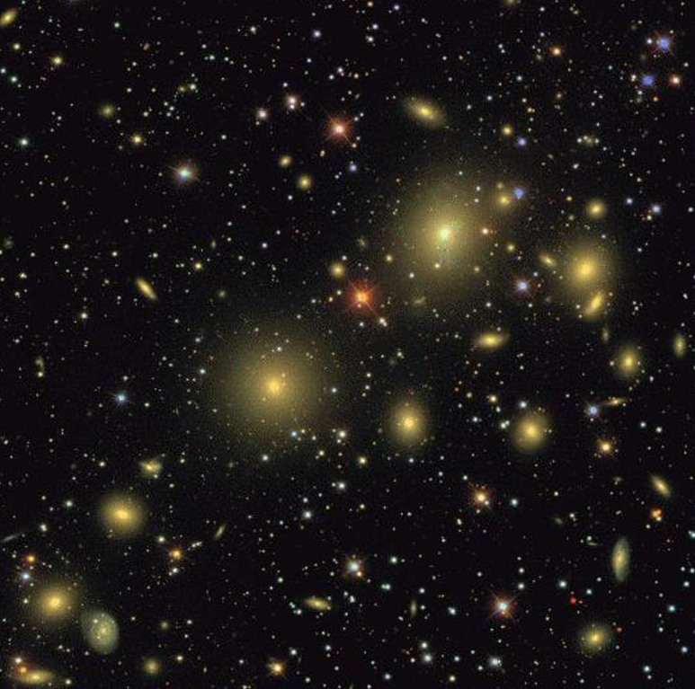
Beautiful Data – Introduction I.
Alex Szalay

Slide 2
Big Data in Science
Data growing exponentially, in all science
All science is becoming data-driven
This is happening very rapidly
Data becoming increasingly open/public
Non-incremental!
Convergence of physical and life sciences
through Big Data (statistics and computing)
The “long tail” is important
A scientific revolution in how discovery takes place
=> a rare and unique opportunity

Slide 3
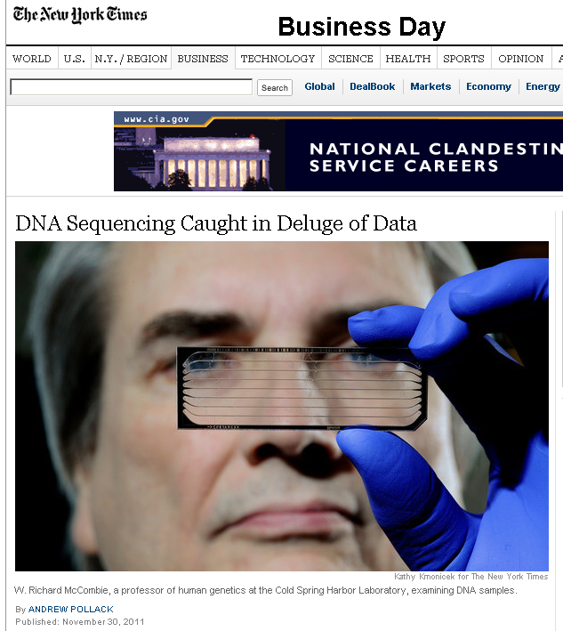

Slide 4

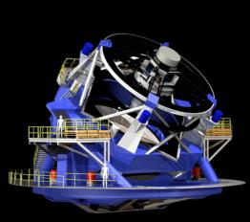
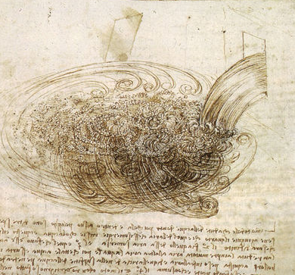
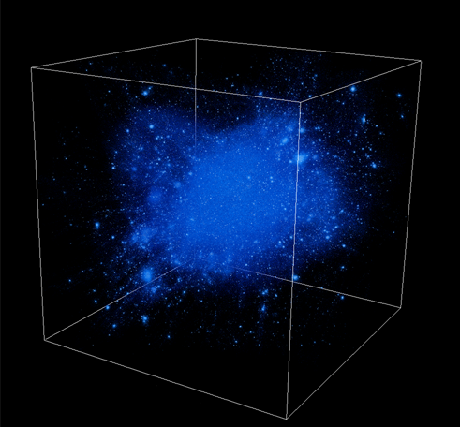
Science is Changing
THOUSAND YEARS AGO
science was empirical
describing natural phenomena
LAST FEW HUNDRED YEARS
theoretical branch using models, generalizations
LAST FEW DECADES
a computational branch simulating
complex phenomena
TODAY
data intensive science, synthesizing theory,
experiment and computation with statistics
►new way of thinking required!

Slide 5
Scientific Data Analysis Today
Data is everywhere, never will be at a single location
Data grows as fast as our computing power
  Need randomized, incremental algorithms
  Best result in 1 min, 1 hour, 1 day, 1 week
Statistical vs systematic errors
Both “exploratory” and “confirmatory” searches needed
Architectures increasingly CPU-heavy, IO-poor
Most scientific data analysis done on small to midsize BeoWulf clusters, from faculty startup, in broom closets
Universities hitting the “power wall”
Not scalable, not maintainable…

Slide 6
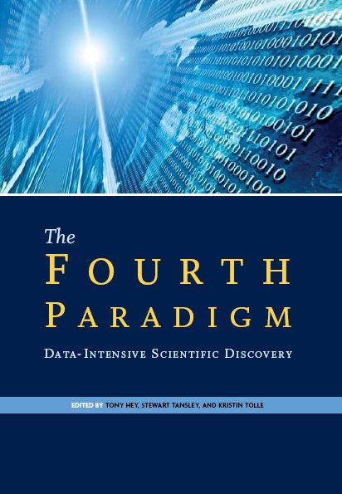
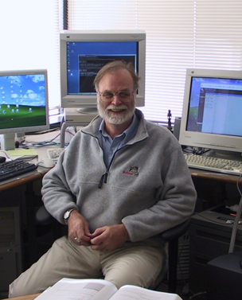
Gray’s Laws of Data Engineering
Jim Gray:
Scientific computing is revolving around data
Need scale-out solution for analysis
Take the analysis to the data!
Start with “20 queries”
Go from “working to working”

